Slide 1
Agile Networks High Density Wireless using Aruba Instant for Dublin Pope Visit 2018
Andrew Byrne, Senior Presales Manager

Slide 2
Scope of Requirements
Services Required :
Wired and Wireless Secure Internet Services
For Media in Attendance at Pope’s visit to Dublin August 2018
In Scope for Agile Networks : Wired, Wireless, Firewalls, DHCP, DNS, Support
Out of Scope for Agile Networks : ISP, Cabling, Mounting
Site A : Phoenix Park
Potential of 1,000+ users.
No Current Infrastructure, Temporary Structure
400 no. journalists seated 4 per desk. | 400
600 no. dining (60 tables 10 per table) | 600
28 booths | 28
Total Users on site | 1028
No. of Devices to users | Total Device
3 | 3084
Ratio of Clients to Access Points
50
Estimated Number of Access Points required | 61.68
Size of Room | 67Mt | Length
 | 40Mt | Width
 | 2680 | Area
Access Point every | 7 | Mtrs
Maths say we need 62 Access Points ; One every 7 Mtrs
Experience says we need less than that !
Suggest 16 High Density Access Points ; IAP-315

Slide 3
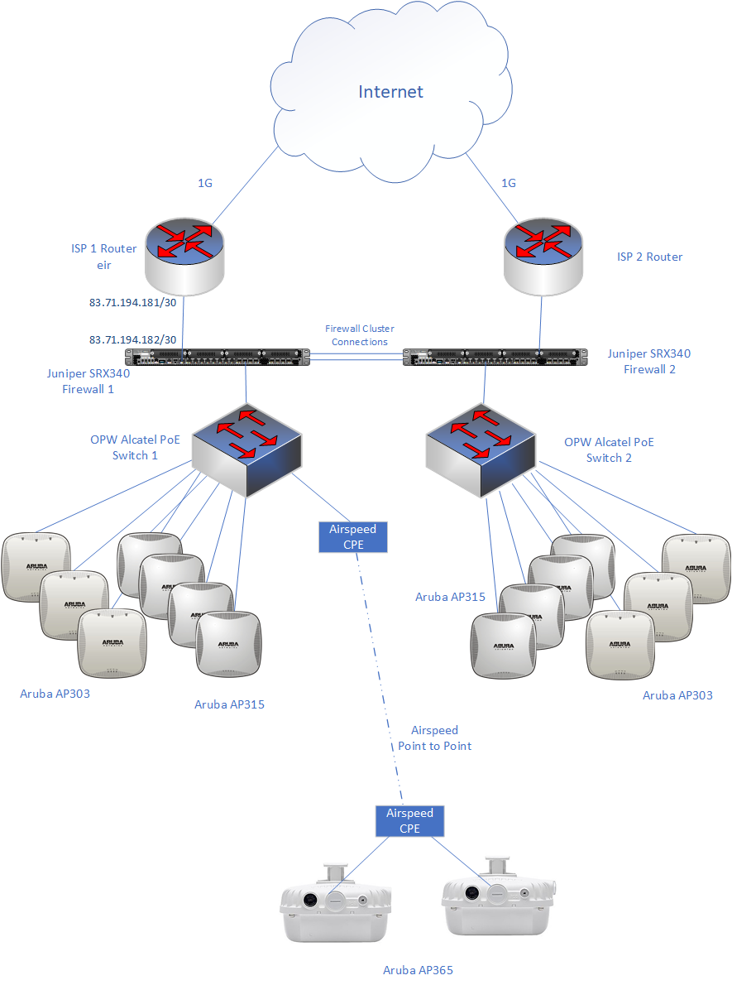
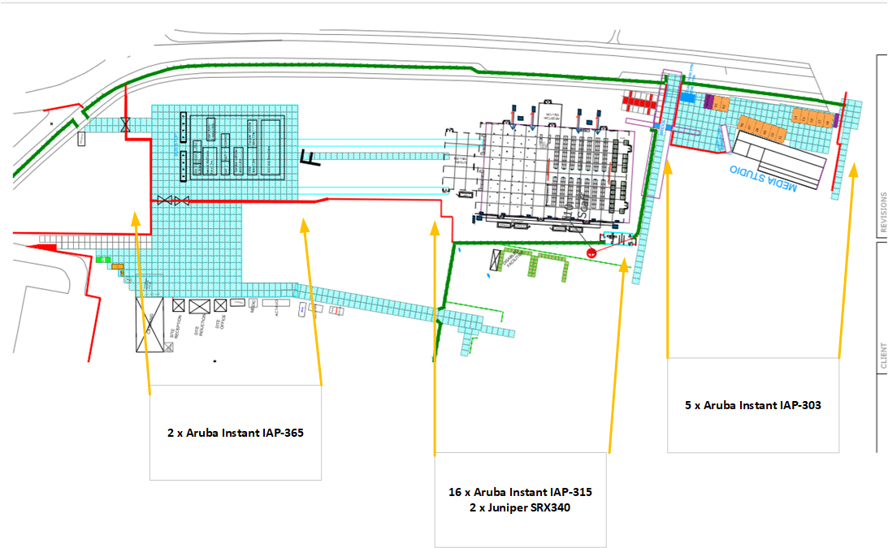
Phoenix Park
Aruba Instant Wireless chosen to allow for easy and quick setup
Aruba IAP-315, AP-303 and AP-365
Juniper SRX340 x 2 with UTM ; Also providing DHCP, DNS
Alcatel PoE switches provided by AN Other

Slide 4
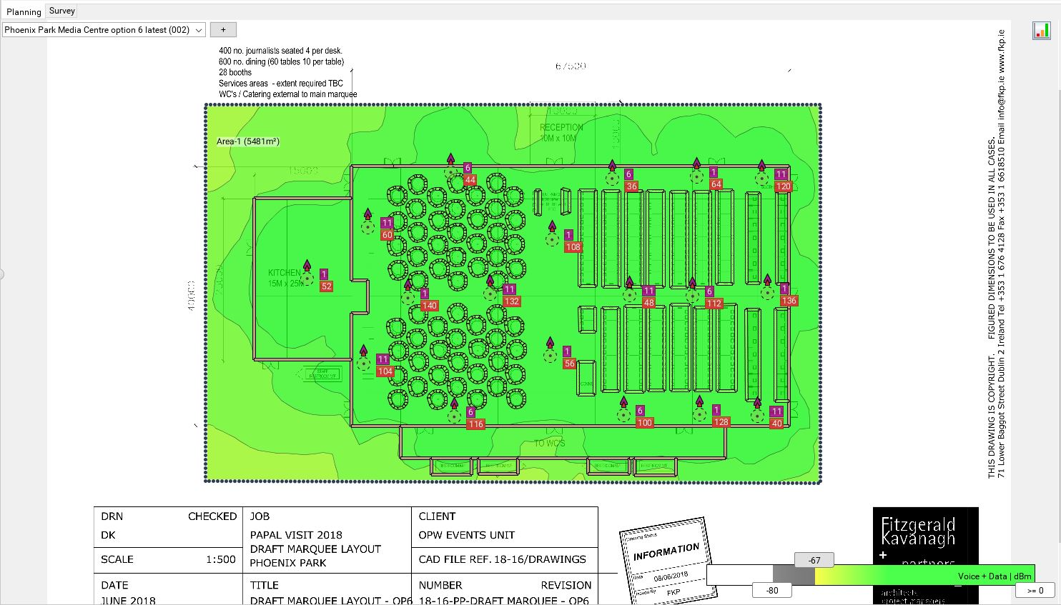
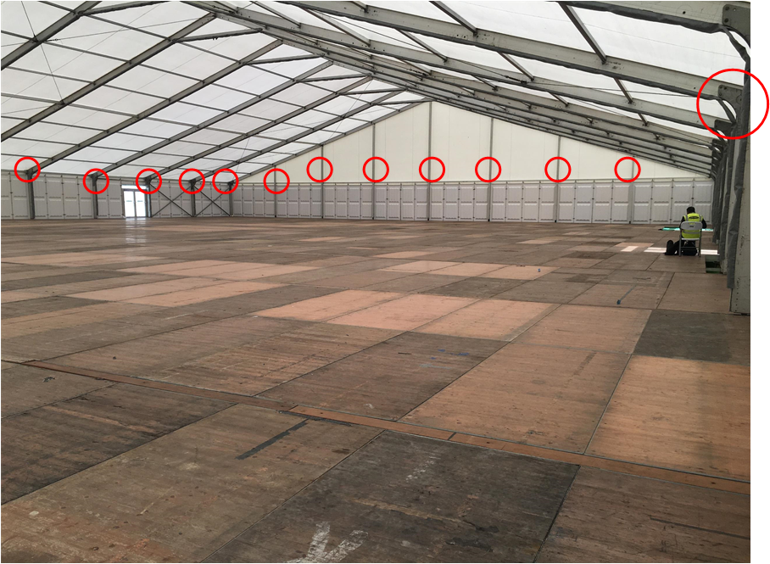
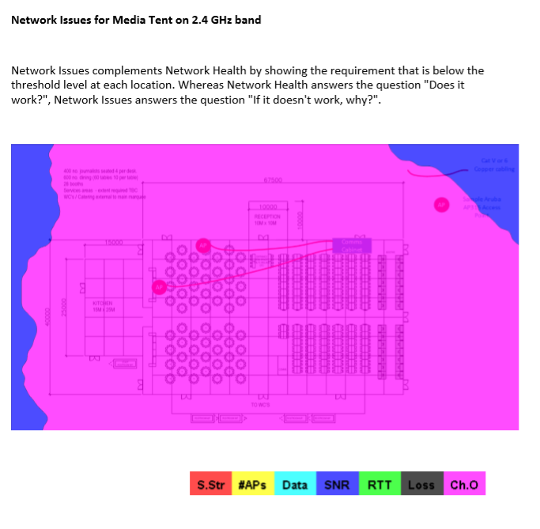
Media Tent – Phoenix Park
16 x AP-315 Specified
~ Every 10Mtrs !
Mounting Options
Ekahau Survey Fails !
Don’t worry !

Slide 5
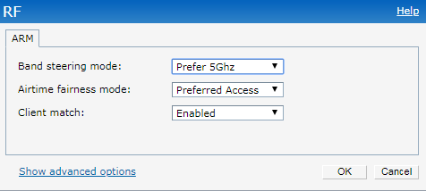
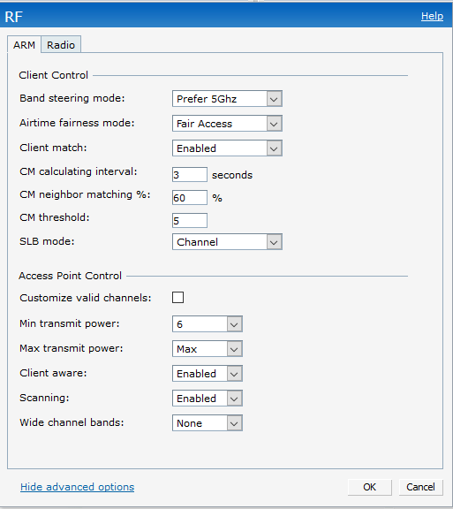
Aruba Instant Setup
Default Settings apart from:
WPA/PSK based access only
No captive portal
DHCP and DNS offloaded to Firewall ; Juniper SRX340
2 VLANs ; Management and Clients
Clients : 192.168.0.0/16
Management : 172.168.100.0/24
Lowered max power for 2.4Ghz spectrum to 6
Wide Channel Bands - None

Slide 6
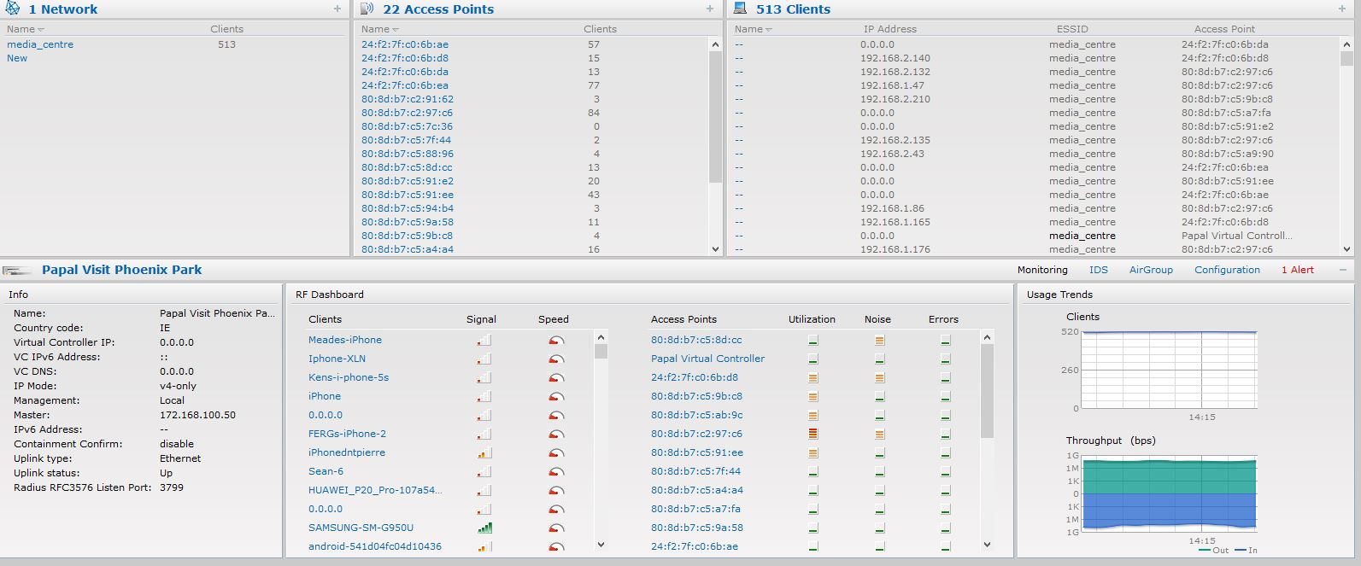
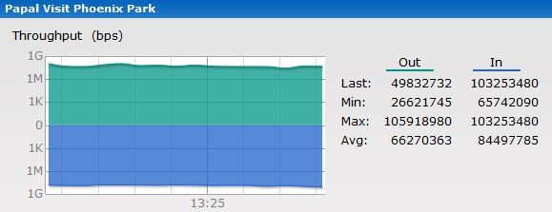
Aruba Instant working Stats
Phoenix Park
Number of Indoor Access Points : 20
Number of Outdoor Access Points : 2
Maximum Number of Clients : 520
Max number of clients on Access Point : 88 (AP-365)
Average Throughput of wireless in site : ~70Mbps
Firewall requests : ~1,020,120 sessions
Firewall blocks : ~15,211 sessions
ARM in Action

Slide 7
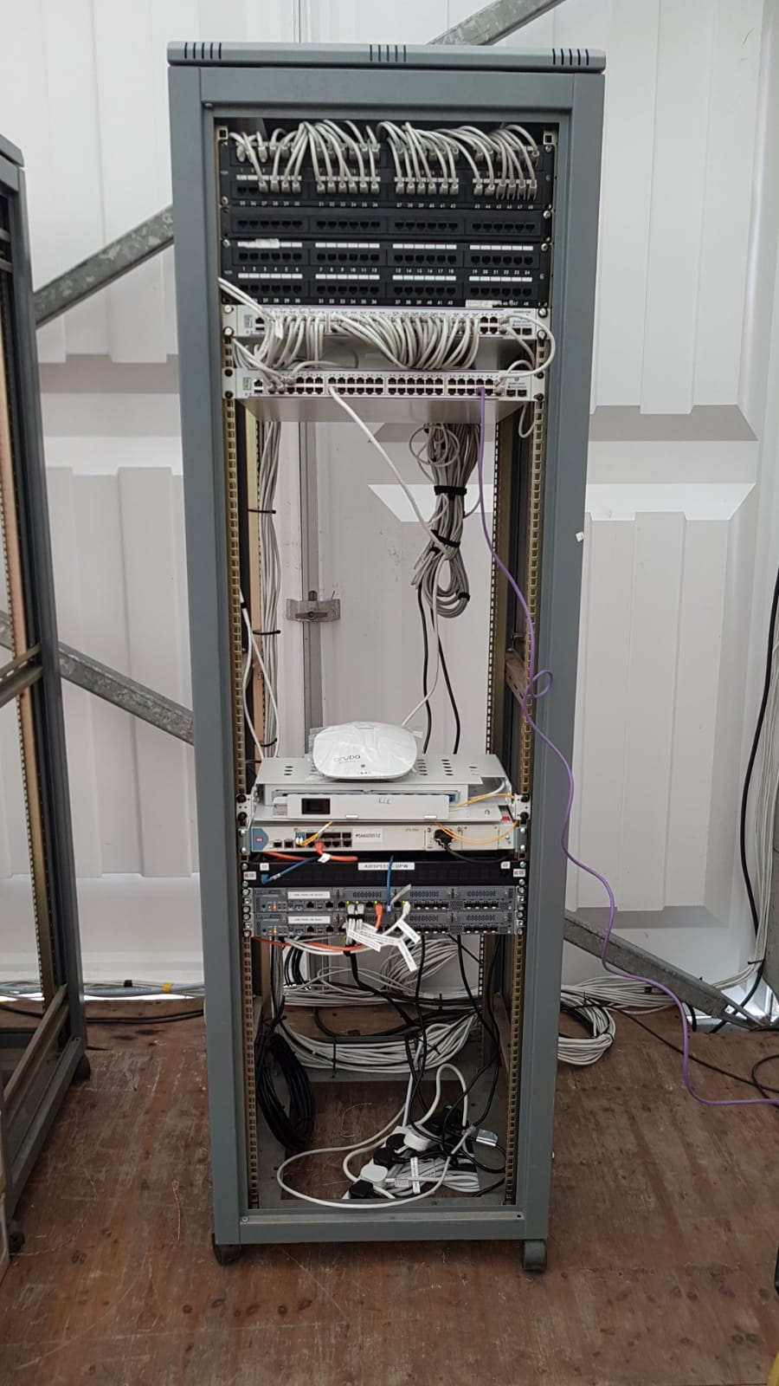
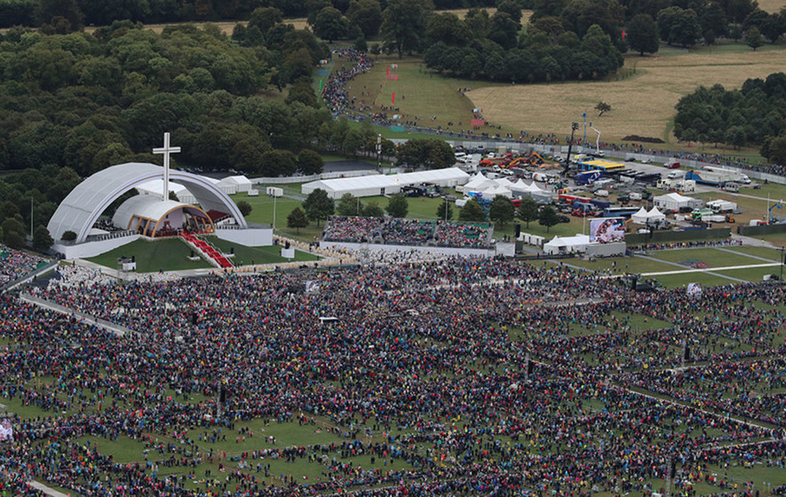
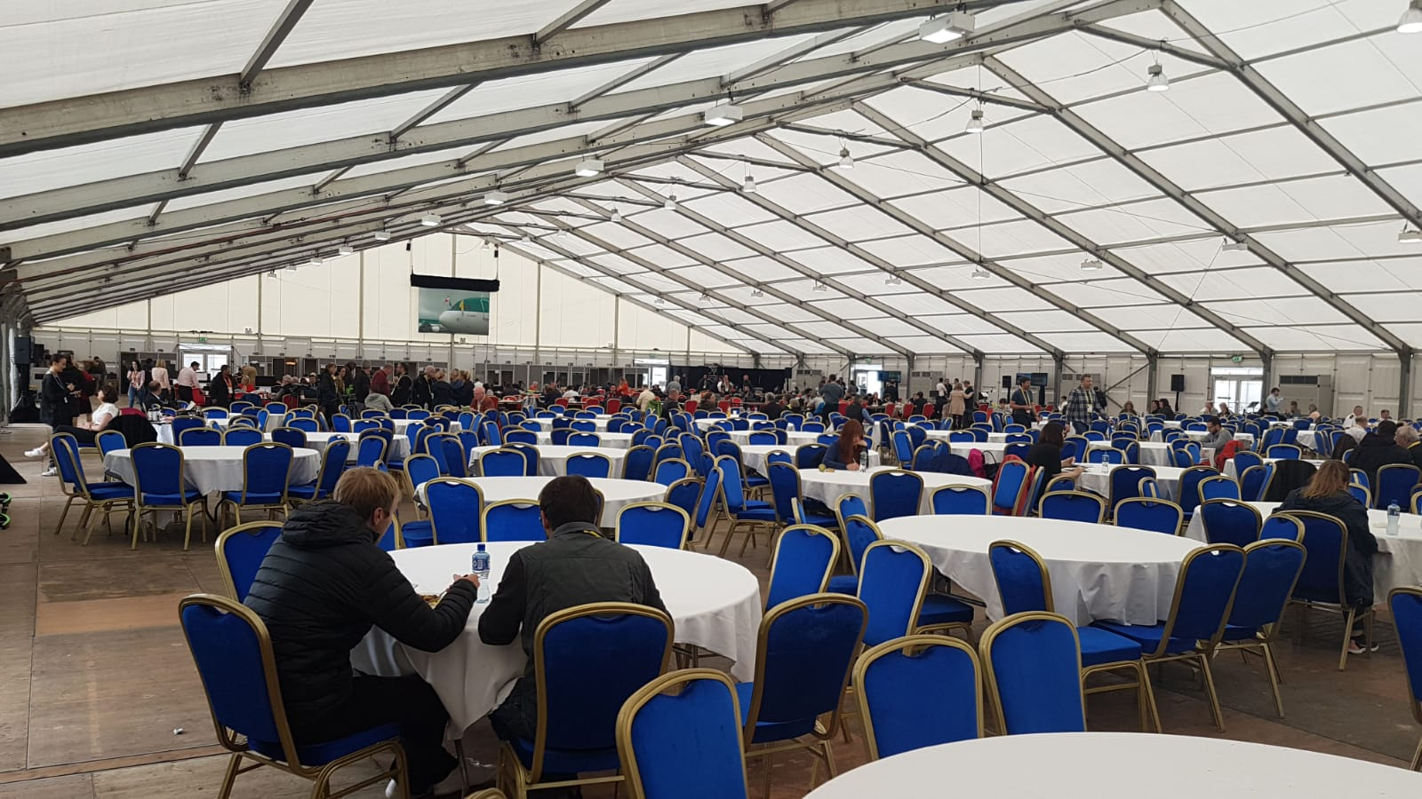
Pictures from Phoenix Park

