Slide 1
HPE Intelligent Edge
Maximizing the IOT Value
Mohammed Hafiz Darvesh
Worldwide Solution Architect, IoT
HPE Communications and Media Solutions

Slide 2
Agenda
Edgeline Overview
Use cases
Operationalize Video Surveillance Use case
Edgeline and Universal IoT in action
Performance Data

Slide 3
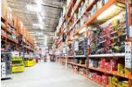
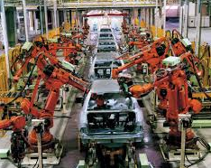
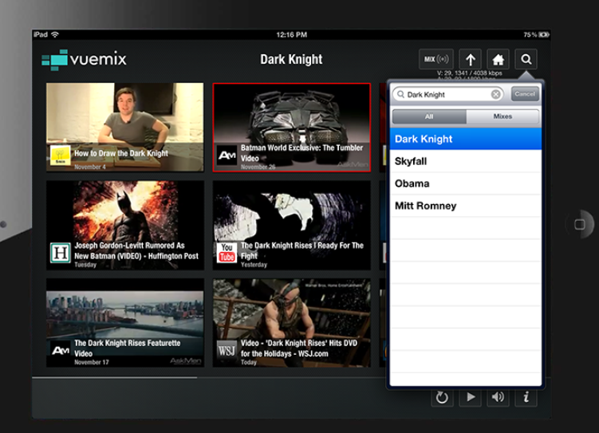
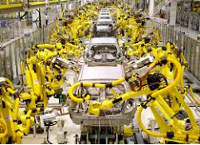
Today’s Ask ………. I want Video, always connected and I want response FAST
2,617 x avg. smart phone
touches / day
What customers offer today …..
Centralized Management from Cloud (Slow Response)
Autonomous offline edge operations (no universal connections)
Overall Poor User Experience

Slide 4
… as in Real Estate, the solution lies simply with 3 things:
Location, Location, Location
A fundamental shift in computing at the Edge is necessary for better user experience
#1
#2
#5
Bandwidth & Cost
Network bandwidth to remote locations is often limited, unreliable and expensive. Sending it synchronously adds to the cost.
Latency
The laws of physics apply. Moving data to central cloud increases “time-to-insight” and “time-to-action”.
Agility
Pushing the value-add light but powerful decision making to the edge provides flexibility and agility to the edge
#3
#4
Security
Transferring data by definition exposes data to security threats.
Compliance
More country’s are imposing data sovereignty laws that prevent data from leaving their country.

Slide 5
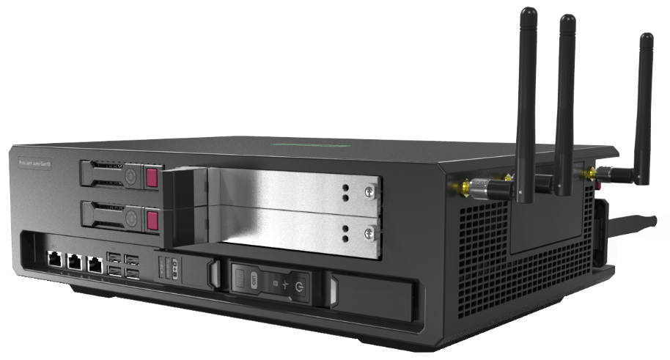
Introducing HPE Strategy : Edge to Core
Intelligent Edge = Aruba + Edgeline
T
Process video at the edge (do not backhaul to cloud)
Perform analytics at the edge
Secure data at the edge
Cars
Lights
Planes
Machines
Pumps
Trackers
Phones
Badges
Aruba AP
Wheelchairs
Carts
Merchandize
Cameras
Aruba beacons
Aruba trackers
Buses
Kiosks
….
….
T
T
T
Today
Autonomous
Connected to cloud
T
T
T
T
T
T
Edgelines
GL10, GL20
EL1000
EL4000
T
Cloud
T
Hybrid IT
Apollo
DL360, 380
Moonshot
T
T
T
T
T

Slide 6
Introducing the Edgeline : Helping the Top Line & the Bottom Line Growth
Use case enablement functions consolidated to Reduce Costs (Converged Edge)
An end Use Case that is Monetizable (Smart Edge)
Connected Vehicles
Smart Cities
Manufacturing
Retail, Gaming and Hospitality
Healthcare
Public Utilities and Agriculture
…..
Edgeline
IOT
(Act)
Network
(Connect)
Security
(Secure)
Media
(Analyze)
Edge
Edge
Connectivity at the Edge
Public or Private LTE, 5G
CPE, SDWAN
Encryption, authentication, public key cryptography
Video recording, analytics and playback
Video transcoding, packaging and distribution

Slide 7
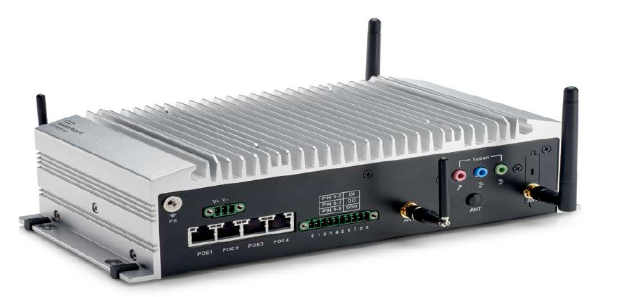
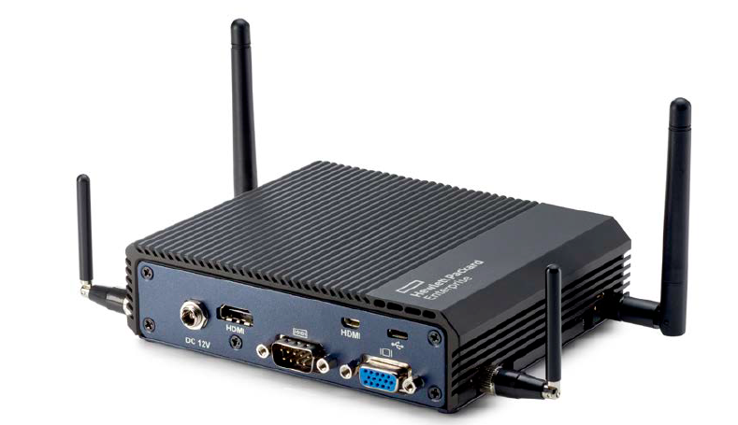
Edgeline Product Portfolio
Deep Edge
EL4000
Performance
Deep Edge Compute & Control
EL1000
Entry
Deep Edge Compute & Control
GL20
Performance
Intelligent Gateway
GL10
Entry
Intelligent Gateway
Entry Edge

Slide 8
Why HPE Edgeline ?
Edge Reqt | Why is it a requirement / why is it important? | Why Edgeline?
Dense computing | 5G, MEC architectures require high density compute at the edge (e.g., for centralized, coordinated virtual RAN functionality) | Up to 64 cores single CPU Intel® Xeon® D optimized for packet processing High density and low power.
Very low latency | 5G uplink/downlink speeds are much higher (e.g., downloads at 10Gbps vs 100 Mbps for 4G) Latency reqts for 5G really low at 1ms (vs. 45ms for 4G) Billions of devices to be connected (IOT) This facilitates the opportunity to deploy low latency use cases (e.g., autonomous vehicles) | Single socket SoC optimized to minimized latency and jitter High speed, low latency control and data planes with DPDK support
Security | Security at the edge before the data traverses through to cloud Encryption, authentication, public key cryptography etc. | Security acceleration through IT best practices with iLO basics
AR/VR, Video broadcast | Video is a MUST Due to high bandwidth low latency requirements, the closer to the edge, the better IOT use cases with AR/VR for manufacturing, retail, gaming etc. Video transcoding and packaging at the edge for broadcasters | Integrated Intel® Iris ProTM P580 GPU for video processing Extended Nvidia GPUs hosted on PCIe cards for video analytics, facial recognition etc.
Environment | Edge compute equipment are located on-premise at the edge in harsh environments (not data centers) Hence equipment must be rugged and resilient to such conditions | NEBS compliant Operating temp: up to 55°C Storage: -30 to 60°C 95% non-condensing Humidity Tolerance to high shock and vibe
Form factor | An edge is not a data center, and in many cases smaller areas Hence equipment needs to be able to fit into tight spaces | Compact form factor (pizza box ff) Wall or rack mountable
Remote Maintenance | With hundreds of equipment at remote edge locations, it is important to be able to manage them all remotely (and centrally) | iLO with Redfish REST APIs Cloud ready and web based (enterprise class TCO)

Slide 9
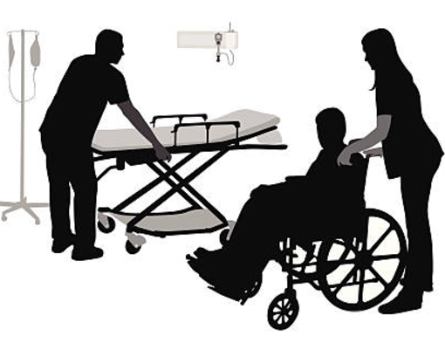
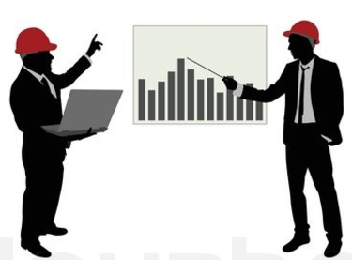
IOT Verticals : Smart Edge
People
(Security and Protection)
IOT Edge Experience
Retail
(In-Store personalized Experience)
Cities
(Traffic, Utilities, Lighting, Streets)
Auto
(In-Vehicle and surrounding environment Experience)
Healthcare
(Safety and Operations Enhancement)
Pre-sales
BU provides architecture blueprint and partner recommendations for each IOT Vertical
Leisure
(Personalized Experience – Gaming, Restaurants, Hotels, Stadiums)
Fields (Operations Enhancement and Security for Oil Fields, Plantations etc.)
Manufacturing (Enterprise operations enhancements)

Slide 10
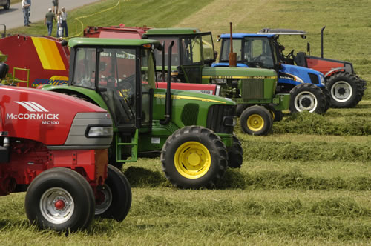
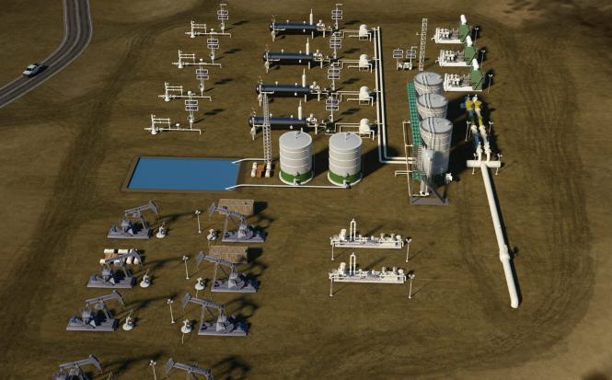
Connected Field : Oil Fields, Plantations, Rainforests etc.
Securing Workforce
Securing people in remote areas
Video surveillance
Intrusion detection : hazardous or un-authorized location
Access control
Facial recognition
Crowd recognition
Emergency response system activation (oil spills, fires, forest fires etc.)
Asset Tracking and Monitoring
Indoor asset tracking
Outdoor asset tracking in remote parts of the fields
Location tracking of assets (e.g., vehicles)
Asset monitoring through video surveillace
Asset Maintenance
Preventative maintenance for older equipment
Detect anomalies and provide Predictive maintenance insights on gathered telemetry
Automation of maintenance
Order spare parts
Contact maintenance personnel
Suggest alternatives
Enabling Workforce
Increase productivity
Provide AR services for mobile workforce
Hands-free voice-operated interface
Step-by-step maintenance, telemetry readings and analytical insights
Video conferencing with remote experts
Status updates to managers

Slide 11
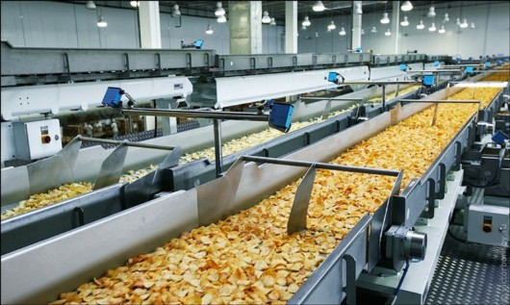
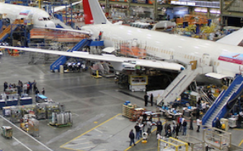
Manufacturing : Plants, Assemblies in any vertical (Food, Retail, Oil & Gas, Equipment etc.)
Connecting Supply chain
Inventory tracking and management
Ensure just in time approach to inventory management and resource allocation –
Having too much inventory on hand is wasteful while…
Not having inventory when needed halts production
Digital Factories
Monitor production process (temperature and other factors)
Monitor operations equipment
Anticipate the need to maintain or fix equipment before it actually breaks down and results in unplanned down-time
Digital Design & Simulation
Validate products early in the manufacturing process through modeling and simulation (instead of physical prototypes)
Globally disperse design to trouble-shoot in a collaborative environment
Enabling Workforce
Increase productivity
Provide AR services for mobile workforce
Hands-free voice-operated interface
Step-by-step maintenance, telemetry readings and analytical insights
Video conferencing with remote experts

Slide 12
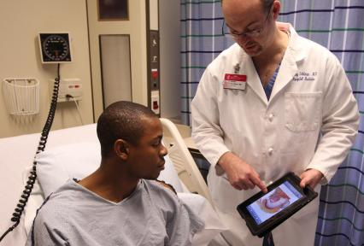
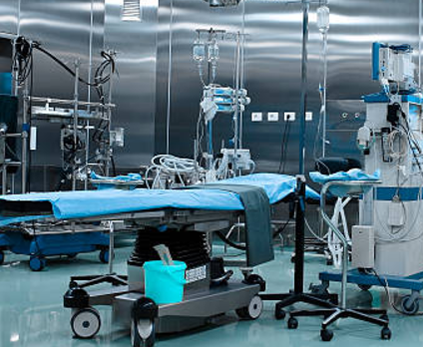
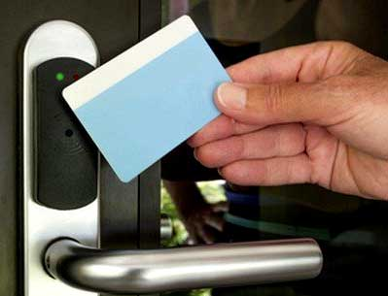
Healthcare : Hospitals, Doctors Offices, Pharmaceuticals and other Research Labs etc.
In-Hospital Care
Workflow management in a hospital (tests, wait times etc.)
Data driven analysis (diagnosis, treatments etc.)
Collected data can also be used for future research
Asset Tracking and Monitoring
Indoor and Outdoor asset tracking
Locate surgical instruments to wheelchairs
Also track drugs and other supplies
Patient tracker
For those needing special care (like Dementia)
Asset Maintenance
Preventative maintenance
Detect anomalies and provide Predictive maintenance insights on gathered telemetry
Automation of maintenance
Order spare parts
Contact maintenance personnel
Suggest alternatives
Security and Access Control
Asset safety : expensive machines to wheelchairs
Drug safety
Patient safety
Infant monitoring
Video surveillance
Facial recognition
Detecting presence in un-authorized sites
Movement of equipment from/to un-authorized locations

Slide 13
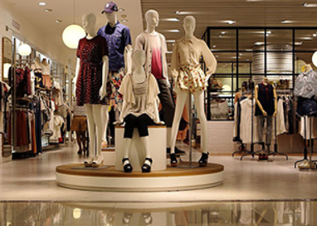
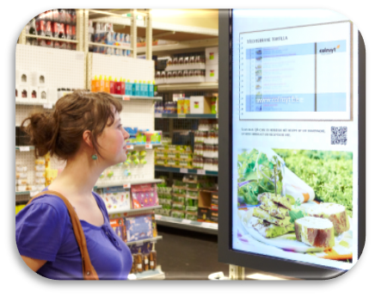
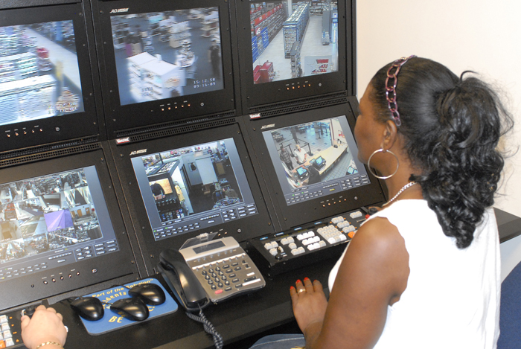
Retail : Stores, Shopping Malls etc.
Inventory Management
Track inventory to ensure that supplies are not low
Find items in low supply
Find if the sales analysis indicates there is demand for it
Weed out low sellers with sales or markdowns
Restock inventory
Determine if an item's in stock
Locate it, order it and keep track of it until receipt
Have a backup plan in case the supplier is out of the said items
Consumer Engagement
Use Retail Analytics to get consumer insights
Based on this information, periodically customize the store to maximize traffic and hence sales:
Displays
Floor layout
Promotions and ads
Products sold
Etc.
Consumer Satisfaction
Present relevant content (consumer loyalty programs)
Personalized offerings
Recommendations
Product comparison
Wayfinding - to the appropriate product
Dwell time analysis
A future AR/VR experience for possible product options
Safety and Security
Protect store from :
Product thefts
Shoplifters
Employees monitoring
Video surveillance
Crowd and facial recognition
Asset tracking
Merchandize tracking
Panic buttons
Emergency response system
Etc.

Slide 14
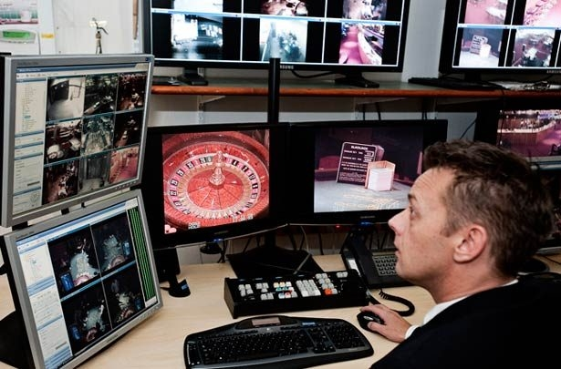
Leisure : Casinos, Hotels, Hospitality, Airports etc.
Customer Experience
A trip perfectly in tune with each visitor’s needs
Suggestions for restaurants, rides, games….
Reducing lines and wait times
Wayfinding - to the approp. dest.
Customer Loyalty Programs
Instantaneous loyalty program credits
Free perks to increase customer spend
Dwell time analysis – re-arranging perks and attractions based on this
Upsell guests on personalized experiences
Security and Safety
Video surveillance
Crowd recognition
Facial recognition
Security scanning through AR lens
Avoid homeland security threats – find them, address them before they happen
Emergency response system
Etc.
Data Driven Efficiencies
Collect engine health, air traffic control, route restrictions & fuel use to detect any operational anomalies or signs of developing faults
Flight data analyzed during the flight – upon landing airport engineers ready to quickly fix issues
Fixing equipment through AR instructions

Slide 15
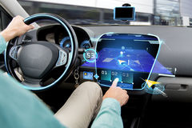
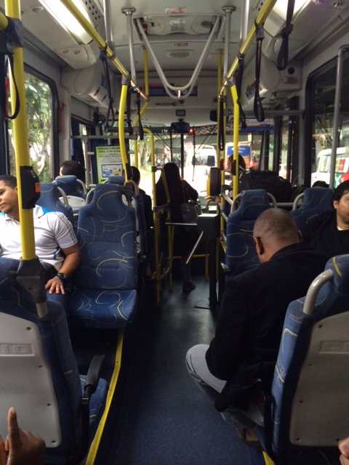
Intelligent Auto : Cars, Buses, Trains etc.
Infotainment
Public hot-spots in a vehicle, especially during long commutes
Broadcast channels on public transportations
Real-time trip Info :
upcoming weather
Traffic, pothole info for safer driving
Local rules and laws (speed limits etc. when crossing the border)
Local attraction ads and information along the way
Security and Surveillance
Driver Safety for personal and insurance rates adjustments
Public safety : Ability to trigger the emergency response systems, when disturbances occur in a public transportation
Connected Car
On-board predictive maintenance
oil lifecycle, breaking pads lifecycle,
rpm vs. acceleration, etc.
Road conditions monitoring:
Wind detection
Potholes detection
Autonomous Car
Cars sharing info with each other as well as street, environment info makes them able to drive automously

Slide 16
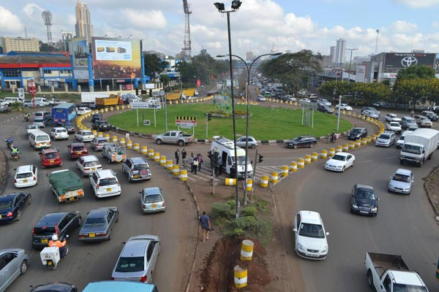
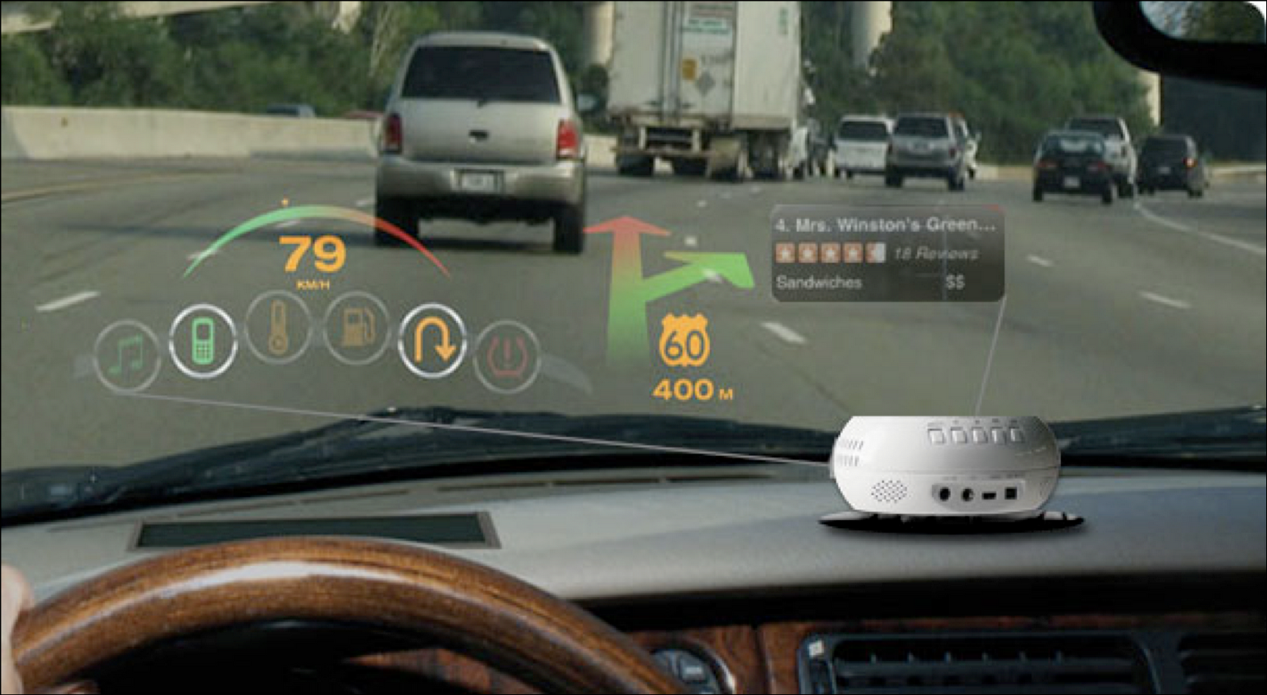
Smart Cities : Parking, Lighting, Traffic Flow, Navigation, Emergency Response Systems, etc.
Citizen Safety
Citizen can trigger Panic button, which :
Turns on the street light that is closest to him
Turns on the nearest camera that starts video recording
Alerts the nearest public safety authorities
Emergency response system is activated
City Safety
Disturbance in a city (e.g., riot)
The street cameras do crowd recognition
They start recording
The city’s emergency response system is triggered
The response turns on approp. lights & sirens
Deploys Law enforcement
Dispatching Emergency vehicles
Disaster in a city (e.g., flood)
Street sensors detect this
The city’s emergency response system is triggered
The response may control traffic lights, railway crossings, Broadcast information to people
Traffic Flow
Ease the city traffic
Brighten the light when its rainy or dim the light when there is no traffic
Green light for emergency vehicle, Adaptive green for traffic jam mitigation
Facilitate Safe Driving
Merging traffic from left, blind spot traffic
Congestion ahead : due to roadworks…
Wild life detected ahead
Slippery road, strong wind, rain ahead
Light turns red in 5s
Recommended speed is 42mph to pass on green
Tourism Enhancement
Navigate drivers to the closest / cheapest available parking spot
Find the restaurants or shops nearby – along with their menus, merchandize
Entice to shop at stores along the way through receipt of promotions, ads
Smart Kiosks for pedestrians
Interactive menus to check out local stores, their merchandize, and promotions
Access to local events
Buy tickets to events
Build an itinerary based on preferences

Slide 17
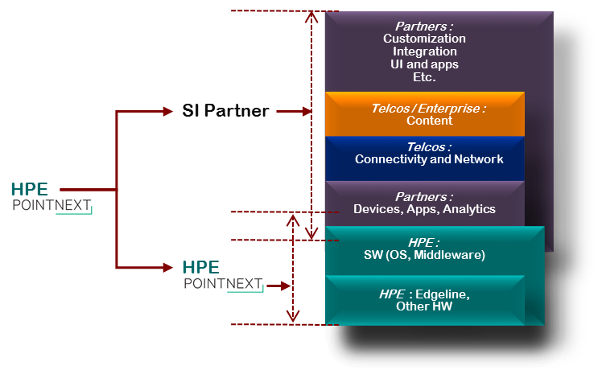
HPE as Ecosystem Integrator
Digital transformation is occurring in every industry
No single company can deliver complete solutions
You need a partner that can connect with your business issues : Ignite the right ecosystem & technologies to create your solution
Solutions housed on Connect IoT & Cloud28+, organized by use-case, industry and geography
Solution descriptions – with best in class partner recommendations
Links to published collateral
Notes:
We believe IoT is going to be transformational in every business.
No single company can deliver a shrink-wrapped solution that will enable this. To help you benefit from the coming digital disruption, you need a partner that understands your business issues, and can pull together the right group of companies & technologies that together can build a solution to meet your needs.

Slide 18
Video surveillance – HPE Edgeline and UIoT

Slide 19
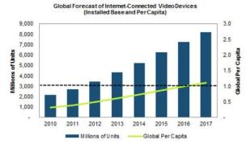
Explosion of internet-connected cameras
Phones
Cars
Surveillance
Plugin
Action
AR/VR
Drones
79% of internet traffic expected to be videos by 2020, up from 63% in 2015
9B internet-connected video devices to be shipped by 2017
Seven reasons to not send rich media to the cloud

Slide 20
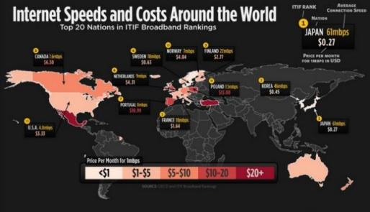
Pushing “rich media” to the data center for VA is not efficient
Number of streams | Network utilization
1 PoE stream | ~150-300 KB/s
2 PoE streams | ~ 500 KB/s
3 PoE streams | ~ 1021 KB/s
4 PoE streams | ~1500 KB/s
720p, H.264 streams from off-the-shelf PoE cameras
PoE - Power over Ethernet
Machine
Video and audio
Text
Sensor
Access control
Fire detection
Bldg
mgmt.
Server/ network
CCTV
Broadcast
Mobile
Audio
Images
WWW
Social media
Email
Documents
Notes:
1080p 30fps for 1 sec = 2.5 MB/s
100 cameras = 250 MB/s = 15GB / min = 900 GB/hr = 21.6 TB/day
Unlike Machine or textual data which is one dimensional time series ; Video data is inherently multi-dimensional time series
Beyond bandwidth considerations, it is extremely latency sensitive i.e. it is valuable when immediate insights are generated from it

Slide 21
Surveillance needs to become “smart”
There’s just too much data generated
Over-reliance on operators to detect problems
Most times humans are just not good enough

Slide 22
Computer vision state-of-the-art has improved order-of-magnitude
Neural Network (NN) vs. Deep Neural Networks (DNN)
Classic machine learning
(Legacy VA)
Deep learning
(AI enabled VA)
Feature-based approaches
Deep Neural Networks
(DNN)
Notes:
Scale-invariant feature transform (SIFT) is an algorithm in computer vision to detect and describe local features in images. Developed in 1999. Good example of “feature based approach” where every feature to detect needed its own optimized set of features.
Accuracy increased significantly due to introduction of Deep Neural network models such that super-human accuracies of up to 97% are now common. This area is seeing an explosion of capabilities since 2012.

Slide 23
Solving the smart surveillance problem requires accelerators
Converged Edge Systems
Deep learning expertise
Connectivity
Hardware accelerators
Security
Video analytics SW ecosystem
High-density compute
Storage
Industry-standard platform

Slide 24
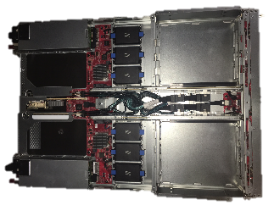
HPE Edgeline Converged Edge Systems can carry Nvidia P4 GPU for high performance AI “inference” and are expressly designed for edge environments
HPE EL4000
HPE EL1000
Compute Cartridges x2
PCIe cards x2
⁺
PCIe cards x2
Compute Cartridges x2
CPU:GPU=1:2
CPU:GPU=1:1

Slide 25
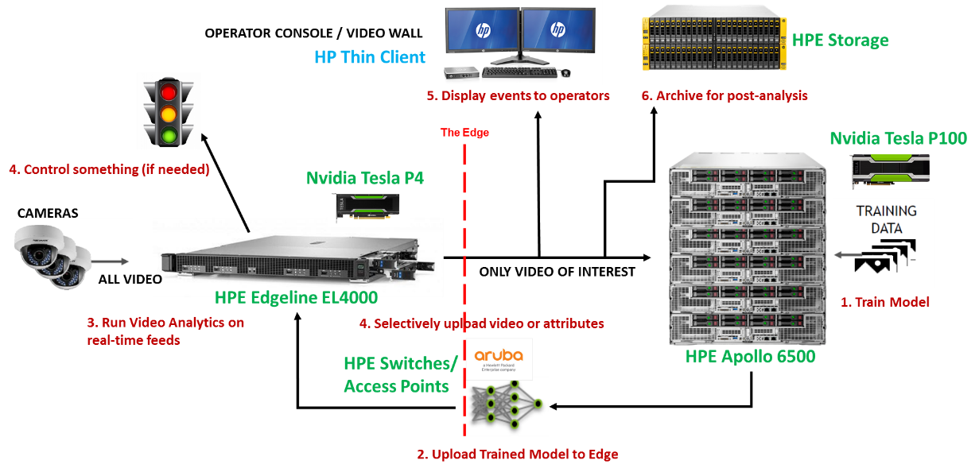
HPE offers integrated edge-to-core solution for smart surveillance

Slide 26
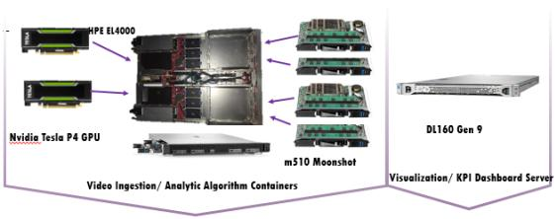
HPE and its SI partners (PWC, TCS and Accenture) offer “turn-key” kits and services to generate immediate RoI in real-world situations
Video Analytics result to insight
How to unlock value by integrating video analytics output with understanding of process, facilities, people and assets?
+
License plate recognition
Person/attribute detection
Pre-characterized HPE/ACN/Nvidia validated systems architecture
Systems performance and recommended camera/installation support as a “kit”
Scalable Edge Video Analytics Offering
(right-sized hardware and software)

Slide 27
How do I operationalize a distributed video analytics system?

Slide 28
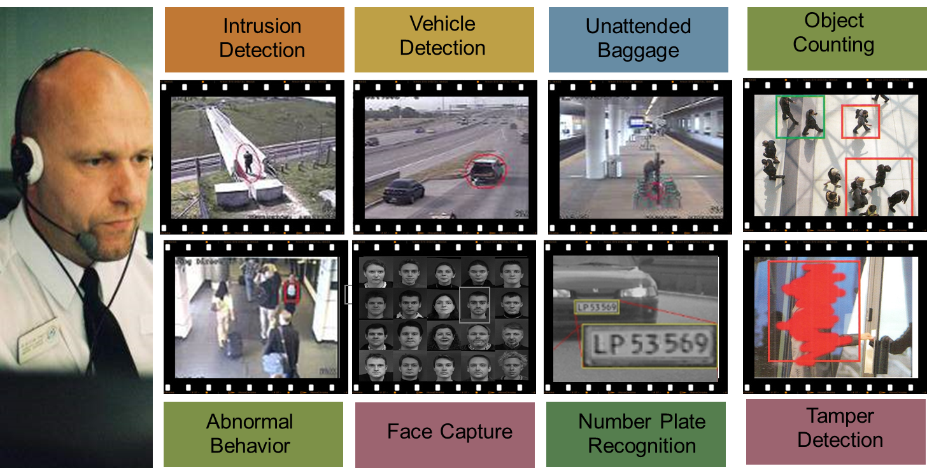
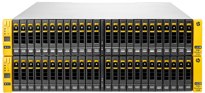
Edge in action
Operator console/video wall
HPE Storage
Intelligent video surveillance
6. Archive for post-analysis
The Edge
Display events and trigger actions to operators and authorities
Nvidia Tesla P4
Cameras
Command and
Control application
All video
HPE Edgeline EL4000
HP UIoT
Data Service Cloud (DSC)
Run Video Analytics and Management (VMS) on real-time feeds
Device & Service
Management (DSM)
Data Analytics (DA)
BSS (ACI – IUM) / OSS
HPE Universal IoT
Data Acquisition & Verification (DAV)
HPE Switches/
Access Points
Network Interworking Proxy (NIP)
Video metadata, attributes and events
HPE Universal IoT

Slide 29
Solution architecture: Intelligent video surveillance with Command Control Center
Video Feed over VMS API’s
IoT data visualization
Remote Cloud
Storage
Data Service API
Pre-Defined Operational Dashboard
Console
User-defined dashboards
HPE
REST
Command and control
alarms
Application context
Service Provider
OneM2M Value Pack
OneM2M/ Application Value Pack
Illegal parking
Rule-triggered events, alerts and alarms
DSM
HPE
HPE
Cameras
Nvidia Tesla P4
REST
REST, HTTP
Deep Learning computer vision
Internet
REST/JBDC
OneM2M Mca REST Interface
HPE
Internet
HPE
DSC
Mca
Internet
NIP
Mca
DAV
HPE
OneM2M Mca REST Interface
HPE Edgeline EL4000
Area and line counting
OneM2M/ Application Data
“Video Surveillance and
Analytics Platform”
HPE
Face recognition
HPE Universal IoT Platform
“Command and control”

Slide 30
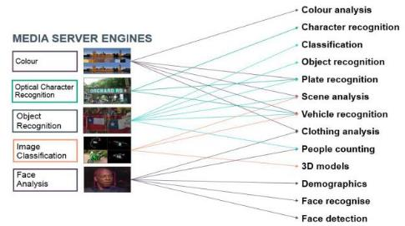
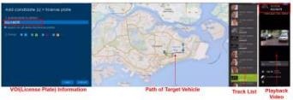
Video Analytics use cases
Area counting
Line counting
Illegal parking detection
Crowd motion analysis

Slide 31
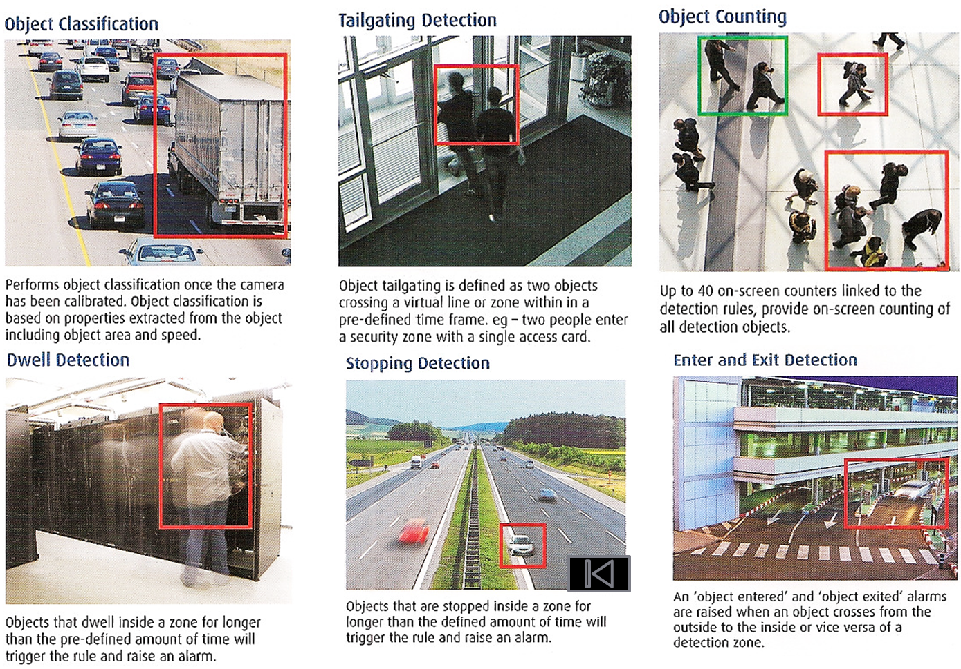
Video Analytics smart city use cases

Slide 32
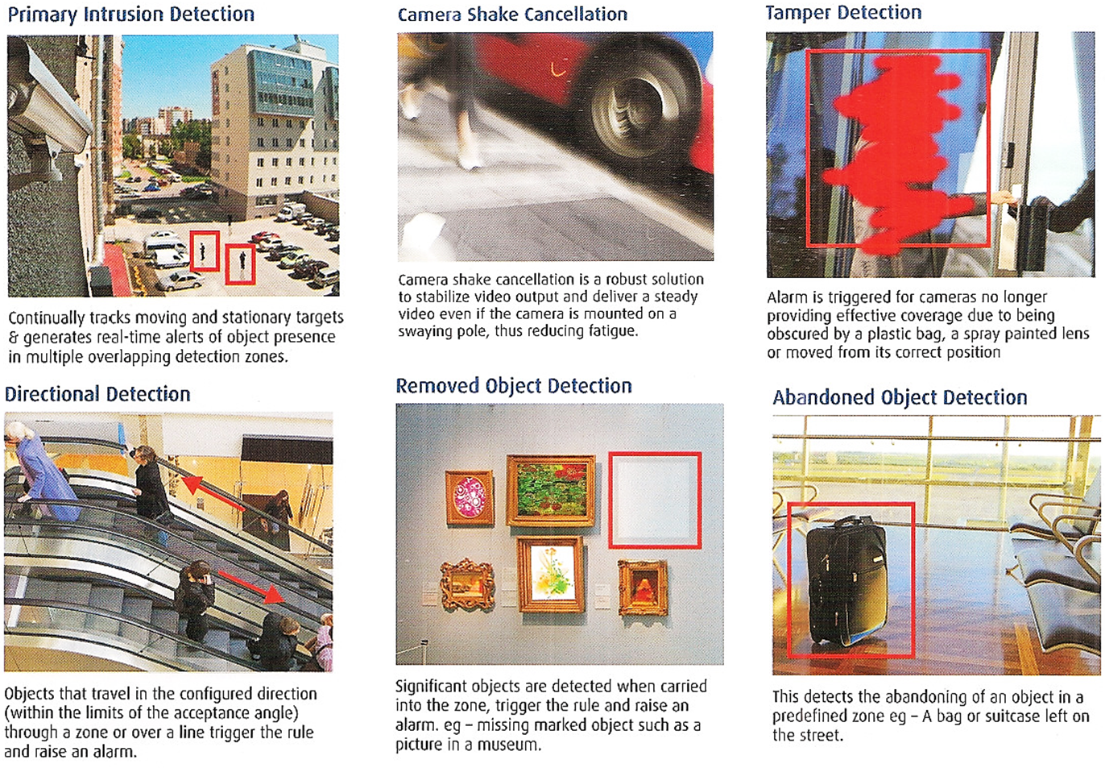
Video Analytics smart city use cases, cont’d.

Slide 33
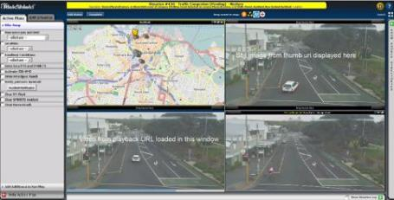
Safe cities: Auckland Transport (traffic mgmt.)
Video Analytics Platform Powered by HPE
Objective: Improve public safety
Deployment environment
City-wide camera network
Road and environmental sensors
Real-time social media and news
Phase 1: Detect high risk activities and investigate threats with scene analysis and license plate recognition
Future phases
Uncover breaking trends
Facilitate incident responses with social media
Integrated transport management
City dashboard

Slide 34
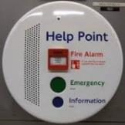
HPE at Auckland Transport (data sources integrations)
Ingested data sources
Video management systems
CCTV
Help point systems
Scheduling systems
Road sensors
Social media
News websites
Databases
File systems

Slide 35
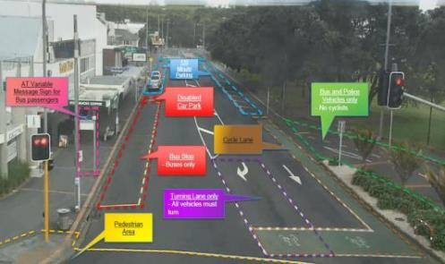
Solution breakdown
HPE Smart Surveillance for traffic mgmt.
Advanced video analytics
2,000 video feeds recorded
200 video analytics running in real time
Used for optimizing traffic flow through the city
Improving safety by detecting illegal or dangerous actions
Track pedestrians, bikes, cars, buses, etc.
Detect red light jumps, congestion, clearway violation and much more

Slide 36
Some performance data
How good are HPE Edgeline Systems for video analytics/surveillance?

Slide 37
HPE “deep compute” cartridges run legacy VA well
(Simple scenes only)
System | #Cores | Memory | #Streams (scene analysis) | #Streams (face recognition) | #Streams (number plate recognition)
HPE GL10 | 2 | 4 GB | ~1 | ~1 | 0
HPE GL20 | 2 | 8 GB | 2 | ~2 | ~1
HPE EL1000 (m510-8) | 8 | 80 GB* | 18 | 5 | 2
HPE EL1000 (m510-16) | 16 | 128 GB | 20 | 10 | 4
HPE EL1000 (m710x) | 4 | 64 GB | 17 | 4 | 2
HPE EL4000 (4x m510-8) | 4x8 | 4x80 GB | 72 | 20 | 8
HPE EL4000 (4xm510-16) | 4x16 | 4x128 GB | 80 | 40 | 16
HPE EL4000 (4xm710x) | 4x4 | 4x64 GB | 68 | 16 | 8
Ref. HPE DL360 G9 | 2x8 | 128 GB | ~20 | 12 | 4
More details at: http://www.hpe.com/support/EL-EVA, uses IDOL Media Server; Formal Set of experiments. Details available on request

Slide 38
Example: CPU+GPU VA – Nvidia and Xjera ISV Software
XJERA Xintelligence / Xhound/ Xtransport / XPlate
Core executable which runs over Nvidia SDK (CUDA 8.0, CUDNN 5.1)
Optimized by use-cases: Person detection/counting, Facial tracking, Vehicles, License plates/Traffic
Assumes neural network “training” is performed in datacenter, “inferencing” is performed at the edge
Low latency response time, detect large number of features in given stream with super-human accuracy
Award-winning ISV software demonstrates “power” of HPE Edgeline + Nvidia hardware for accelerated video analytics
Certified!
Nvidia P4
HPE EL1000/4000

Slide 39
However, when paired with an Nvidia P4, Accelerated Video Analytics delivers huge performance gains
(Complex Scenes)
31X
111X
31X
31X
Gap will further widen as complexity of video analytics increases

Slide 40
HPE Edgeline is the perfect Smart Surveillance platform
(Complex scenes)
Max. Cameras @ 720p/15fps
HPE Edgeline EL1000 | 9 | 6 | 9 | 9
HPE Edgeline EL4000¹ | 36 | 24 | 36 | 36
¹ Limited to 1 Tesla P4 for the test. HPE EL4000 update to support 4 Tesla P4 per system is expected in 2HCY2017

Slide 41
Thank you
For more information please visit our web site hpe.com/CSP/IoT
hpe.com/IoT

