Slide 1
What does AirMatch do differently?
10:00 GMT | 11:00 CEST | 13:00 GST NOV 28th, 2017
Presenter: SAJIN NAIR
nair@hpe.com

Slide 2
Agenda
Introduction
AirMatch vs ARM
Setup AirMatch
Enable AirMatch and Profiles
AirMatch Optimization
Workflow
AirMatch Input Metrics
Logs
Troubleshooting

Slide 3
Ideal way to solve a Jigsaw puzzle?

Slide 4
Key Considerations with ARM
A decentralized service; each individual radio makes its own decision
ARM is “reactive” in nature, cascading affects
Future spectrum enhancements, Lack of bandwidth planning
Asymmetric EIRP planning which may not provide optimal client roaming behavior
Cascading affects

Slide 5
What is AirMatch ?
A centralized RF optimization service
Newly defined information collection and configuration deployment paths
Models and solves the network as a whole
Results in better channel, bandwidth and EIRP plan for the network
Notes:
AirMatch provides unprecedented quality of RF network resource allocation. It consumes the past 24 hours of RF network
statistics, and proactively optimizes the network for the next day. The RF plan change is applied in the early mornig to minimize
the client disconnection and to maximize the the user experience. To conquer the instantaneous change in RF environment,
AirMatch also reacts to detrimental RF events such as radar and high noise. The network under AirMatch will experience the
minimum number of channel and EIRP change while network throughput is predictively maximized.

Slide 6
Advantages of AIRMATCH
Clean slate RF optimization service
Long term network stability & Performance
Holistic view of network
Different mode of data collection and calculation
Once a day optimization
Reactive optimization

Slide 7
How is it different from ARM?
Master
Master
Local 1
Local 2
Local 3
Local 1
Local 2
Local 3
5am
1,6,11
1,6,11
1,6,11
10am: 1,6,11
11am: 11,6,1
1 pm : 1,6,11
2pm: 11,6,1
3pm : 6,11,1
4 pm : 6,1,11

Slide 9
How Airmatch works?

Slide 10
AirMatch Workflow
Air Match
calculates solution for each AP
1
AP sends RF statistics as AMON messages to Managed Devices (MD’s)
MM Master
MM Standby
2
The MD’s forward the AMON messages to Mobility Master (MM)
VRRP
Cluster 1
Cluster 2
3
AirMatch calculates an optimal RF solution
MD1
MD2
MD1
MD2
4
Mobility Master pushes the solution down to MD’s
MD3
MD4
MD3
MD4
5
MD’s send dot11 radio profile to AP’s
Notes:
AirMatch is Aruba’s next generation automatic RF planning service. This is not only to replace a legacy solution – ARM – automatic channel and EIRP assignment, but also to control the radio’s bandwidth, statistics collection and radar events. ClientMatch and its associated profiles and loggings are not part of Air Match’s project scope, and they shall remain as before.
The AirMatch service runs on AP, MD, and MM with respective functions, forming a big feedback loop of INPUT-PROCESS-OUPUT (IPO). The INPUT stage is to collect detailed RF statistics, controller configuration and radio configuration from AP. The PROCESS stage consumes what INPUT stage provides, and generate an RF solution that specifies new channel, bandwidth, EIRP, and mode of operation per radio. The OUTPUT stage deploys the RF solution to the radio.
INPUT stage
AP’s AM periodically sends statistics in AMON format to Managed Device
MD’s SOS forwards that AMON messages to Mobility Master (Only in 8.0.1, updated in 8.1)
The MM’s Airmatch service receives the AMON messages, performs ingress processing, and then stores them to MongoDB.
PROCESS stage
AirMatch service in MM calculates the solution based on the info in the DB and stores the solution back to the DB.
OUTPUT stage
MM’ SAPM constructs a message and sends the solution as CLI commands down to an MD.
The MD receives the config message, converts that to dot11radio profile override, and apply.
The AP sapd receives the config from its MD, and apply the change in radio config.

Slide 11
AirMatch – Input Metrics

Slide 12
AirMatch – Input Metrics
Radio’s operating condition ( in reporting_radio)
Radio Feasibility
Neighbor Measurement ( in pathloss_history and nbr_pathloss)
User defined metrics include EIRP and Channel Bandwidth
Notes:
Add a 4th bullet for user defined inputs. EIRP and Channel bandwidth. All these are taken as input into the algorithm.
reporting radio- these are the feasible solutions. Basically these are the options that you can possibly assign.

Slide 13
Information flow at the high level
Bandwidth
Channel
EIRP
What
Radio Membership
Link Path-loss
Input
Process
Output
How
AP’s AM -> AMON -> LC
LC -> AMON -> SC
SC -> DB
SC’s Airmatch solver
Calculates solution
Triggered by external event
Stores it back to the database
SC’s Airmatch deploy queries and fetches info
SC AMAPI to SAPM
SC’s SAPM to LC
LC’s SAPM to AP’s SAPD

Slide 14
Feasibility Report
Field | Description
Reporting Radio | Base Mac Address
Channel List | List of first 20MHz Channels
Bandwidth | List of supported bandwidth
EIRP Range | Range of valid EIRP values
Introduces Mobility Controller or Managed Node which is completely managed by MM using Zero Touch Provisioning unlike 6.x Master-Local
The MM can only be a VM and not a controller

Slide 15
Neighbor Table
START
Not Sure
Unknown
Is it terminating on MC managed by MM ?
Is it an Aruba AP ?
No
Yes
No
Not a Friend
Yes
Not a Friend
Friend
A neighbor AP is considered a ‘Friend’, if the MC on which it is terminating is managed by the same Mobility Master for which the AirMatch solution is being calculated.
Notes:
A neighbor AP is considered a ‘Friend’, if the MC on which it is terminating is managed by the same Mobility Master for which the AirMatch solution is being calculated.

Slide 16
Timing Of RF Plan Change
8.0.1

Slide 17
Timing Of RF Plan Change
Incremental Optimization
On-Demand Optimization
Reactive Optimization
Scheduled Optimization

Slide 18
On-Demand Optimization
1
“airmatch runnow full”- performs the same quality optimization that would be done in a periodically-scheduled optimization
2
“airmatch runnow quick”-– quick-and-dirty solution, random channels, but computes correct EIRP for cell sizes
3
“airmatch runnow incremental”-– Only considers new AP’s added, keeping the existing AP’s solution intact

Slide 19
Reactive Optimization
Mobility Master/Standby
AM
1
AirMatch allows event driven channel changes
2
Upon noise & radar detection, the AP will change channel
3
Channel with minimal interference index will be chosen
AM
MC1
4
Any channels with radar detected in the last 30 mins are excluded
Channel 36
Channel 44
Upon radar detection, if there is noise on all channels where there is no radar detected, the AP will have no choice but to choose the channel with noise.
Notes:
-It will choose a channel with the minimal interference index.
-Any channels with radar detected in the last 30 mins are excluded.
-Any channel with noise detected is also not preferred.
-If noise is detected on all channels without radar, it has to choose one with noise
-In both case, channel is selected using the interference index.
-On changing channel after a radar detection, an AP returns to the home channel after the radar event has expired.
-The AP considers a channel not assigned to neighboring radios by using the ARM interference indices.
-The AP changes channel on detection of noise and after 30 minutes comes back to the original channel.
-If it detects noise again, then it changes channel and then stays there for another 12 hours before returning back

Slide 20
Incremental Optimization During Initial Phase Workflow
1
First batch of AP’s joining the MC for the first time are called leading pack
Headquarter
Mobility Master/Standby
AM
2
Initial phase defined for 8 hours; solution checked every 30 minutes
3
AirMatch algorithm runs to check for newly joined APs
AM
AM
MC1
MC2
4
If yes, only newly joining radios will be assigned with a new RF plan

Slide 21
Scheduled Optimization
1
AirMatch, by default, is scheduled to run once a day
Controls radio resources such as channels, channel bandwidths and EIRP of a WLAN
Consumes ‘radio membership’ and ‘link pathloss’
Provides centralized computation
Notes:
AirMatch computes and deploys a new RF plan for the network every 24 hours. The network operator sets the hour-of-day through profile configuration. This the-hour-of-day specifies the start of the deployment. The computation is done beforehand, and the exact start time/end time of the computation is determined dynamically

Slide 22
Workflow of RF Plan Change
1
Incremental Optimization starts
Headquarter
Mobility Master/Standby
AM
2
After end of initial phase, you can run on-demand optimizations
3
Event triggered changes lead to reactive optimizations
4
If no event occurs,/no on-demand optimizations, then algorithm runs on schedule.
AM
AM
MC1
MC2

Slide 23
AirMatch Configuration & Commands
Notes:
-Use your setup for the demo.

Slide 24
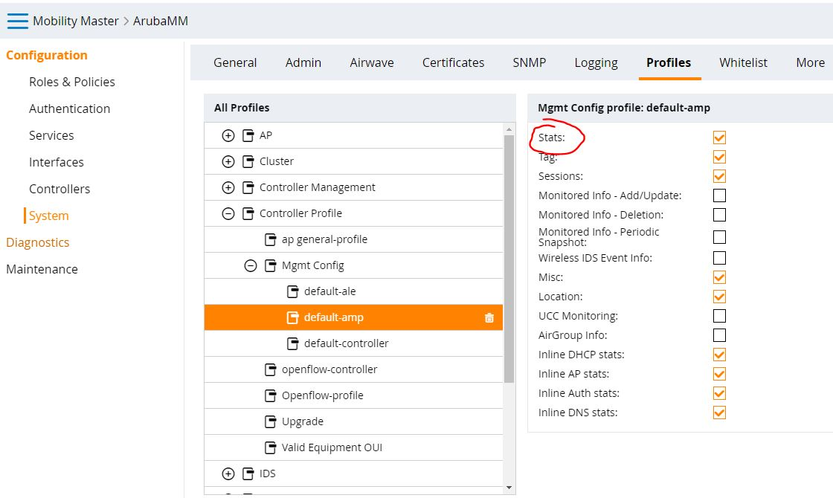
Airmatch setup
This step enables the Mobilty Master to receive reports from Aps. Add the CLI in the Device node.
mgmt-server primary-server <your mobility-master ip> profile default-amp
If “default-amp” is not configured, please enable “stats”. As this is needed to AirMatch to receive amon messages.

Slide 25
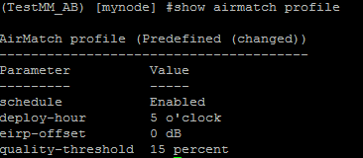
Quality-threshold and Stats
1
Quality-threshold
Checks percentage change against current state
2
Stats Enabled
Interval of stats sent to MM
Notes:
The quality-threshold checks for percentage of improvement in the created solution with reference to current network state. If the improvement reaches the threshold limit, it deploy’ s new solution. Else the existing solution remains. Default value is 15%.
The quality-threshold would provide percentage details per band under airmatch solution <seq>

Slide 26
How & What summary of information from an AP?
#show ap debug airmatch-report ap-name Multizone

Slide 27
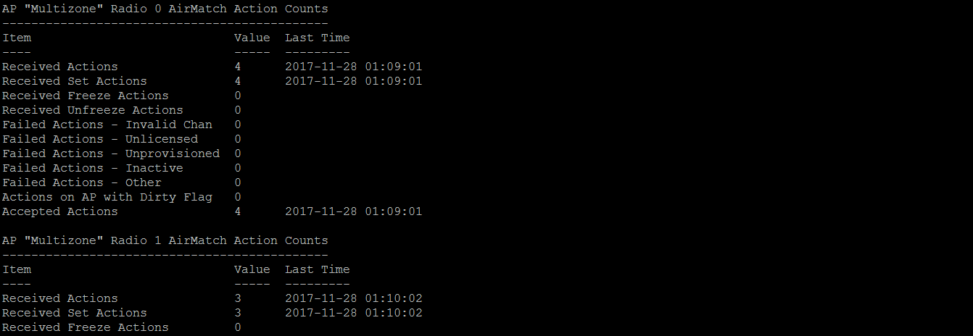
Does the AP implement solution from Master?

Slide 28
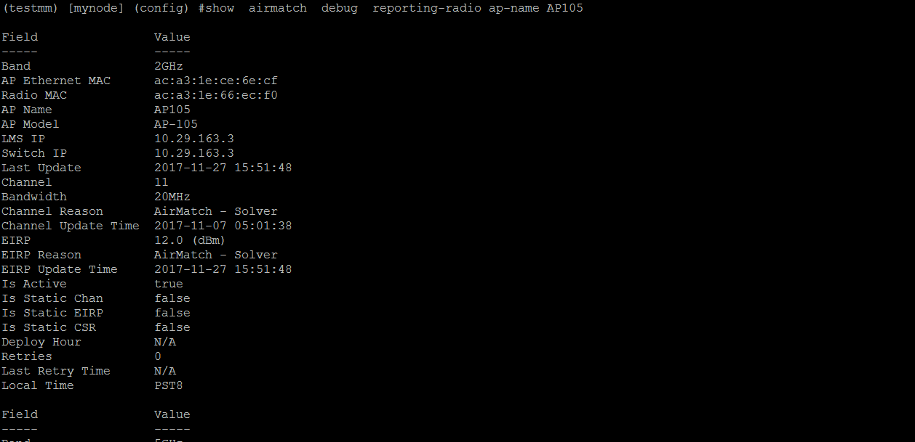
How channel and power where changed?

Slide 29
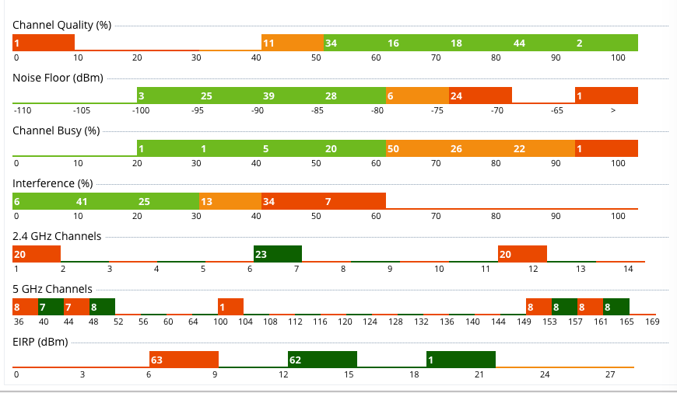
AirMatch – Solution

Slide 30
AirMatch History

Slide 31
AirMatch Solution

Slide 32
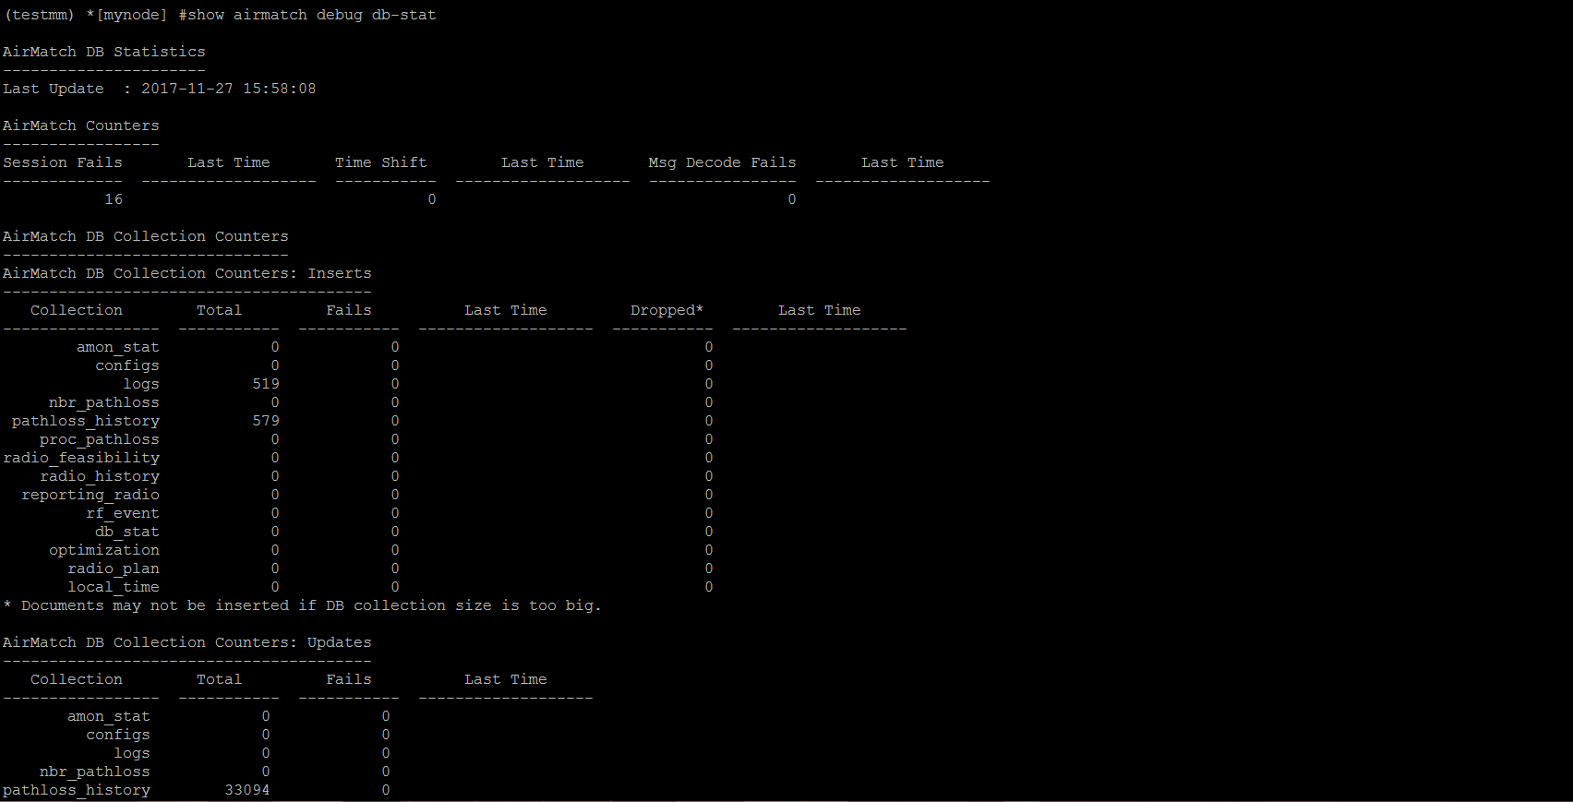
AirMatch debug db-stat

Slide 33
Enabling logging & running AirMatch
(testmm) *[mynode] (config) #logging system level debugging
(testmm) *[mynode] (config) #exit
(testmm) *[mynode] #airmatch runnow quick

Slide 34
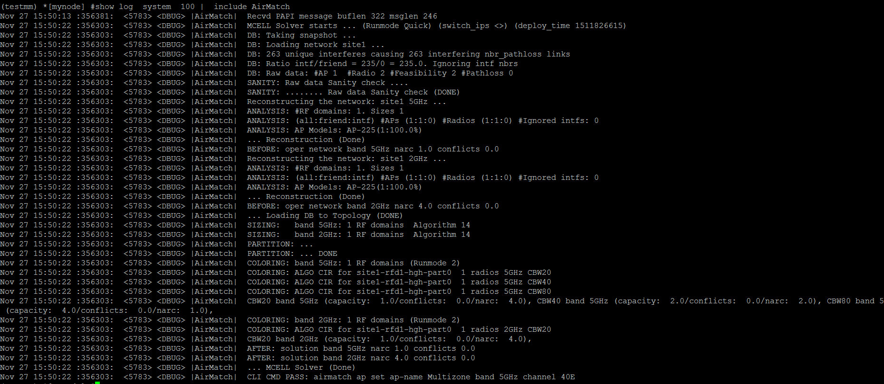
Log Analysis

Slide 35
Static Radio and Power Configuration Commands
Notes:
AirMatch will take into consideration the static assignment for next days plan. On high noise event, AP will not change the channel, but on radar it will even on static assignment.

Slide 36
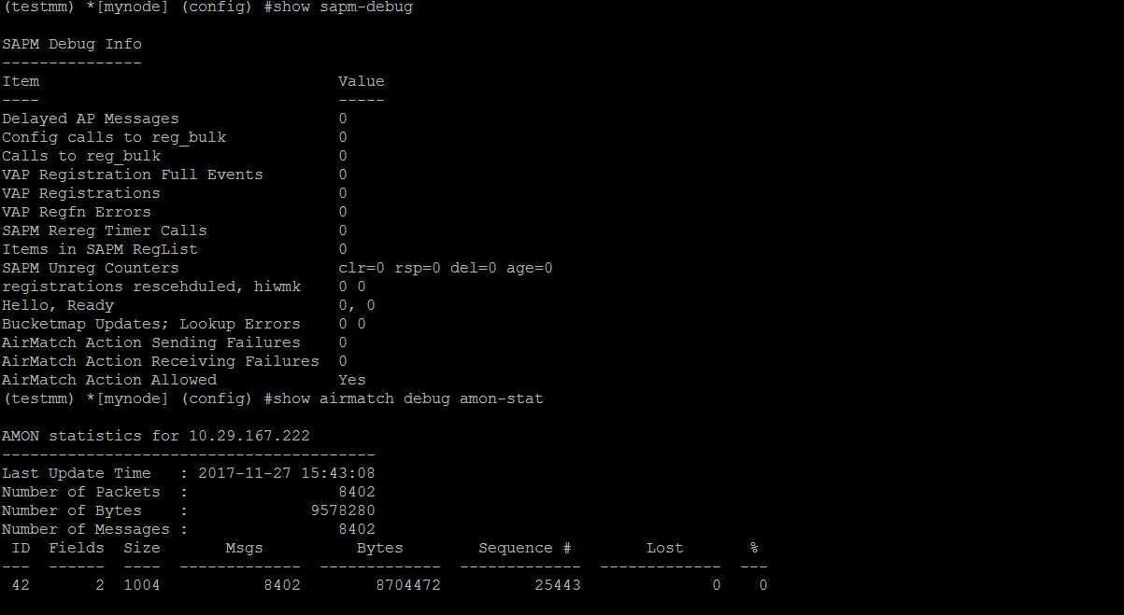
SAPM debug & AMON stats

Slide 37
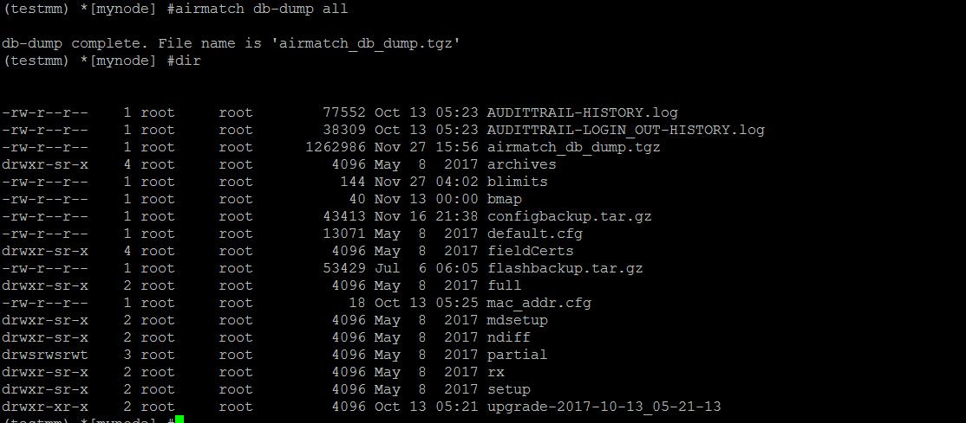
AirMatch DB dump

Slide 38
Questions?

Slide 39
Thank you!

