Slide 1
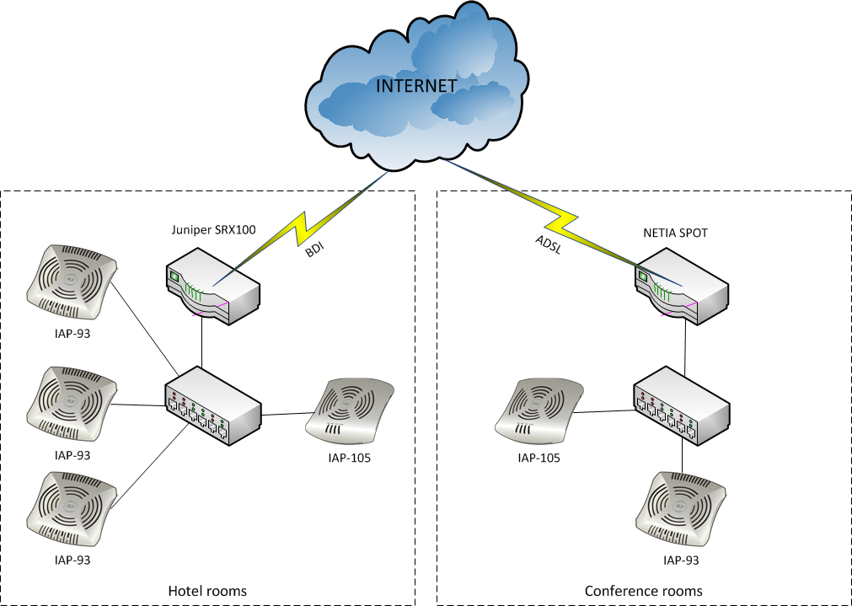
Internet link normal operation

Slide 2
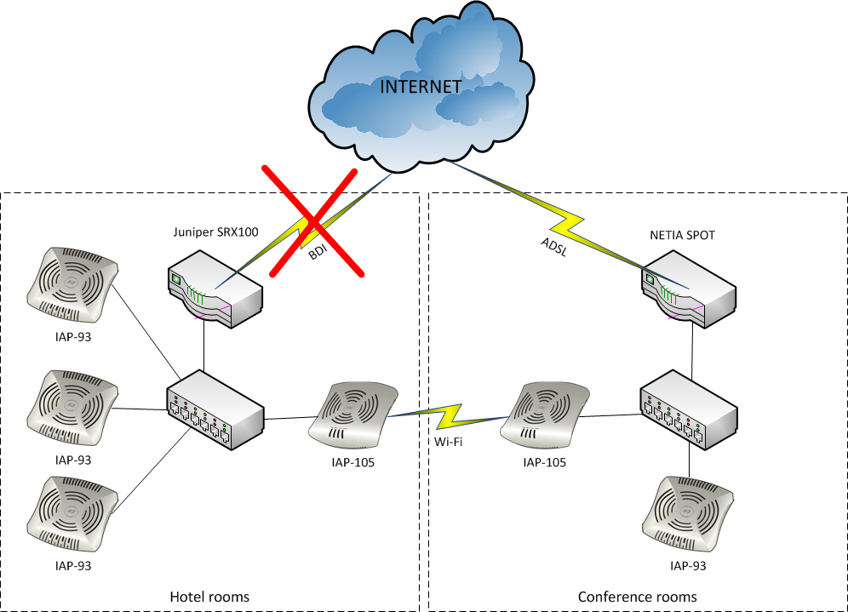
Internet link ADSL backup

Slide 3
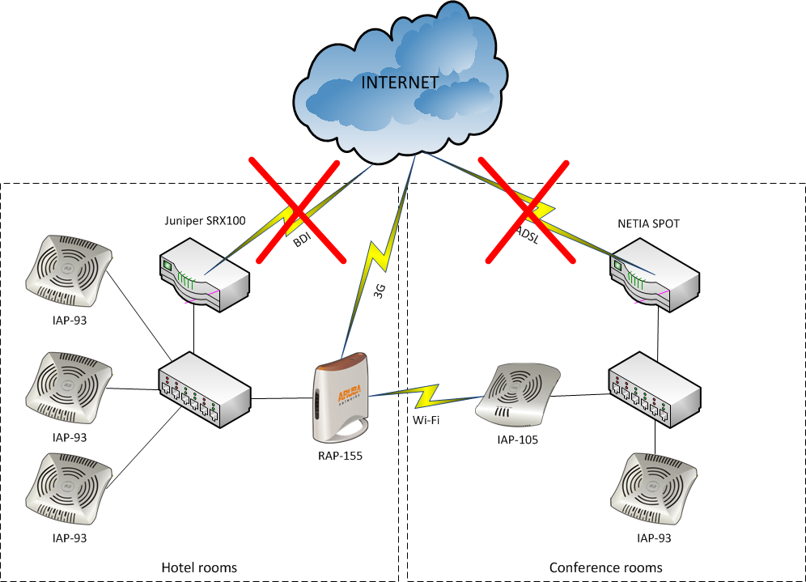
Internet link 3G backup

