Slide 1
Pseudo Multi-Tenant
Derin Mellor
22nd June ‘17

Slide 2
ServiceProvider Tenant Environment
One campus
Multiple tenants
Common secured 802.1X SSID
Service employees
“Service Employee” VLAN
Tenant employees
Specific VLAN per tenant
Common Open SSID
Guests
Guest VLAN
Tenant registration
Common PSK SSID
Tenant non-802.1X devices
Specific VLAN per tenant
TenantA
TenantB
Service
TenantC
TenantX
TenantD
Tenant…

Slide 3
User Experience

Slide 4
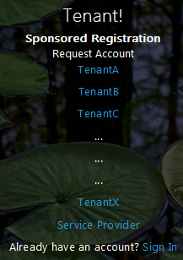
Tenant Employee/Guest Sponsored Registration
This assumes the Tenant environment has been configured
Tenant Employee connect to Guest SSID
User browses – redirected to guest login portal
Guest accounts default to supporting 3 devices

Slide 5
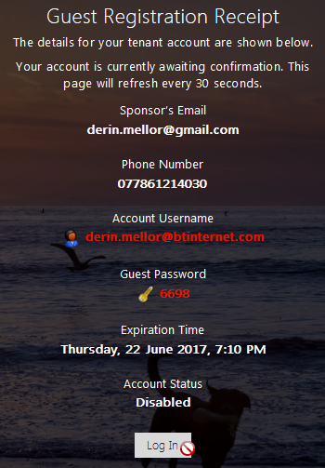
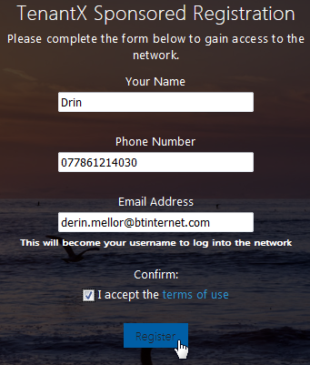
Tenant Employee/Guest Sponsored-Registration
Wording should be improved to instruct Tenant Employees to use the secured SSID
Password complexity can be adjusted – password can be hidden and SMS/email to user
Default duration in this example 8 hours – sponsor can change
Account disabled
Login button disabled
Login button disabled
Might be best to hide

Slide 6
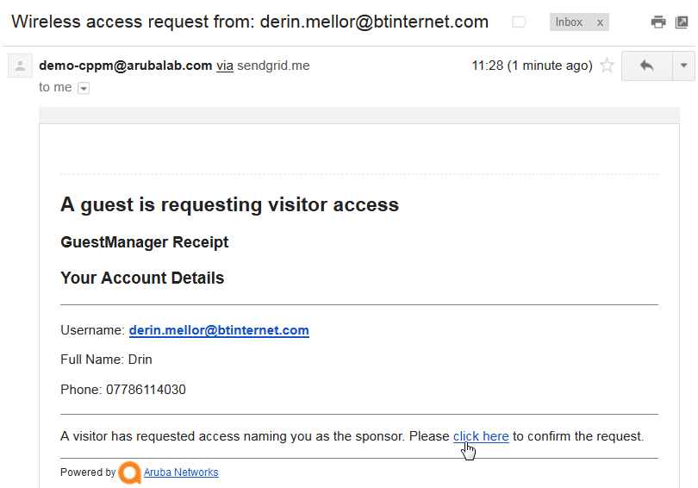
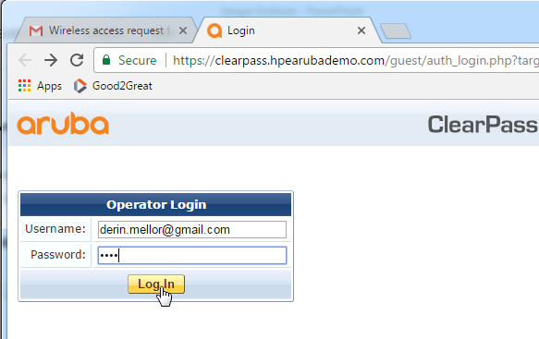
Sponsor Experience - 1
Sponsor receives email
Must be online to access CPG management interface
Follows link to confirm request
User login

Slide 7
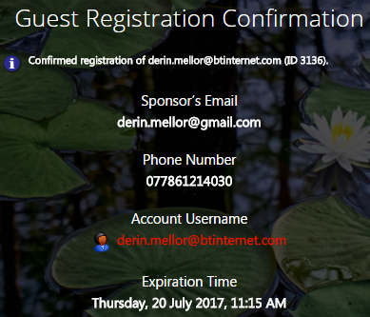
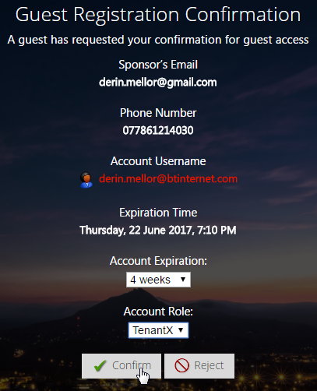
Sponsor Experience - 2
Current Expiry
Duration
His/her TenantX Employee or Guest
Employee & Guest receipt can encourage user to use the 802.1X secured SSID

Slide 8
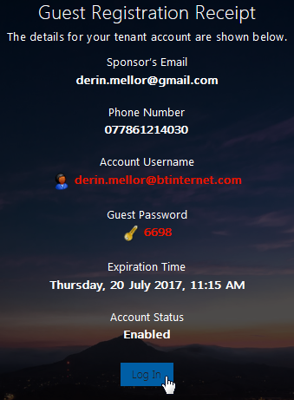
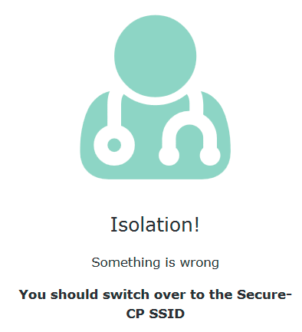
Tenant Sponsored-Confirmation & Login
This allows up to 3 devices to use this account.
Maybe should report this on page?
Updated Account Expiry Time
Login button available
But usage of unsecure Guest SSID is blocked

Slide 9
Connecting to 802.1X SSID or Switch Port
Device can be connected to the 802.1X “secured” SSID/Port
Device will prompt for a username and password
ClearPass will accept
Initially match on the generic 802.1X service
Update the Endpoint:Owner
CoA Disconnect
On reconnection (and subsequent connections) device will match the TenantX service
Easier for reporting
If this is a MS Domain PC a special 802.1X Profile (SSID) will have to be created with the employee username and password
Better to use a trusted certificate

Slide 10
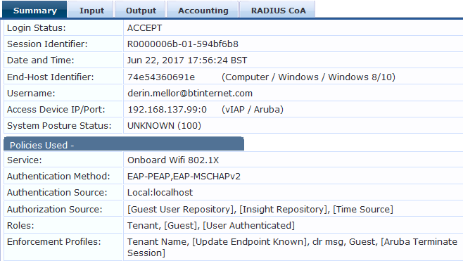
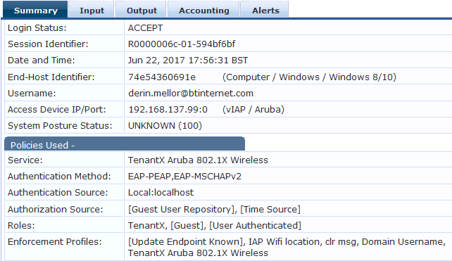
TenantX Employee connect to Secured SSID
On re-connect matches on more specific TenantX service
First connection hits the generic 802.1X service for this SSID
On re-connect matches TenantX service
Set Endpoint:Owner=TenantX
Update Endpoint Known
Assign a role - Guest
Force device to reconnect
This makes it easier to generate specific Tenant reports

Slide 11
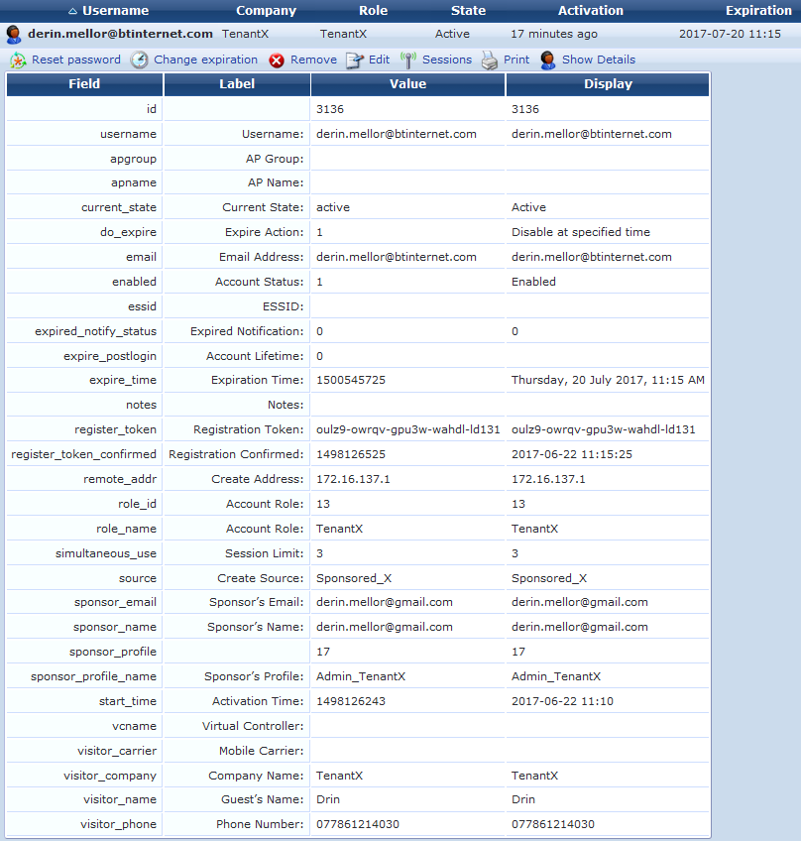
Tenant Employee Account Details
TenantX role to be applied

Slide 12
Guest Login
Having hit login
Device placed into the Guest VLAN

Slide 13
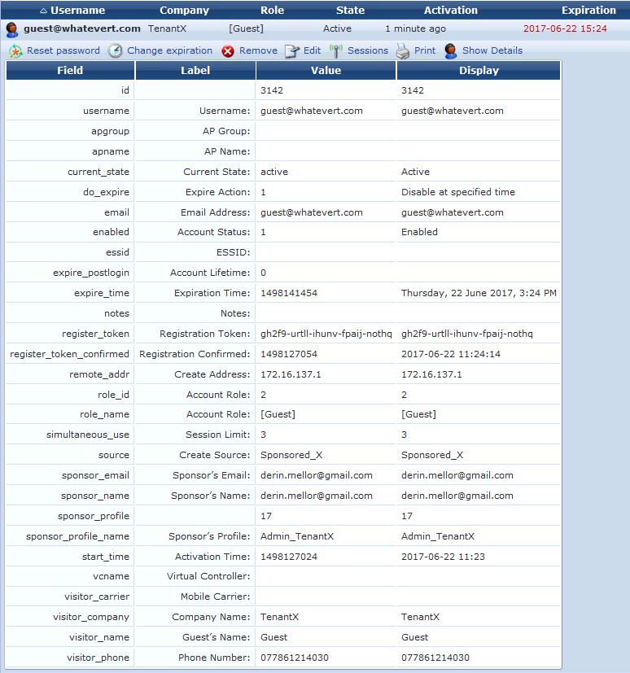
Guest Account Details
Guest role to be applied

Slide 14
TenantX Employee Guest Account Management

Slide 15
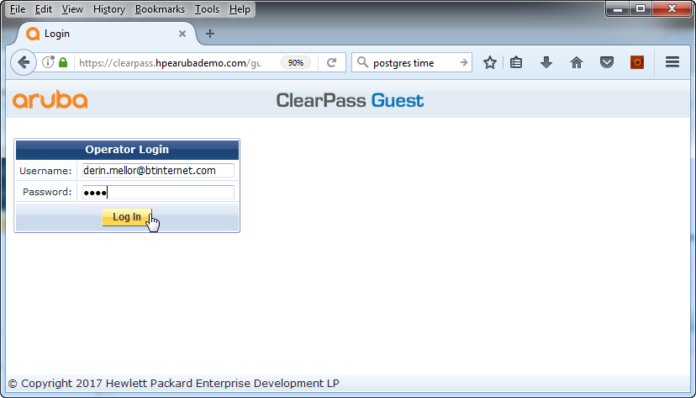
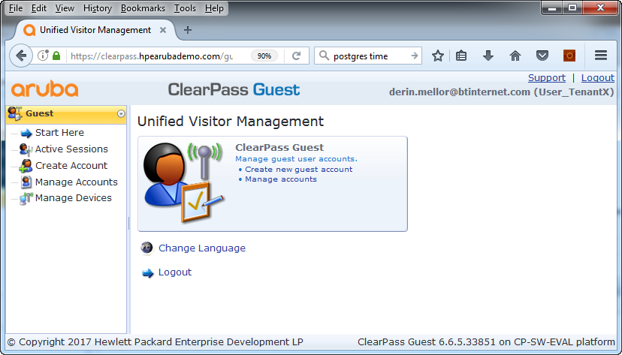
TenantX Employee CPG Login
User at TenantX

Slide 16
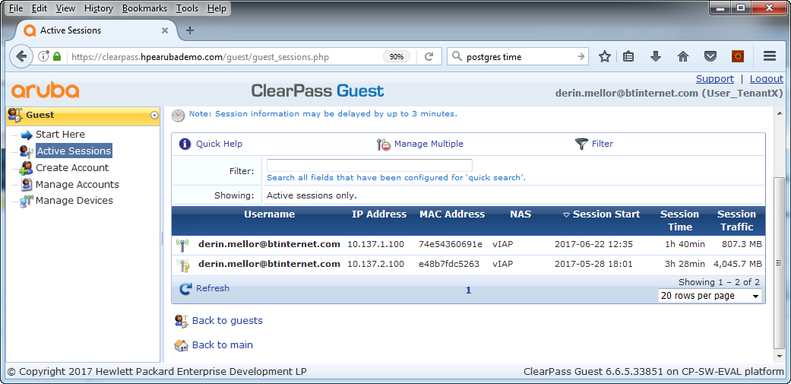
Active Session: TenantX and Guests

Slide 17
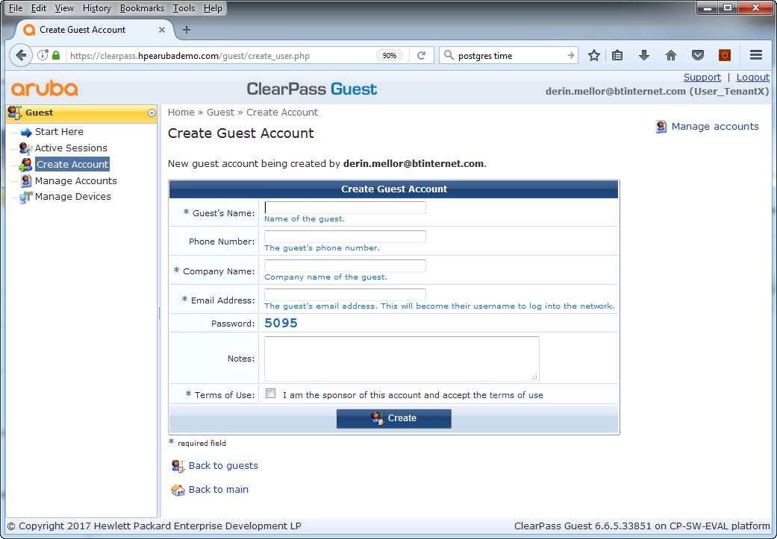
Create Guest Account
Only creates a guest account
Default this account can support up to 3 devices

Slide 18
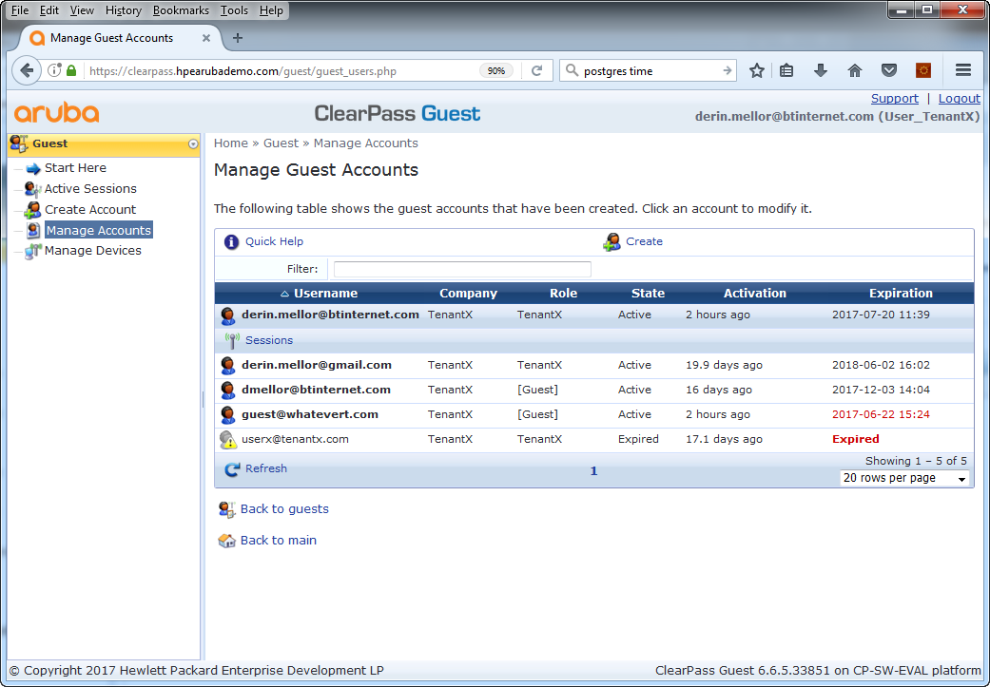
View Accounts: TenantX Employees and associated Guests

Slide 19
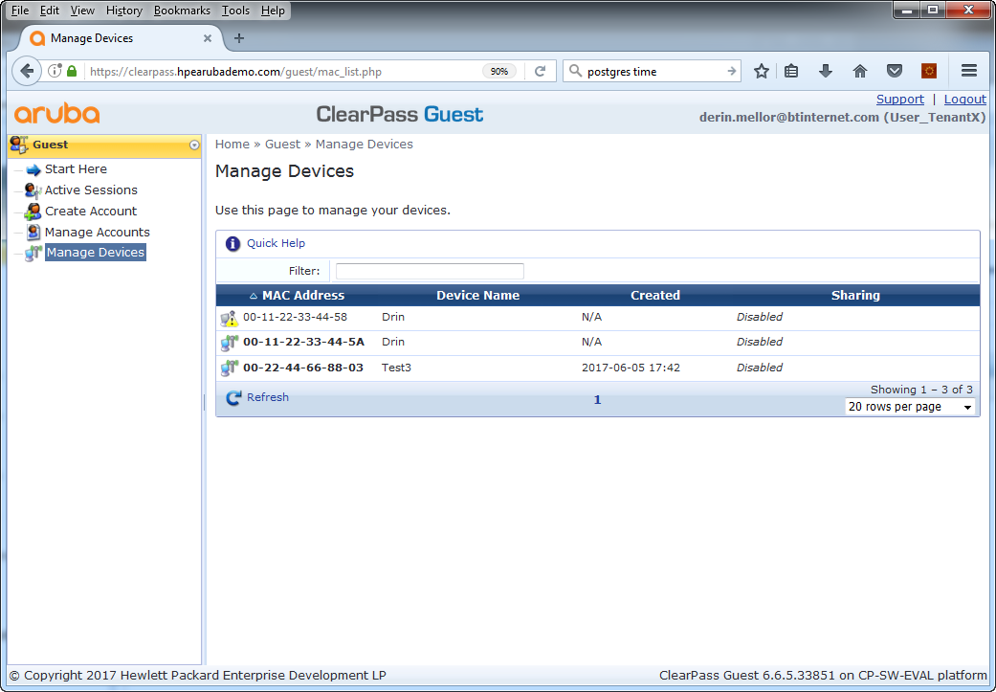
View TenentX non-802.1X Devices

Slide 20
TenantX Employee Sponsor Register Device

Slide 21
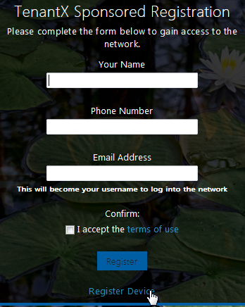
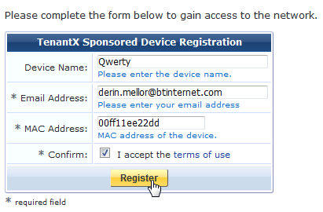
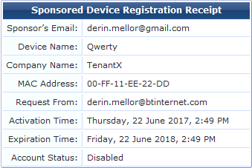
Sponsored Device Registration - 1
Device is disabled until sponsored by admin at TenantX

Slide 22
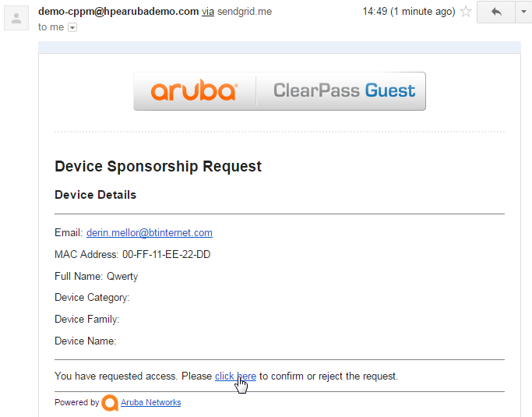
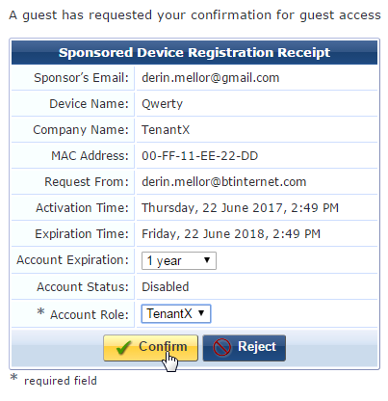
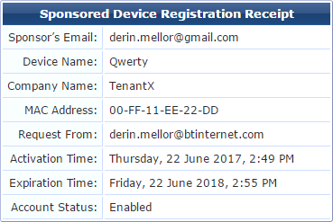
Sponsored Device Registration - 2
Expiry times
His/her Tenant company or Guest

Slide 23
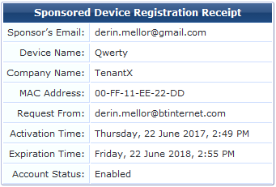
Sponsored Device Confirmation
After confirmation: page refreshes
Could send an email on Confirmation?
Correct expiry time
Enabled

Slide 24
Device Connection
Device can be connected to the Open SSID or wired port and will be assigned the appropriate TenantX “insecure” VLAN

Slide 25
Tenant Creation

Slide 26
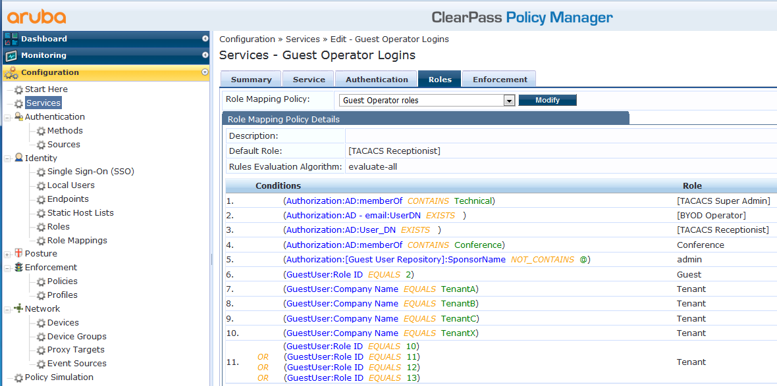
Policy Manager
Login to Policy Manager with suitable ServiceProvider Administrator Account
This has full access to Policy Manager
Administrator had suitable AD group membership

Slide 27
Create Tenant Admin Account - 1
@Policy Manager: Create Tenant’s role
Add new Tenant Role

Slide 28
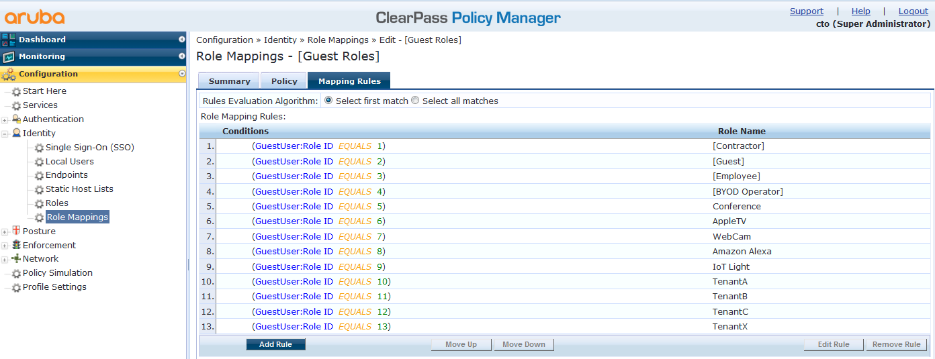
Create Tenant Admin Account - 2
@Policy Manager: Add RoleMapping
Add new Tenant into the [Guest Roles] “RoleMapping”
Assumes role starts with “Tenant”
Incremental

Slide 29
Create a Tenant in CPG
Login to CPG using a suitable ServiceProvider Administrator Account
This has full access to CPG
Administrator had suitable AD group membership

Slide 30
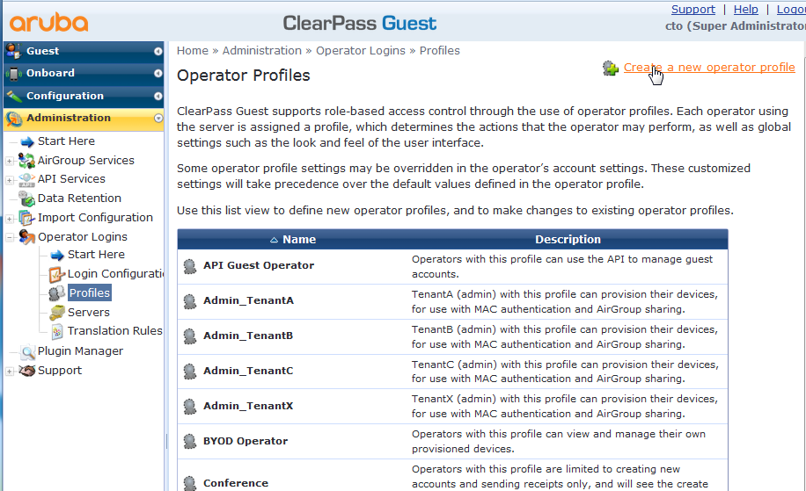
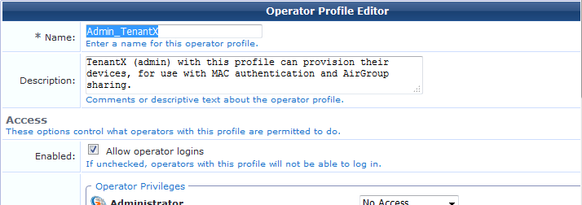
Create Tenant Admin Account - 1
@CPG: Create Tenant’s Admin Profile
NOTE: Easier to copy existing one an correct…

Slide 31
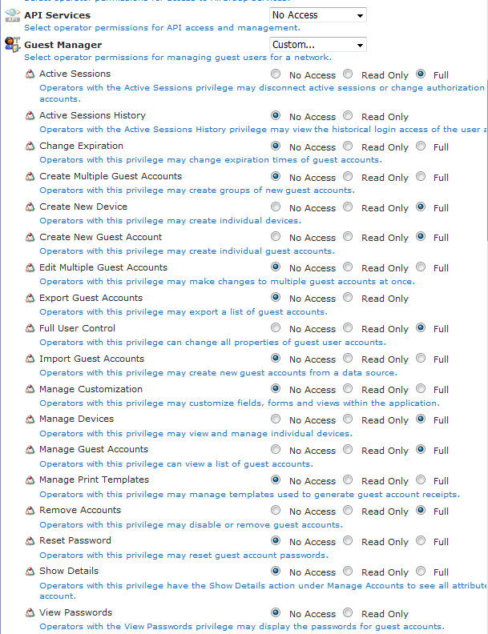
Create Tenant Admin Account - 2

Slide 32
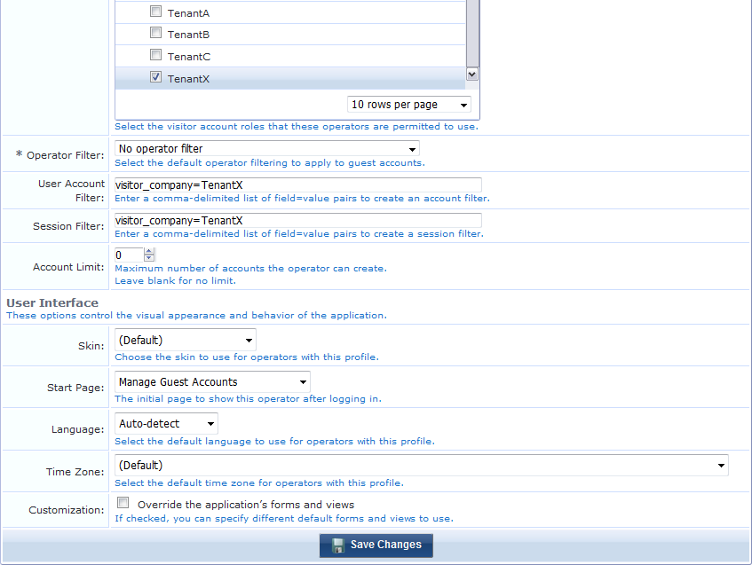
Create Tenant Admin Account - 3
Only allows them to create Guest and TenantX accounts
Only view/edit/delete accounts with TenantX

Slide 33
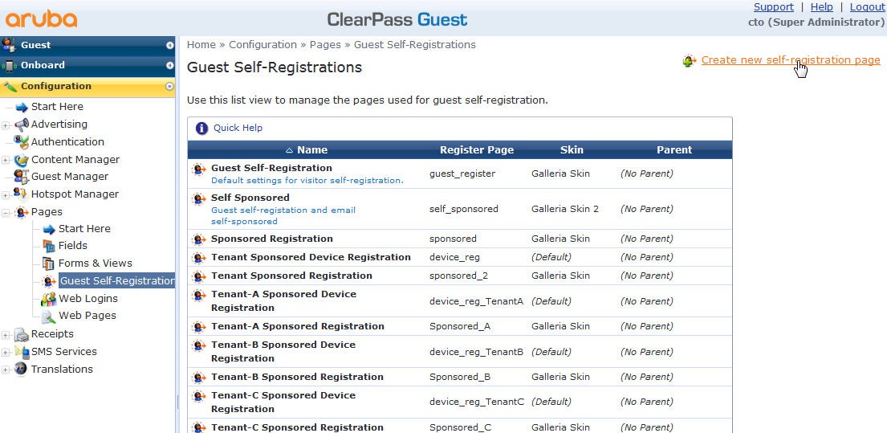
Create Tenant Admin Account - 4
NOTE: Easier to copy existing one an correct…

Slide 34
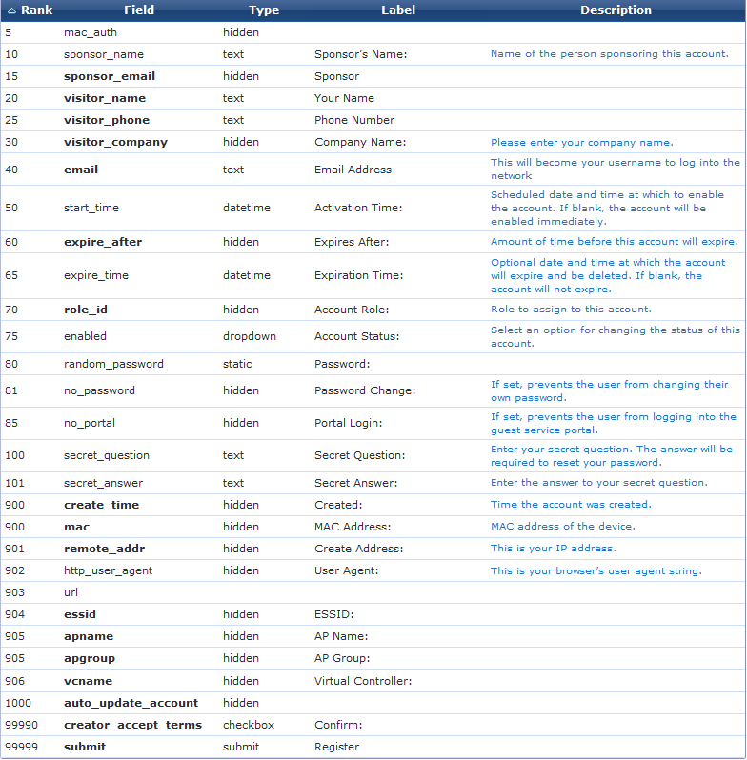
Create Tenant Admin Account - 5
Specify the Tenant admin email – sponsorship request will be sent to this
Set initial value to Tenant’s Role# TenantX=13

Slide 35
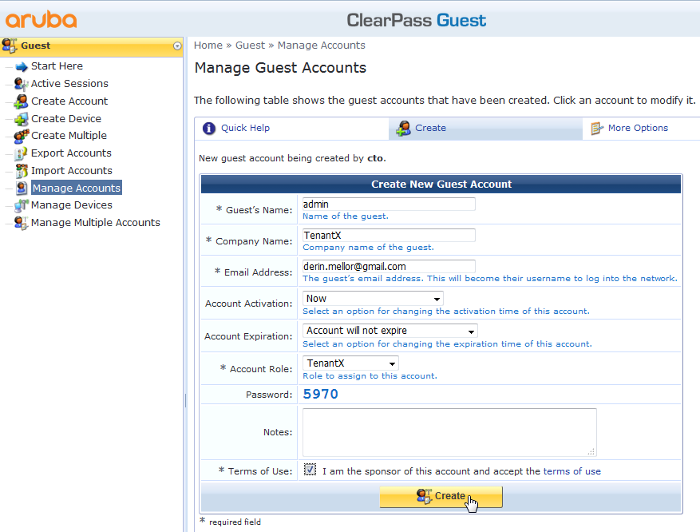
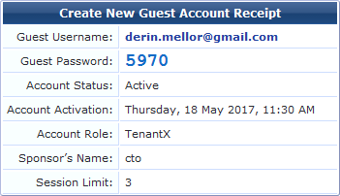
Create Tenant Admin Account - 6
@CPG: Create Tenant’s Admin Account
Complexity of the password can be changed
The fact this has the Sponsor Name of Sangar employee indicates this is an Admin account

Slide 36
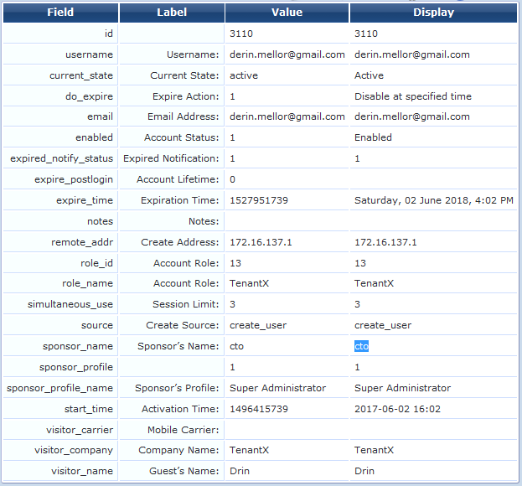
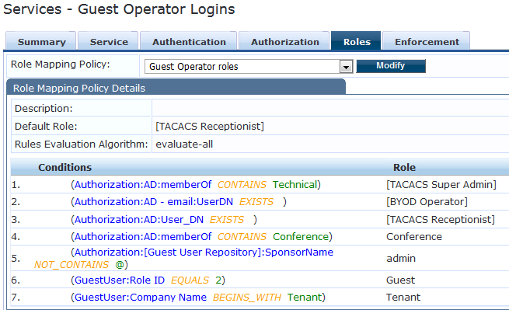
Create Tenant Admin Account – 6a
Policy Manager “Guest Operator Logins” RoleMapping
This is key as if it is created by the Service Provider ie TenantX Administrator the Sponsor is not an email address
Accounts created by the TenantX Admin will have a Sponsor_name = this admin’s email addresss

Slide 37
TenantX Admin CPG Login

Slide 38
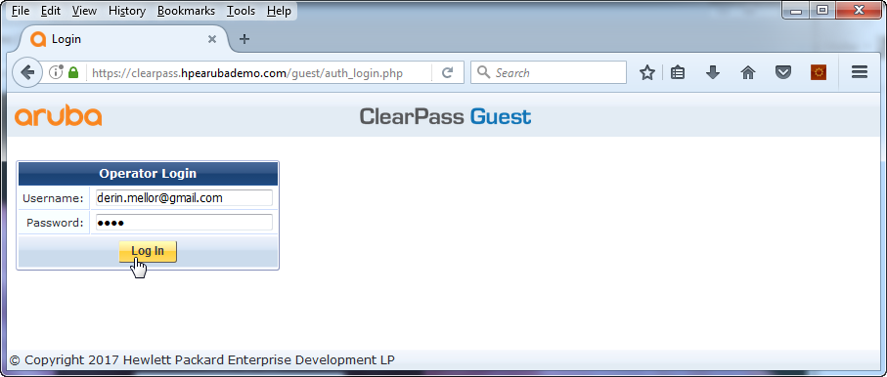
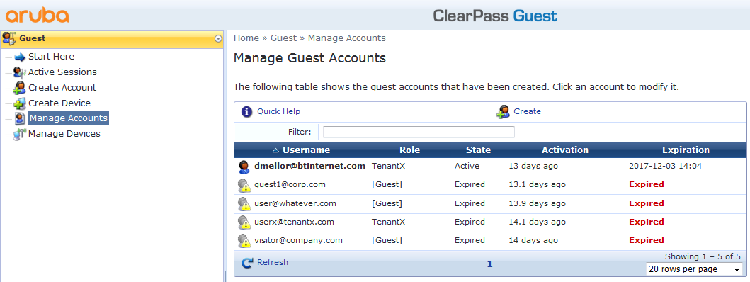
TenantX Admin Login to CPG
Must have access to ClearPass
This will only report account created by administrators for this Tenant

Slide 39
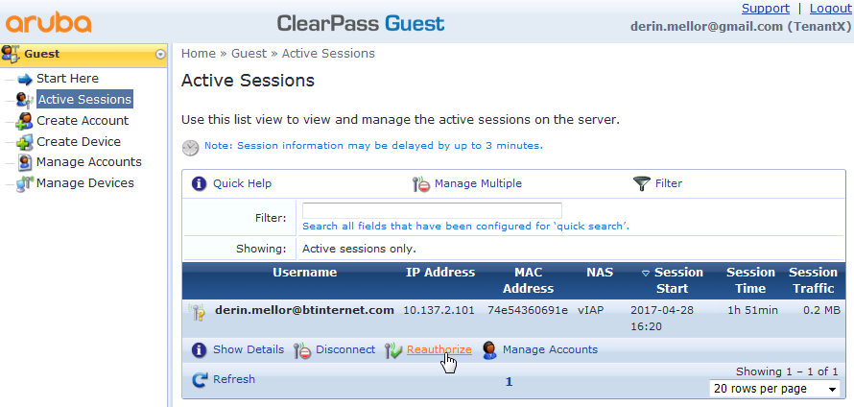
TenantX Admin Active Sessions

Slide 40
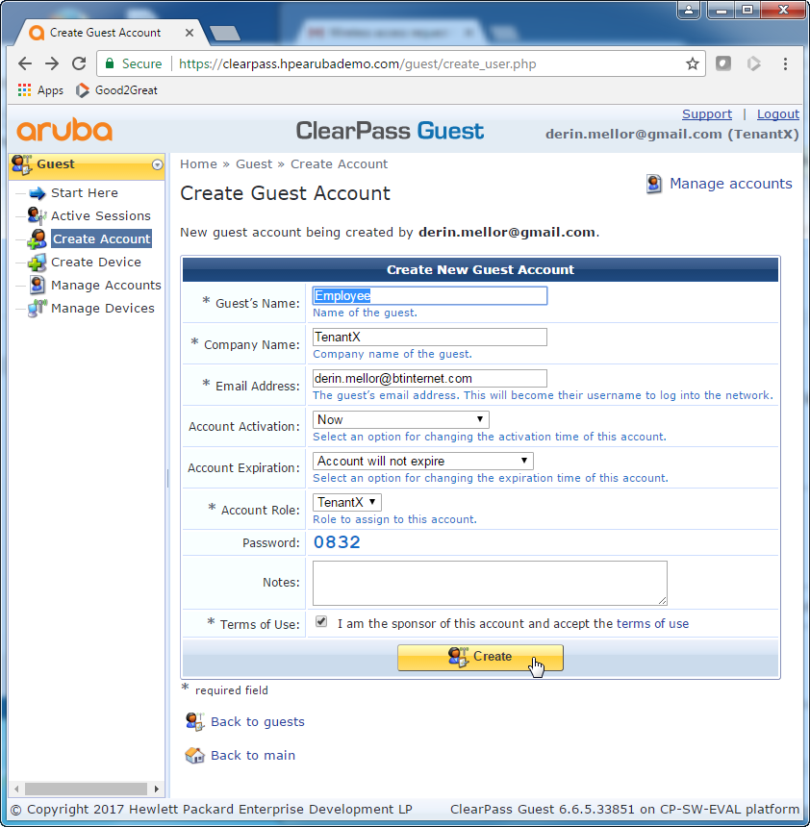
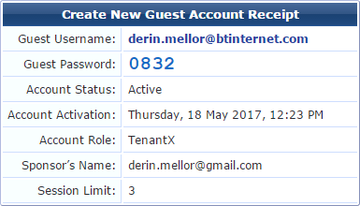
TenantX Admin Create Employee/Guest Account
Full flexibility on account duration
MUST specify the associated tenant company name!
Can create TenantX or Guest accounts only

Slide 41
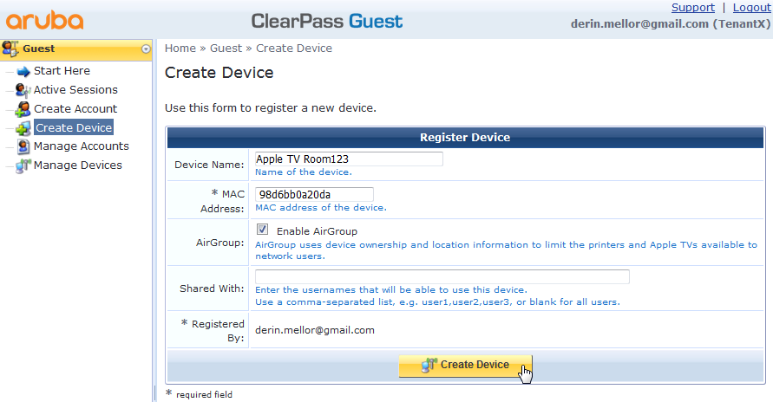
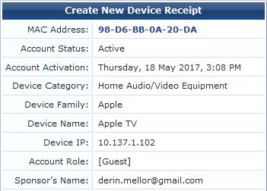
TenantX Admin Create Device

Slide 42
TenantX Admin Manage Employee/Guest Accounts

Slide 43
TenantX Admin Manage Device Accounts

Slide 44
Reporting
TBC

