Slide 1
ClearPass 6.4 TOI
Brisbane Release
Version 1.1, 9/15/2014

Slide 2
OnGuard: Connectivity Tests
Feature #21647
Related feature: 22943
OnGuard Agent now performs the following tests:
ICMP Echo (ping) to ClearPass
Traceroute to ClearPass
SSL connectivity to ClearPass (TCP 443)
Control channel availability to ClearPass (TCP 6658)
Also checks internal communication between OnGuard frontend and backend
Locahost on TCP 25427

Slide 3
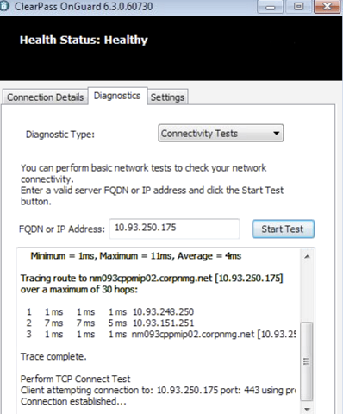
OnGuard: Connectivity Tests

Slide 4
OnGuard: Admin Control of Agent UI
Feature #19320
Related Features: #24072, #24073
Hide Quit button on agents for Windows and Mac
New option in the Agent Enforcement Profile

Slide 5
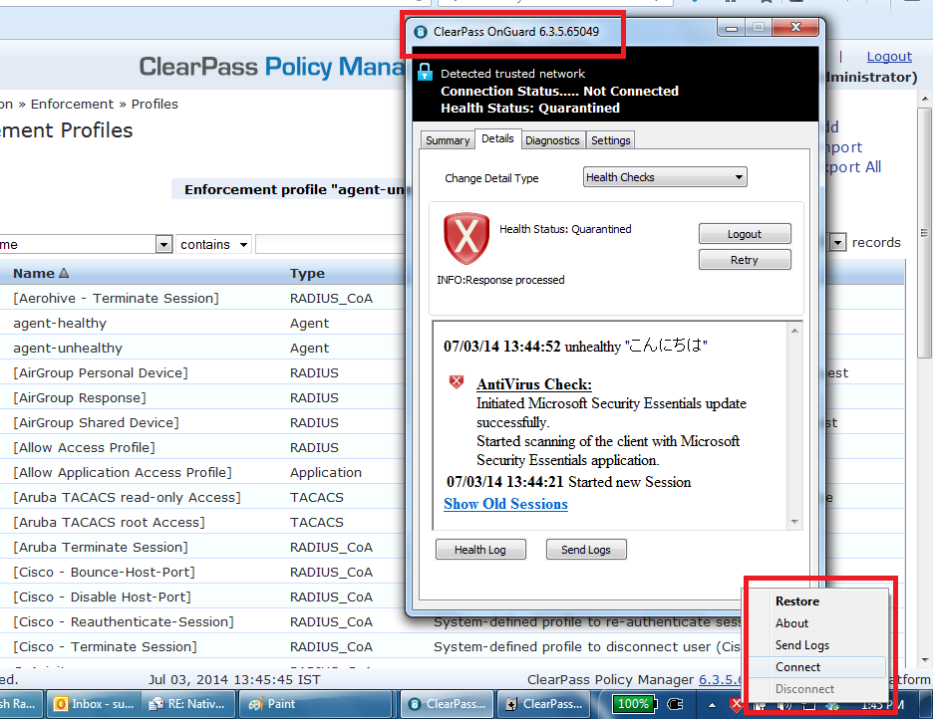
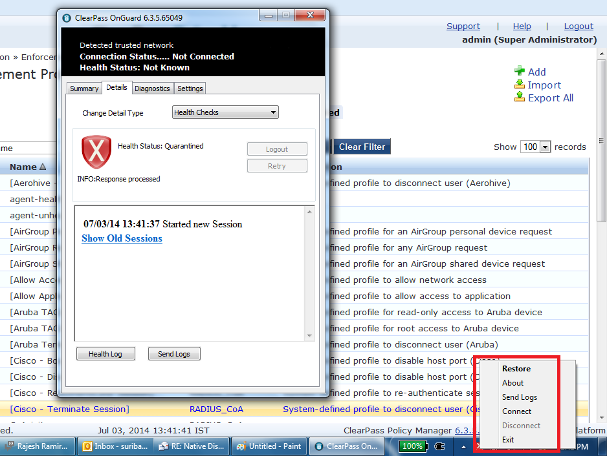
OnGuard: Admin Control of Agent UI

Slide 6
OnGuard: Dissolvable Agent
Adds support for a native application to run OnGuard DA instead of Java
Only supported on OSX and Windows
DMG on OSX, EXE on Windows
Supports 3 modes for backwards compatibility and interoperability:
Native Agent Only
With automatically detect Linux and provide Java
Native Agent with Java Fallback
Provides links to both for all OSs
Java Only
Same as pre-6.4 behavior

Slide 7
OnGuard: Dissolvable Agent
User will be required to download and launch the agent only once
The first time they connect to the network or start health check
Once installed, the Guest Page will launch the agent automatically
Agent will persist on user’s machine
Java-based agent is still an option
Because no native dissolvable agent for Linux

Slide 8
OnGuard: Workflows/Configuration Enhancements
New “Login Method” called “Policy-Initiated”
This prevents the need for a service in CPPM to initiate a CoA from weblogin page.
Relies on other service (i.e., OnGuard service) to initiate CoA or policy change
Mimics what solution looked like pre-6.3, 6.3 we needed an extra service.
New “Authentication Method” called “Auto”
This prevents the need to code in a “click here” button (or require login) to do an anonymous login to get user to OnGuard DA (6.3 behavior).
With this set, user is redirected directly to OnGuard DA health check, no login, no buttons and when combined with the above, no service needed for weblogin authentication.

Slide 9
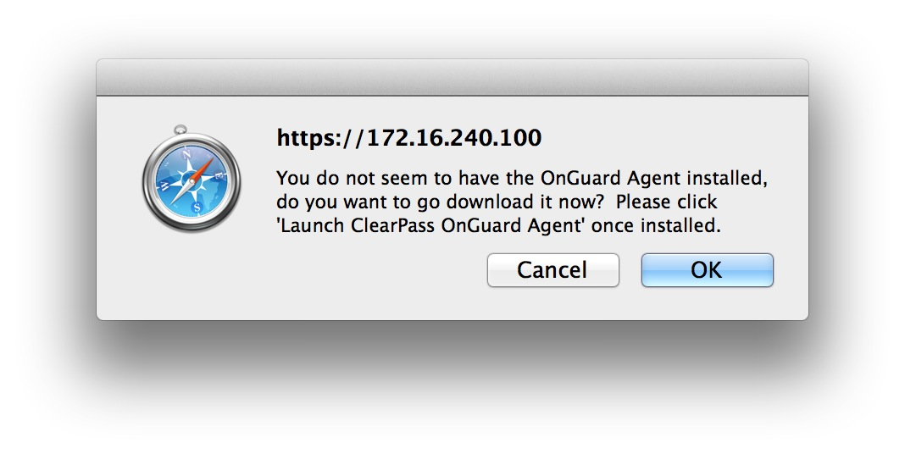
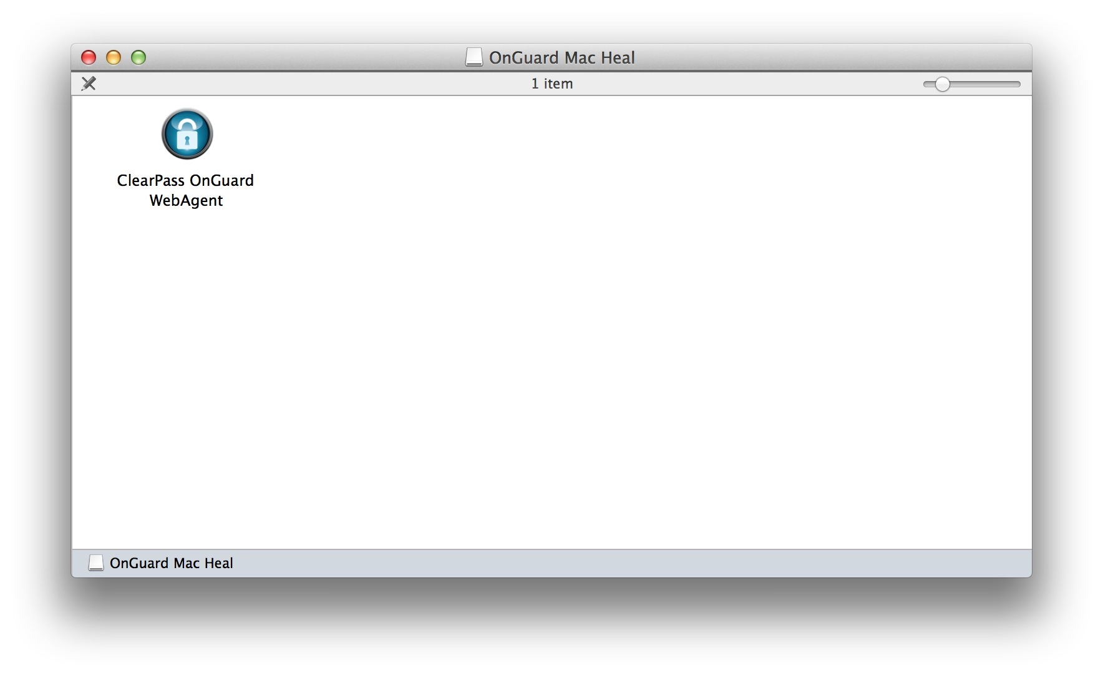
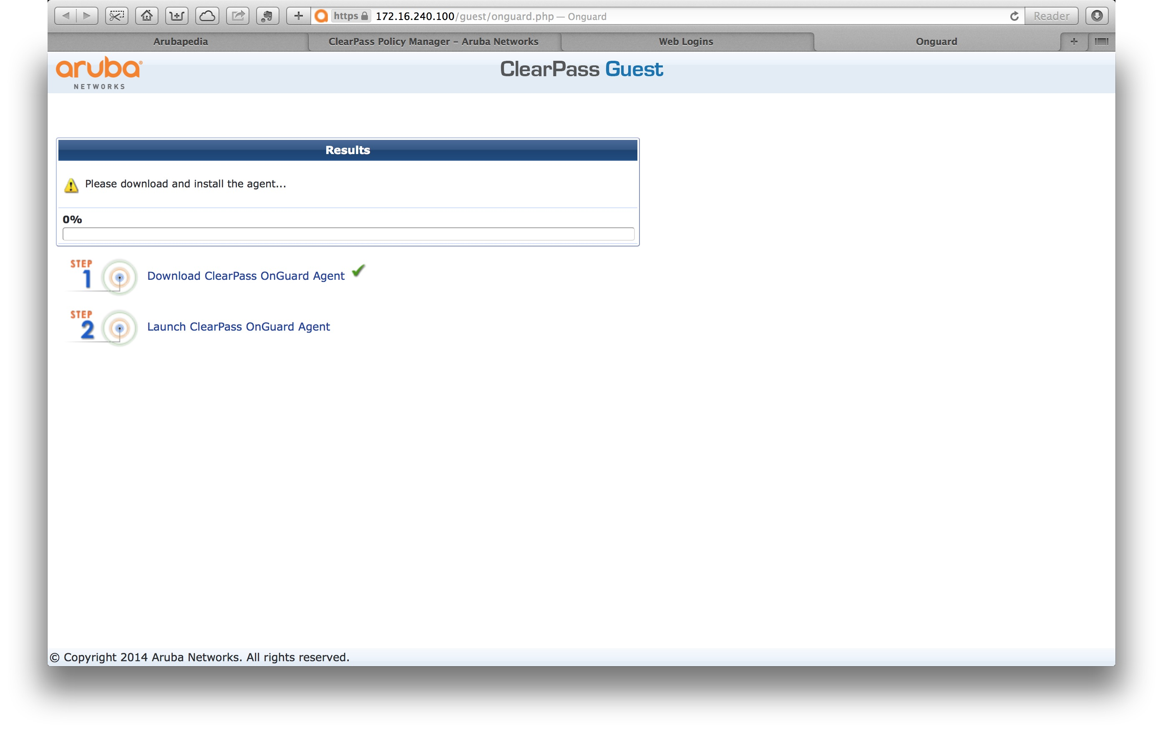
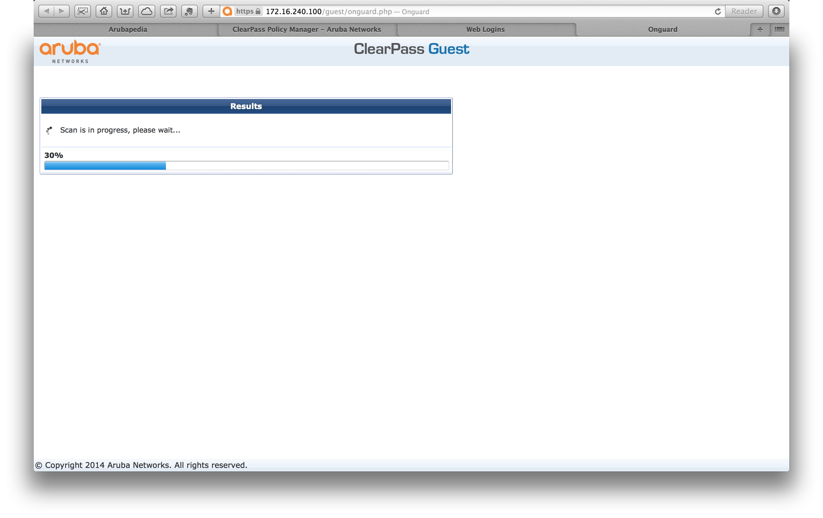
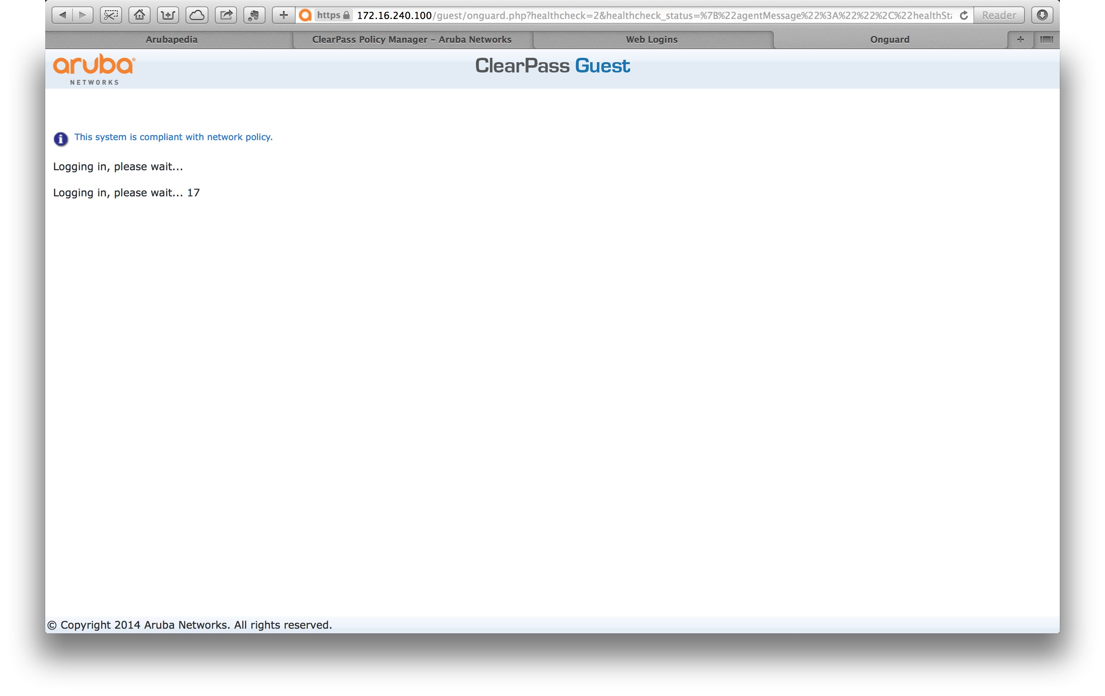
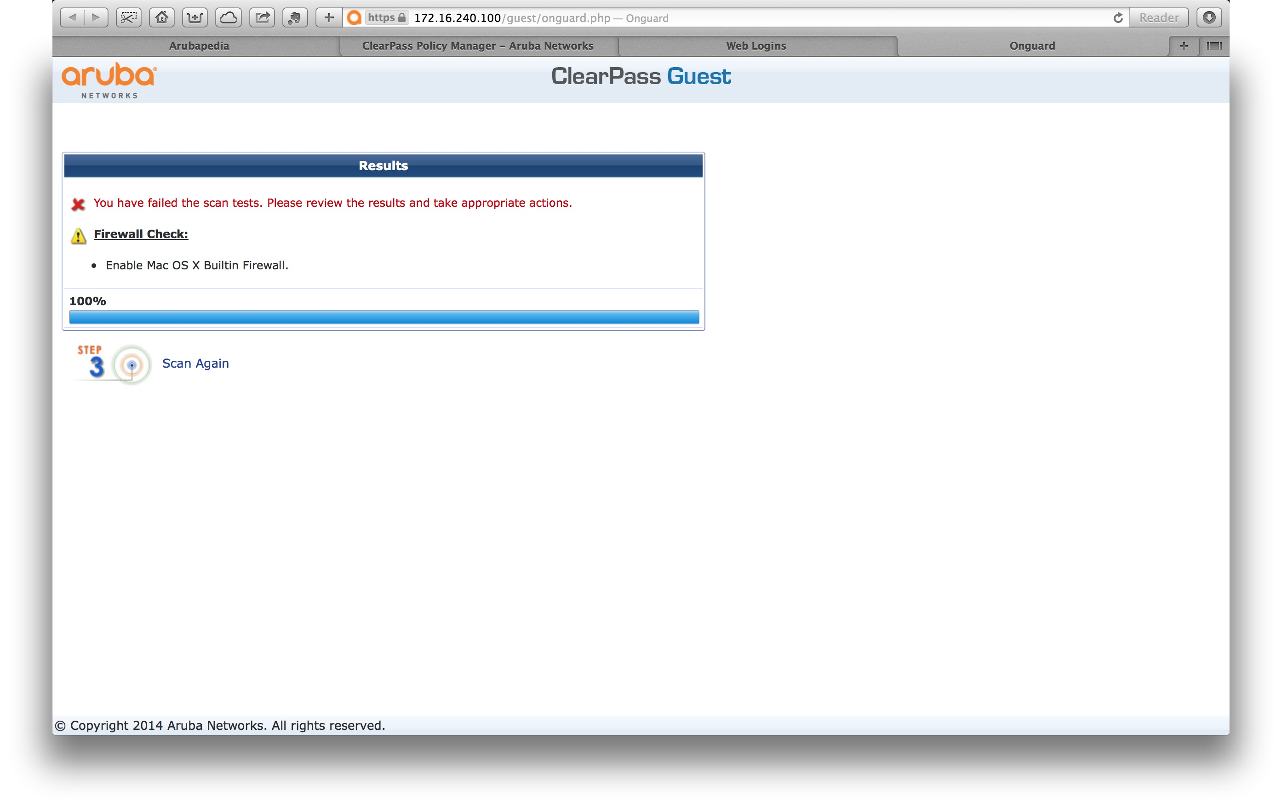
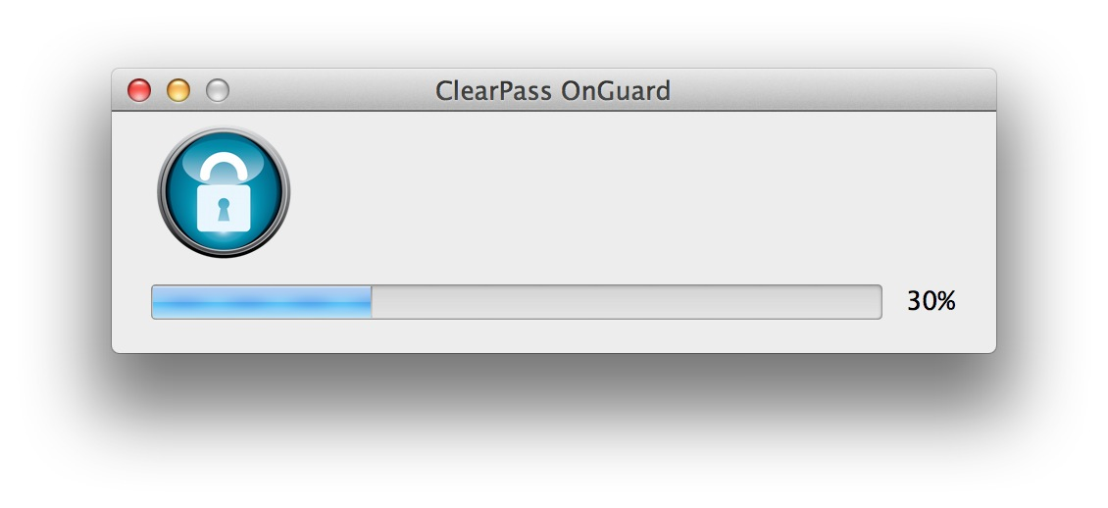
OnGuard DA Example

Slide 10
OnGuard DA: Tips and Tricks
Use Agent Message Enforcement Profile to overwrite messages seen on success or failure page
Set Login Delay to more than default of “0” to present the message before redirect to welcome page (on success)
Also helps ensure that CoA and reauth takes place before client tries to open welcome page
To start from scratch during demo/eval, delete installed OnGuard browser plugin or OnGuard application
Agent installation does not require admin rights as an FYI

Slide 11
OnGuard: Dissolvable Agent Differences
Key differences between DA and PA
DA does not support auto-remediation
DA does not continuously monitor system health
DA is launched on-demand by Health Check Portal
DA performs health checks and exits

Slide 12
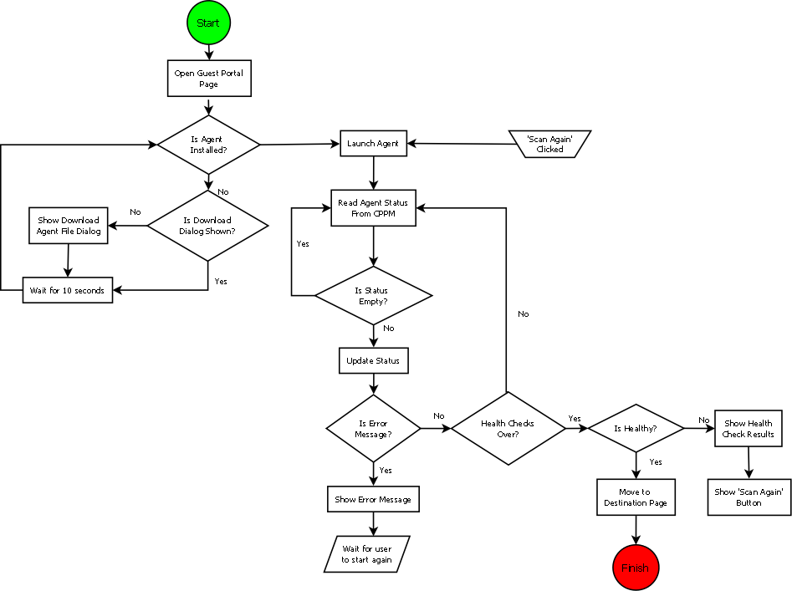
OnGuard: Native Dissolvable Agent Workflow

Slide 13
Notes:
Make networks mobility-defined instead of fixed

