Slide 1
DHCP Fingerprinting - David Westcott

Slide 2
Resources
http://community.arubanetworks.com/t5/Discuss/ct-p/discuss
Search Airheads for “dhcp fingerprint”
http://www.networksorcery.com/enp/protocol/bootp/options.htm
List of DHCP options
www.fingerbank.org
Database of DHCP fingerprints

Slide 3
What Is DHCP Fingerprinting?
Passively identifies the client OS signature
Examines DHCP option information
Differentiates devices that use the same network
Instead of creating separate networks for each
Requires ArubaOS 6.0.1.0 or newer
Supported on 600, 3000, and M3 controllers

Slide 4
Fingerprinting Process
Identify the device value of the DHCP option
Create a firewall role
Write and apply a user derivation rule
Test the rule

Slide 5
Identifying The Device Signature
Enable DHCP debugging
# configure terminal
# logging level debugging network subcat dhcp

Slide 6
Make Sure The Client Is Disconnected
Make sure that the client is disconnected
# aaa user delete mac <client mac address>

Slide 7
Identify The Client Signature
Attach the client to the WLAN
View the log and look for the signature
#show log network all | include Option
Apr 23 07:01:55 :202536: <DBUG> |dhcpdwrap| |dhcp| Datapath vlan1: REQUEST 00:0d:4b:78:9f:07 reqIP=192.168.1.242 Options 36:c0a80103 37:0103060f0c 0c:4e502d4b3041304458303236373936
Apr 23 07:01:55 :202536: <DBUG> |dhcpdwrap| |dhcp| Datapath vlan1: REQUEST 00:0d:4b:78:9f:07 reqIP=192.168.1.242 Options 36:c0a80103 37:0103060f0c 0c:4e502d4b3041304458303236373936

Slide 8
Identify DHCP Option
Apr 23 07:01:55 :202536: <DBUG> |dhcpdwrap| |dhcp| Datapath vlan1: REQUEST 00:0d:4b:78:9f:07 reqIP=192.168.1.242 Options 36:c0a80103 37:0103060f0c 0c:4e502d4b3041304458303236373936
Apr 23 07:01:55 :202536: <DBUG> |dhcpdwrap| |dhcp| Datapath vlan1: REQUEST 00:0d:4b:78:9f:07 reqIP=192.168.1.242 Options 36:c0a80103 37:0103060f0c 0c:4e502d4b3041304458303236373936
Search log output, looking for options 0c, 37, 3c, or 51
Combine option and signature value, removing the colon
eg. 37:0103060f0c becomes 370103060f0c

Slide 9
Common Option 55 Signatures
OS Match Option Match Type Fingerprint
(dec/hex)
Android 2.x 55/0x37 starts-with 37017921030
Android 2.3 55/0x37 equals 3701792103061c333a3b Samsung Galaxy S with Android 2.3
Blackberry 55/0x37 equals 370103060F unknown model of Blackberry
iPhone/iPad 55/0x37 equals 370103060F77FC Common to most Apple i-devices
Macbook 55/0x37 equals 370103060F775FFC2C2E2F Apple Mac Book (assumed OS X)
Maemo OS 55/0x37 equals 370103060c0f111c28292a Nokia N900 running Maemo OS
Nintendo DS 55/0x37 equals 37010306
Playstation 3 55/0x37 equals 3701031c060f
Symbian OS 55/0x37 equals 370C060F01031C78 Nokia N97 / SonyEricsson
Win Mobile 6.x 55/0x37 equals 370103060f2c2e2f Seen on HTC phones with Win Mobile 6.x
Win XP 55/0x37 equals 37010f03062c2e2f1f21f92b exact match on WinXP
Win Vista 55/0x37 equals 37010f03062c2ef1f2179f92b exact match on Vista
Win 7 (korean) 55/0x37 equals 37010f03062c2ef1f2179f92b exact match on Win7 (korean edition)
Win 7 (eng) 55/0x37 equals 37010f03062c2ef1f2179f92b exact match on Win7
Win (Multiple) 55/0x37 starts-with 37010F03062C2E2F1 Generic multi-version "windows"

Slide 10
Common Option 60 Signatures
OS Match Option Match Type Fingerprint
(dec/hex)
Android 2.x (multiple) 60/0x3c starts-with 3c6468637063642034 partial match on “dhcpcd 4” – caution: may match
some linux
BlackBerry 60/0x3c equals 3c426c61636b4265727279 match 'BlackBerry' option
Maemo OS 60/0x3c starts-with 3c756468637020302e392e39 partial match on "udhcpd 0.9.9", used in
Nokia N900 Phones
Windows CE 60/0x3c equals 3c4d6963726f736f66742057696e646f777320434500 match "Microsoft Windows CE"
- this may match MANY devices
Windows (Multiple) 60/0x3c equals 3c4D53465420352E30 match multiple windows versions with “MSFT 5.0”

Slide 11
Not So Common Signatures
OS Match Option Match Type Fingerprint
(dec/hex)
Cisco 1750 55/0x37 equals 3701060F2C0321962B cisco 1750 VPN
Linux generic 55/0x37 starts-with 37011C02030F0677 Debian/Linux 2.6 generic
Linux (unknown) 55/0x37 equals 37011C02030F06770C2C2F1A792A tbd
Linux Debian 2.6.35 55/0x37 equals 37011c02030f06770c2c2f1a Backtrack 4 R2 dhclient
Palm PDA 55/0x37 equals 37011C02030F060C unknown model of Palm
Samsung s8000 55/0x37 starts-with 370102030405060708090C0D0F1011171A1C2A2C3233353638
Win CE Casio Scanner 55/0x37 equals 370103060F2C2E2F unknown model of Casio scanner
Win CE Symbol Scanner 55/0x37 equals 370103060F2C2E2F4243 unknown model of Symbol scanner

Slide 12
Create Firewall Role For The Device
# config terminal
# user-role roku
# access-list session allowall
# exit

Slide 13
Create Firewall Derivation Rule (CLI)
# config t
# aaa derivation-rules user wc-user-rules
# set role condition dhcp-option equals “370103060f0c” set-value roku
# exit

Slide 14
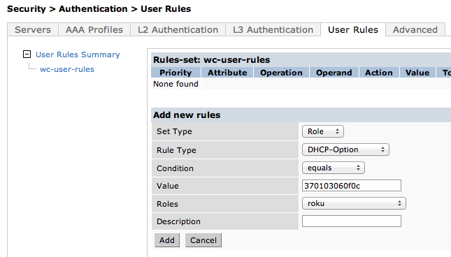
Create Firewall Derivation Rule (WebUI)

Slide 15
Attach Derivation Rule To AAA Profile (CLI)
# config terminal
# aaa profile <aaa profile name>
# user-derivation-rules wc-user-rules
# exit

Slide 16
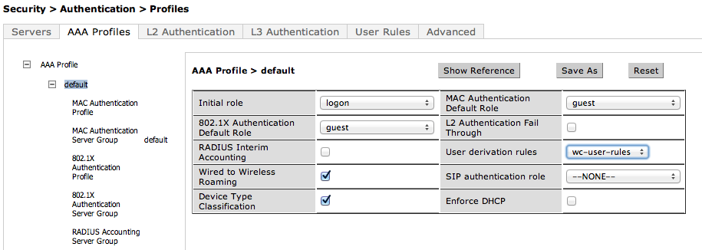
Attach Derivation Rule To AAA Profile (WebUI)

Slide 17
Configure Logging To Monitor The Client Connection
# config terminal
# logging level debug user-debug <client mac address>
# exit

Slide 18
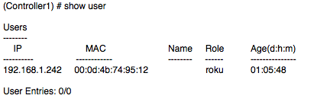
Verify The User Connected To The Right Role
show log user-debug all | include <mac address of client>
Apr 22 13:01:58 :522026: <INFO> |authmgr| MAC=00:0d:4b:78:9f:07 IP=0.0.0.0 User miss: ingress=0x10ca, VLAN=1
Apr 22 13:01:58 :522004: <DBUG> |authmgr| MAC 00:0d:4b:78:9f:07, dhcp option 50, signature 32C0A801F2
Apr 22 13:01:58 :522004: <DBUG> |authmgr| MAC 00:0d:4b:78:9f:07, dhcp option 54, signature 36C0A80103
Apr 22 13:01:58 :522004: <DBUG> |authmgr| MAC 00:0d:4b:78:9f:07, dhcp option 55, signature 370103060F0C
Apr 22 13:01:58 :522019: <INFO> |authmgr| MAC=00:0d:4b:78:9f:07 IP=0.0.0.0 Derived role 'Roku' from user rules: utype=L2

Slide 19
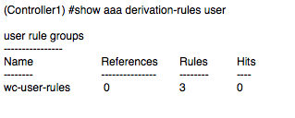
Show How Many Time Rule Was Triggered
# show aaa derivation-rules user

Slide 20
Common Rules (CLI)
aaa derivation-rules user wc-user-rules
set role condition dhcp-option equals "370103060f0c" set-value roku
set role condition dhcp-option equals "370103060F" set-value blackberry
set role condition dhcp-option equals "3701031c060f" set-value playstation3

Slide 21
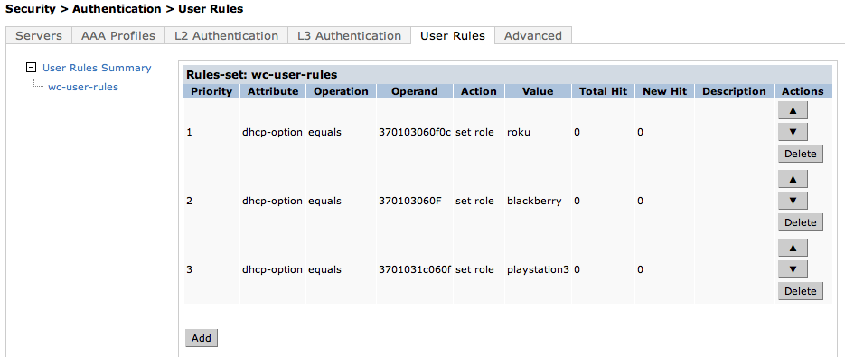
Common Rules (Example-WebUI)

