Slide 1
ARUBA AIRWAVE
Vishnu Mannil
June 20th, 2016

Slide 2
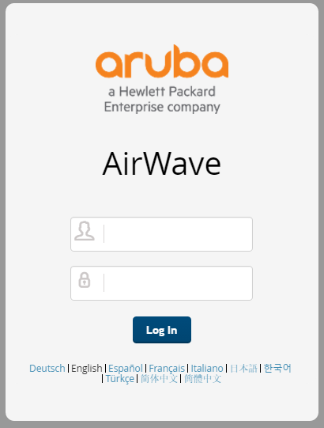
What is Airwave?
AirWave is a powerful and easy-to-use network operations system that not only manages wired and wireless infrastructures from Aruba/HPE but also wide range of third-party manufacturers, and also provides granular visibility into devices, users and applications running on the network.
Notes:
AirWave 8.2 is the only network management software that offers you a single intelligent console from which to monitor, analyze, and configure wireless networks in automatic fashion. Whether your wireless network is simple or a large, complex, multi-vendor installation, AirWave manages it all.
AirWave supports hardware from leading wireless vendors including the following: l Aruba Networks® l ProCurve™ by HPE® l Avaya™ l Cisco® (Aironet and WLC) l Dell Networking W-Series l Enterasys® l Juniper Networks®
The AirWave Management Platform (AirWave) is the centerpiece of AirWave, offering the following functions and benefits: l Core network management functionality: n Network discovery n Configuration of APs & controllers 14 | Introduction AirWave 8.2 | User Guide n Automated compliance audits n Firmware distribution n Monitoring of every device and user connected to the network n Real-time and historical trend reports l Granular administrative access n Role-based (for example, Administrator contrasted with Help Desk) n Network segment (for example, Retail Store network contrasted with Corporate HQ network) l Flexible device support n Thin, thick, mesh network architecture n Multi-vendor support n Current and legacy hardware support

Slide 3
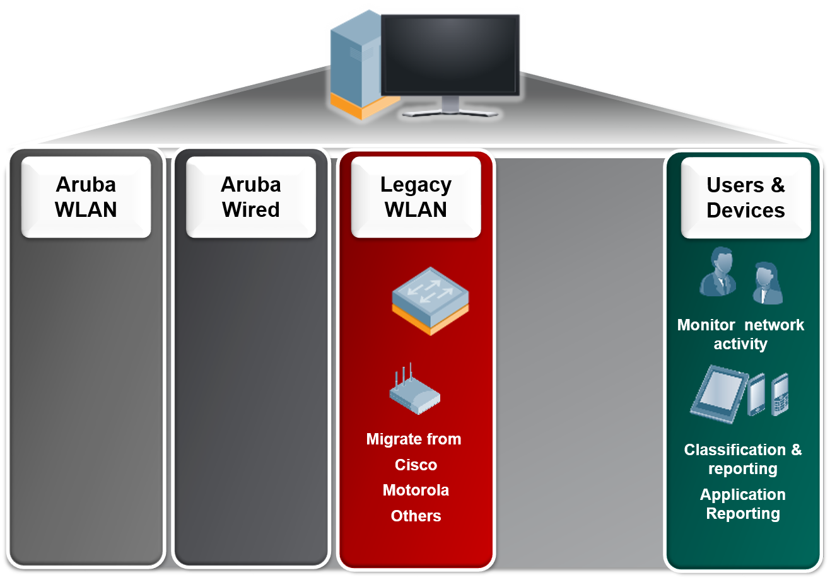
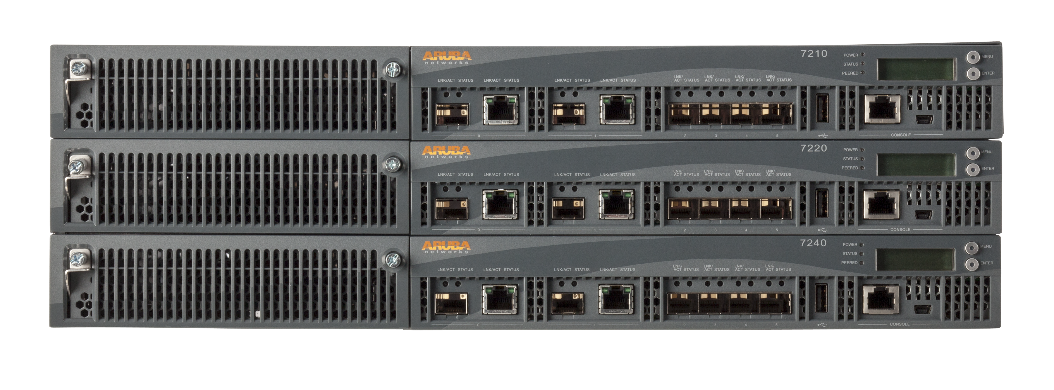
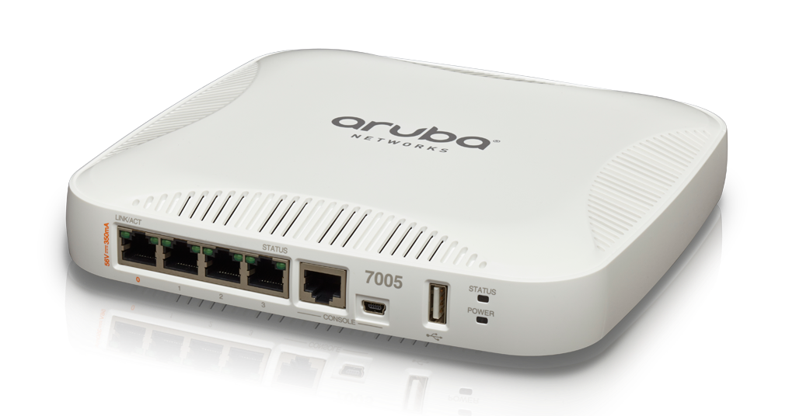
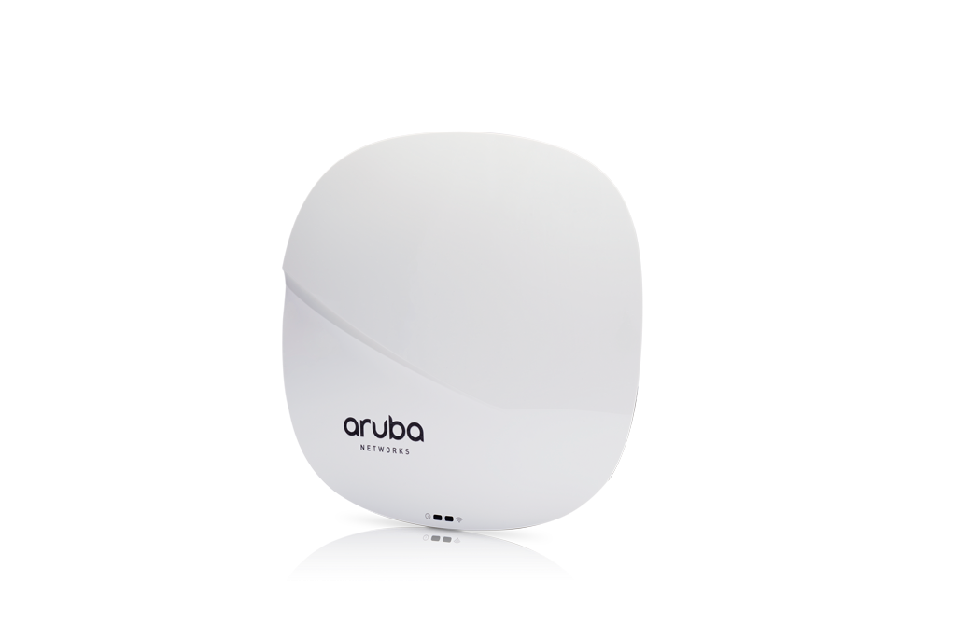
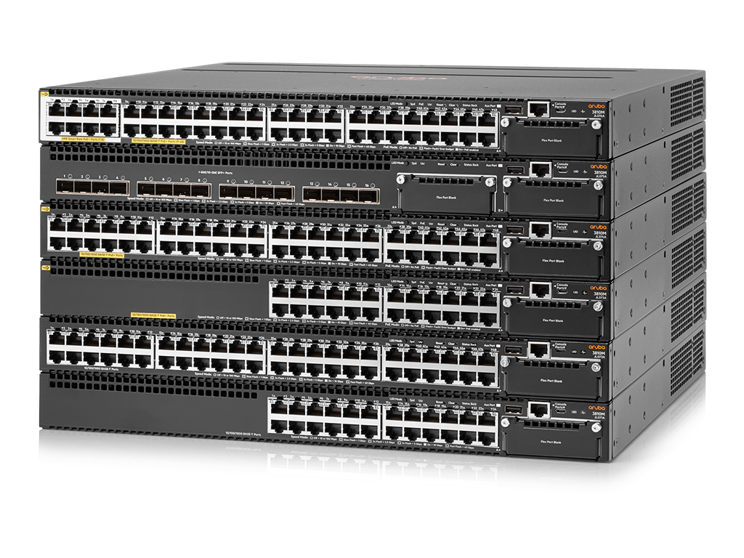
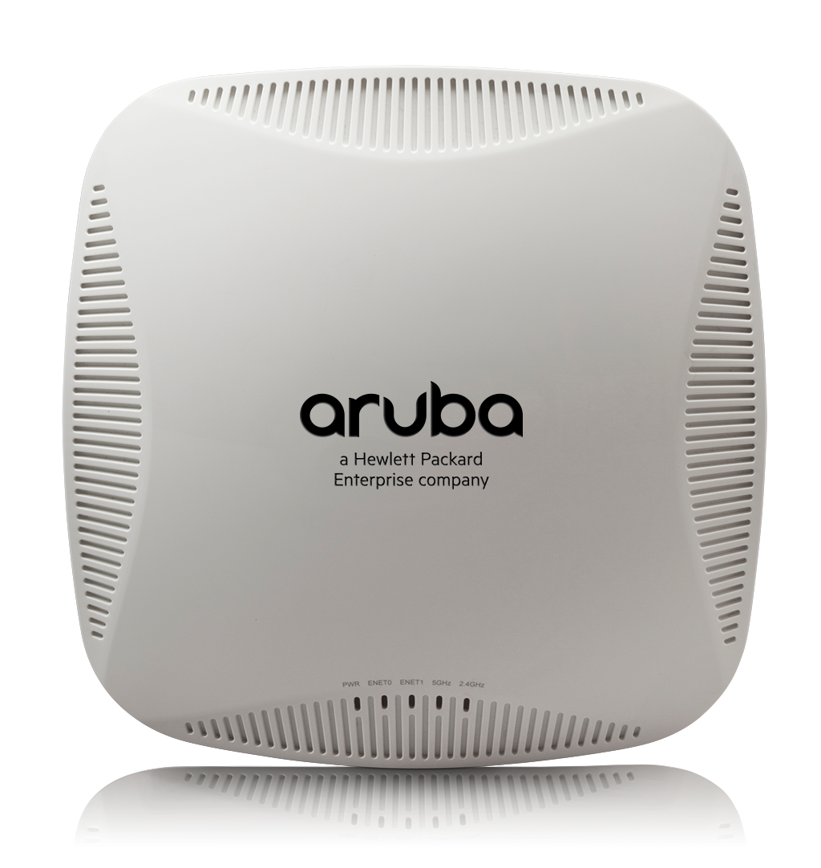
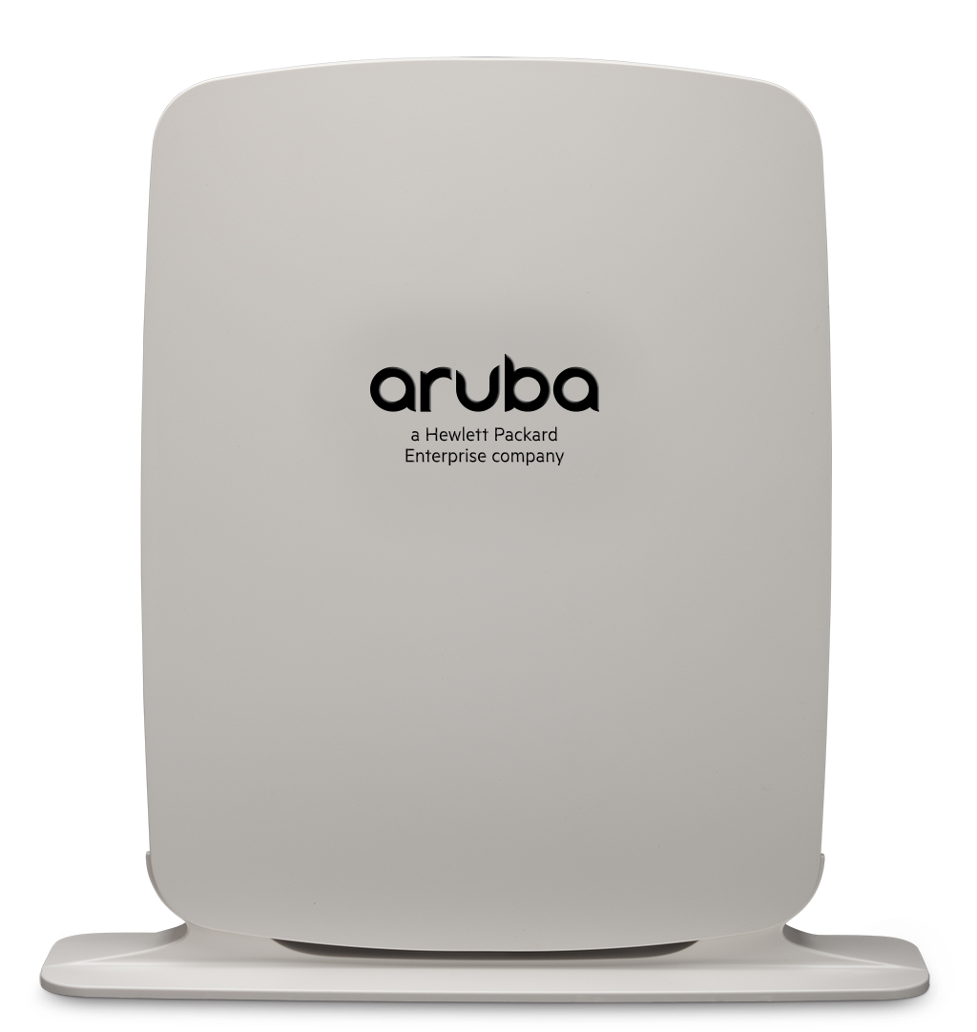
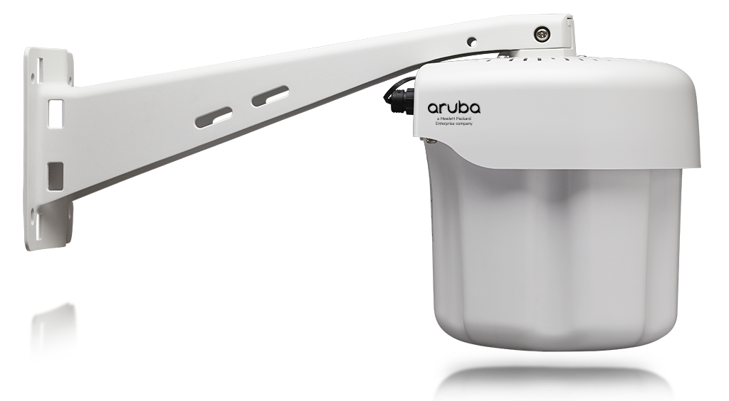
Airwave Manages it all
Multi-Vendor Network Monitoring
Real Time Monitoring And Visibility
Device Discovery
Better Network Planning And Provisioning
Troubleshooting And Diagnostics
Root Cause Analysis And Event Correlation
Configuration Management
Easy To Use Web Interface
Legacy Wired
Any MIB-II compliant device
Notes:
Key Points:
1. AirWave is a multi-vendor network monitoring tool.
2. Customers can get the most functionality when monitoring Aruba Wired and Wireless devices.
3. AirWave provides visibility and management for 3rd party devices. See the document “Supported Infrastructure Devices” for more information

Slide 4
Airwave Components
AppRF
UCC
CLARITY
CLIENT MONITORING
TRIGGER
REPORTS
RAPIDS
VISUALRF
MASTER CONSOLE
AIRWAVE FAILOVER

Slide 5
Airwave Data Collection
SNMP POLLING
SNMP TRAPS
AMON
SYSLOG
HTTPS

Slide 6
AIRWAVE Architecture AND DATA FLOW

Slide 7
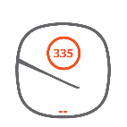
Single Server Architecture
All devices taken as count for licensing
Aruba Instant AP’s each count as a single device even though they only communicate with AirWave via HTTPS and not ICMP or SNMP
4000 devices is the maximum number of devices supported on our ENT hardware appliance.
AirWave Server
Up to 4000 devices supported
Notes:
Key Points:
Scanning, device → sertp
All devices which respond to ICMP and SNMP are treated as a device for capacity and licensing purposes.
“Stacked” switches consume licenses and capacity equal to the number of devices in the stack and not as a single entity.
Aruba Instant AP’s each count as a single device even though they only communicate with AirWave via HTTPS and not ICMP or SNMP.
4000 devices is the maximum number of devices supported on our ENT hardware appliance. This is not a hard coded limitation. It is possible to monitor more than 4000 on a single server, but this is not tested or supported by Aruba.

Slide 8
Multi Server Architecture with Master Console
AirWave Server
Up to 4000 devices supported
AirWave Server
Up to 4000 devices supported
AirWave Server
Up to 4000 devices supported
Visibility into multiple servers from place
Communication over https
Separate license key
Ability to monitor and report
AirWave Master Console
Up to 100,000 total devices supported
Notes:
Key Notes:
In order to monitor more than 4000 devices, additional AirWave servers need to be deployed.
Visibility into the combined group of AirWave servers can be achieved with an AirWave Master Console
This is a standard installation of AirWave which has been converted into a Master Console role by adding a Master Console license.
This license removes most features and leaves only the ability to monitor and report on other AirWave servers.
The AirWave Master Console communicates with the other AirWave servers over HTTPS.

Slide 9
Multi Server Architecture with Master Console and Failover
AirWave Server
Up to 4000 devices supported
AirWave Server
Up to 4000 devices supported
AirWave Server
Up to 4000 devices supported
Watches the primary servers
Takes over primary when primary goes down
Need Failover License Key
AirWave Failover Server
Watches one or more AirWave servers
AirWave Master Console
Up to 100,000 total devices supported
Notes:
Key Notes:
The AirWave failover server watches one or more AirWave servers and gathers their nightly backup on a regular basis.
In the event of a single AirWave server failure, the failover server restores the nightly backup of that failed server and becomes a standard AirWave server.
The Failover Server is a standard AirWave install which has been configured with a failover license. Most features are removed and are not restored until the failover server takes over for a failed AirWave instance.

Slide 10
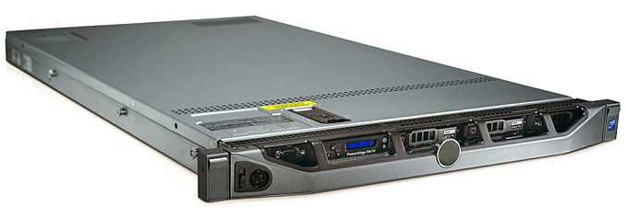
Data Flow to AirWave
AirWave
NMS
Email, SNMP, Syslog
ICMP
HTTPS
SNMP
SSH
Traps
AMON
Controller
Virtual
Controller
Uses SNMP, SSH, ICMP and AMON with Aruba Controllers
Uses HTTPS with Aruba Instant and always initiates the communication
3rd Party devices use primarily SNMP, SSH/Telnet and ICMP
Notes:
Key Points:
When used with Aruba Controllers, SNMP, SSH, ICMP and AMON are used for communication.
All new monitoring capabilities are implemented using AMON instead of SNMP.
Aruba Instant communicates with AirWave using HTTPS and always initates the communication.
All new monitoring capabilities are implemented using AMON instead of SNMP.
3. 3rd Party devices use primarily SNMP, SSH/Telnet and ICMP

Slide 11
Airwave Architecture
UI
swarm handler
report gen
database
SNMP trap recvr
AW-RRD
config gen/audit
work queue
AMON recvr
ALC workers
Visual RF
SNMP pollers
Rabbit MQ messages bus
Notes:
Key Points:
AMON is the preferred method of monitoring Aruba products because the data comes in realtime and has less overhead compared to polling or SNMP traps.
2. Using AMON reduces the CPU load on the controller, whereas using SNMP can increase it

Slide 12
Dashboards

Slide 13
RF Performance
Summary on Clients, Devices they use and the connection modes
This is a real time dashboard
It shows the health of the client
Graphs can be focused on location basis
Notes:
Key Points:
1. This is essentially the summary of how the clients are connecting, what device types, the distribution of 20MHz, 40 MHz, 11n—, AC.
2. This is a real time dashboard. This does not have historical information.
3. Client Health: It’s the actual performance of the client. It’s the airtime taken to actually transmit a certain amount of payload to the ideal amount of airtime it requires for that payload. So it tells you how healthy the client is with respect to that. And it takes into account a lot of metrics—not just SNR but also dropped packets, re-transmissions—it takes into account all those.
4. You can click on clients on this page to go to the “Client Diagnostics” page for that client to get more details about it.
5. This graph can be focused on a particular folder, which in most customer environments would map to a physical location such as a building or campus.

Slide 14
RF Performance
Shows the Client health statistics
Client health is a metric unique to Aruba WLAN
Track trends with client health
Notes:
Key Points:
So what you're seeing here is the graph that we added on the home page, which shows you the clients with poor health. So the red is actually the number of clients with poor health. And what you expect to see is that, if you’re making improvements to your wireless network, you expect this number to actually go down—not up.
Client health is a metric unique to Aruba WLAN.
The main goal of this graph is to track trends with client health for a particular time frame or SSID.

Slide 15
RF Capacity
Find out what APs are reaching their capacity
Tracking radios on AP’s that are at or above 80% The graph is for the past 7 days
The breakdown is for 2.4Ghz and 5Ghz frequencies
Notes:
Key Points:
Find out what APs are reaching their capacity
Number of clients on a radio is not the end-all way to determine load. Channel utilization will track how busy the radio is servicing clients vs. listening to interference.
Tracking radios on AP’s that are at or above 80% utilized for an extended period of time.
The graph is for the past 7 days.
Utilization is not “averaged out” over 24 hour days, but rather AirWave intelligently figures out the busiest hours of the day and uses only those for determining utilization time.
For example, if you look at a campus or a school district, you have 8am-3pm, 8am-4pm that the classroom APs are being used but the dorm APs are probably being used from 8PM to 2AM. So if I count 24 hours, even though I’m dense for most of the time that I’m used, it’s really only 8 of the 24 hours. Really if it gets averaged out, it’s not much. So what we do is we count only those 8 hours that you’re actually being used, and of that 8 hours are you reaching capacity, are you exceeding 80%?
The breakdown is for 2.4Ghz and 5Ghz frequencies.
Radios by peak channel utilization scatter plots point out radios which are heavily utilized but not servicing any client traffic. Most likely, they are experiencing RF interference. Clicking on the dot shows the breakdown of “Busy”, “Interference”, “Transmitting” or “Receiving”.

Slide 16
AppRF
Shows the application details
Historical retention available
Comes over AMON
Notes:
Key Points:
The AppRF data is captured by the Aruba Mobility Controller or the Aruba Instant AP’s and sent to AirWave using AMON or AMON over HTTPS (for Instant).
AppRF data is stored on AirWave for up to 30 days, much longer than can be stored on the Mobility Controller or Instant platforms.
Clicking on the chart enables drilling down for more granular details.
AppRF data is also available via reports.

Slide 17
UCC
Shows call details
Historical view of calls
Call History can be stored in AirWave
Reports definitions available
Notes:
Key Points:
The Aruba Mobility Controller interfaces with Skype for Business using the SDN API to gather call information from the server’s perspective and ties it to RF related information from the controller’s perspective and puts it all together to paint a picture about the network performance of the client and any correlation it may have with the quality of the Skype for Business call.
Call History can be stored in AirWave for up to 30 days and call details can be stored for up to 7 days.
This can be viewed over a period of time as well as focused on a specific folder in AirWave or by AP.
Clicking on the graphs enables drill down to very verbose call information including jitter, round trip time, client headset/speaker information.
UCC information is available via reports as well.

Slide 18
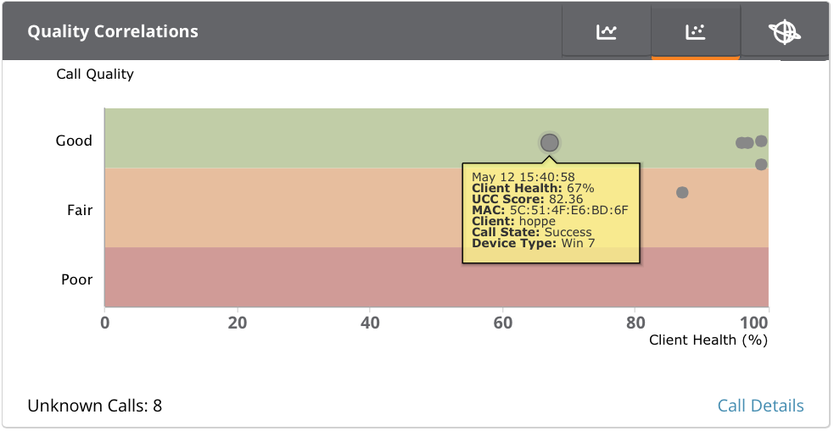
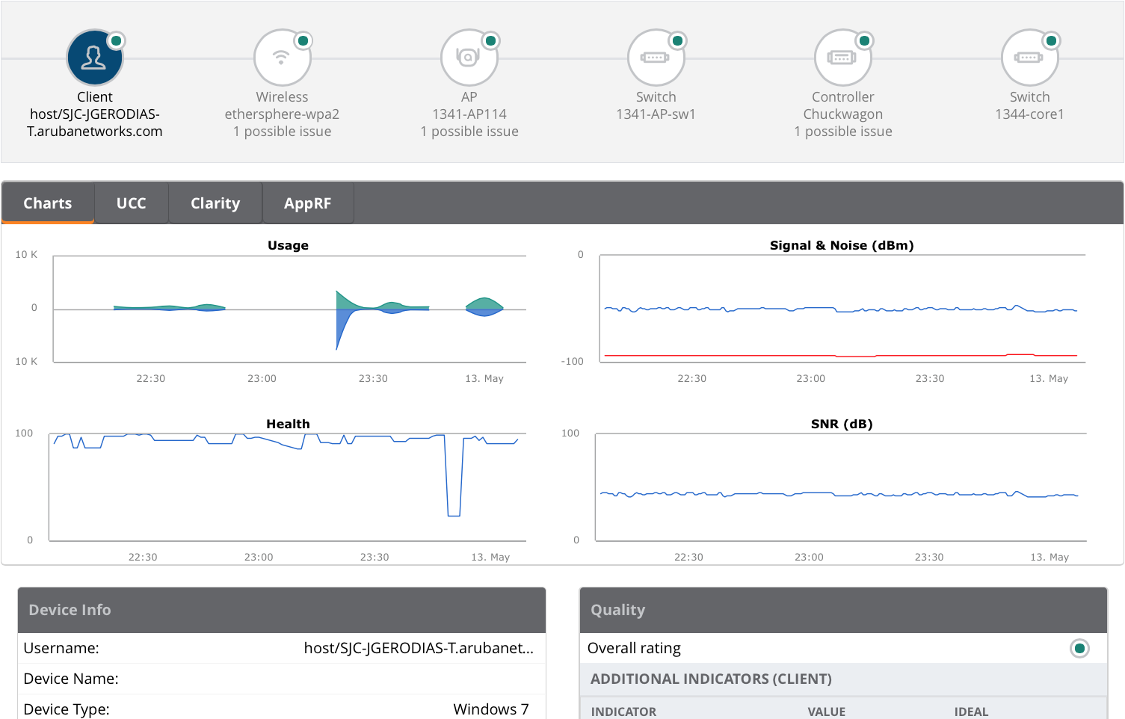
Dashboard to Diagnostic Page
Notes:
Key Points:
The dots on the quality correlations graph are calls and clicking on them drills down to the client diagnostic page for the device that placed the call. Additional information about that client’s health history can be found there.
This can help with identifying events such as roaming which could impact the quality of a call.

Slide 19
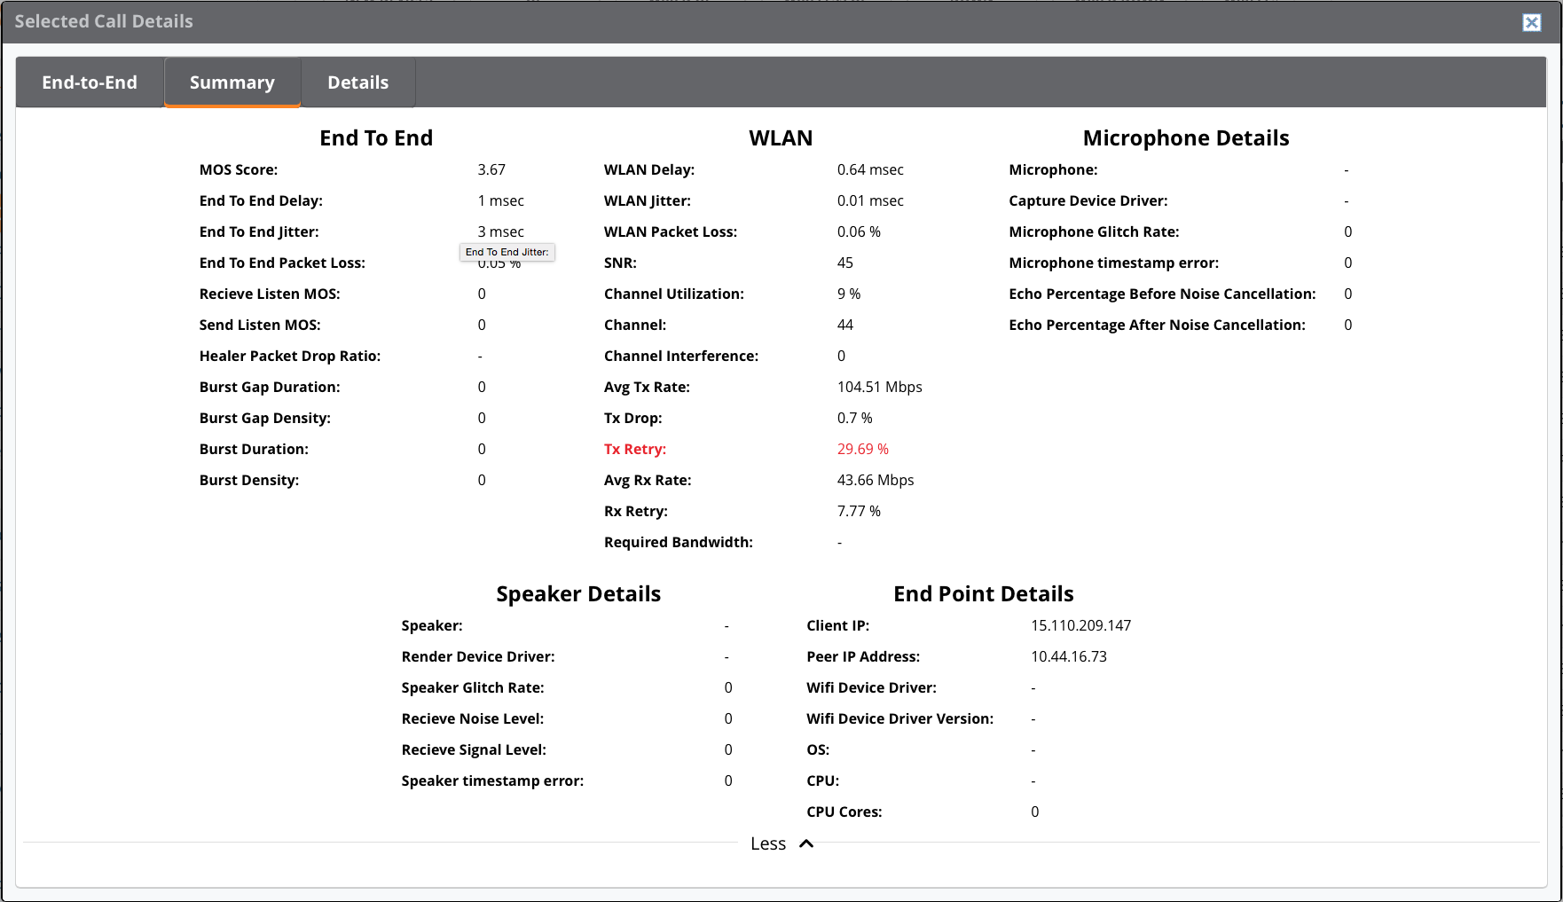
Call Details
All you need to troubleshoot an issue
Shows call topology
Status on drivers and microphone
Graph indication
Notes:
Key Points:
The call details page has all of the information you need to know about the call in order to troubleshoot call quality.
The Details tab shows a table with all of the information gathered each minute during the call
The End-to-End tab shows the call topology and a high level summary of the call quality
The Summary tab also shows more details including Microphone stats, audio driver
The Summary tab shows a graph with call quality, client health, client events such as roaming

Slide 20
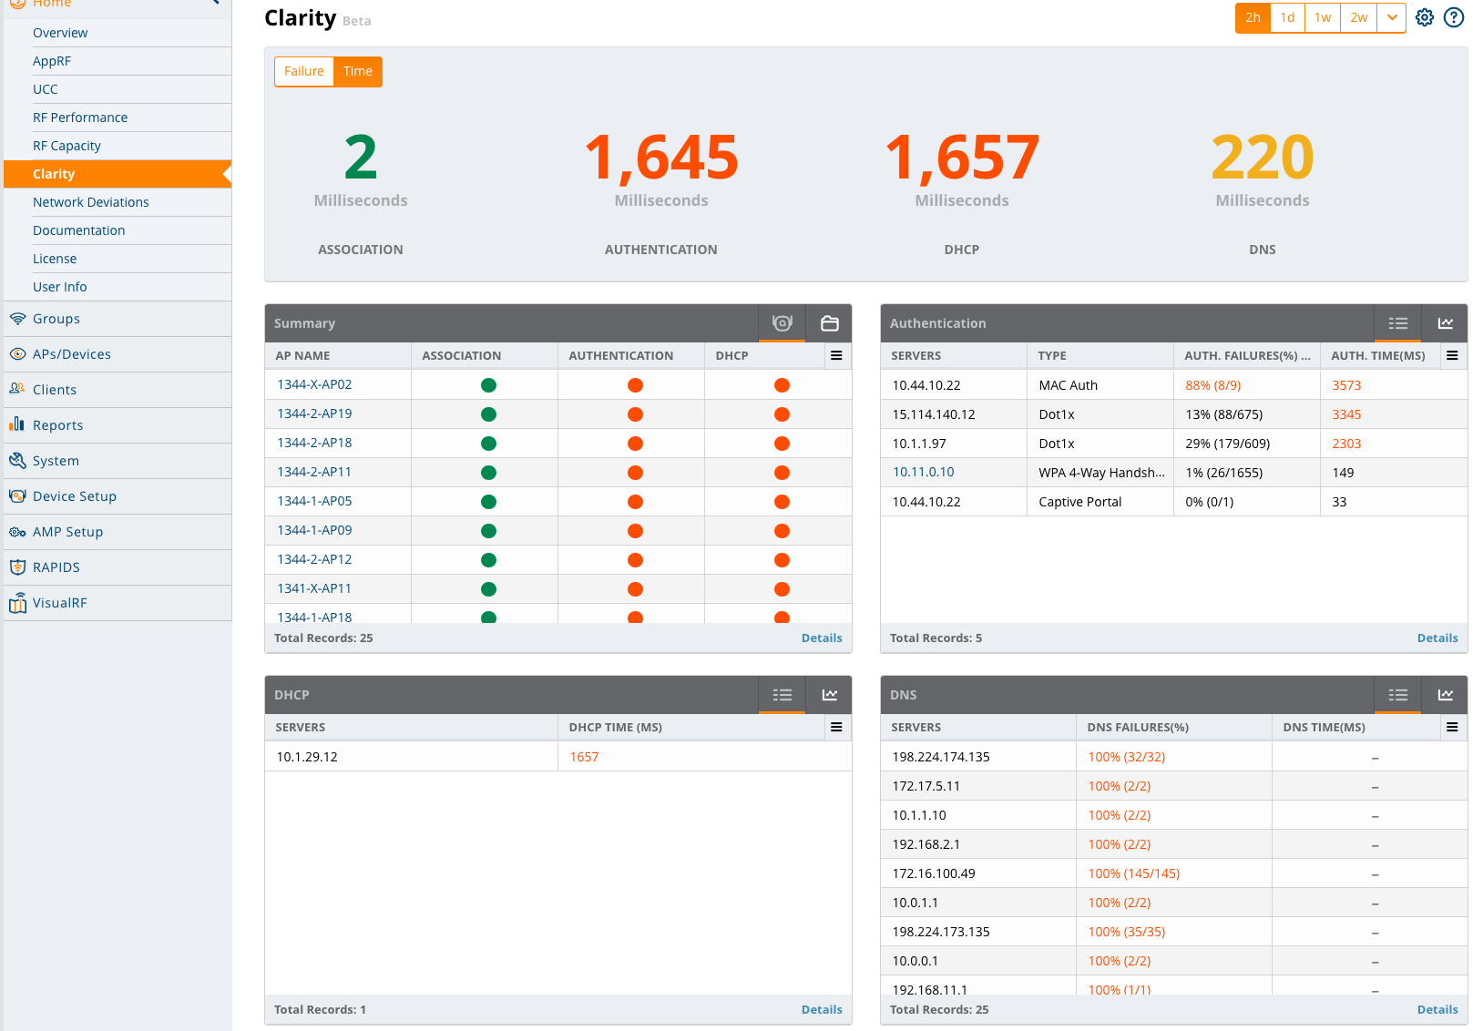
Clarity Live
Network services performance tracking
Failure percentage versus overall time
Historical data available
Visibility to performance of wireless network
Notes:
Key Points:
The Aruba Mobility Controller gathers the association, authentication, DHCP and DNS failure percentage and time taken and sends that data to AirWave over AMON.
AirWave can keep the server stats for up to 30 days and the client stats for up to 7 days.
The main purpose of Clarity Live is to give visibility into services which are typically on the wired network and managed by a different team which could impact the perception of the performance of the wireless network.
This data can be displayed per folder and over time.
Network services performance tracking

Slide 21
Airwave Groups And Folders

Slide 22
Client Diagnostics
Notes:
Client Diagnostics

Slide 23
Client Diagnostics
Client location
Network Hierarchy
Notes:
Key Points:
AirWave needs to be monitoring the switches between the AP and the controller to be able to show the end to end topology for a given client association.
Thresholds for “Good” or “Bad” ratings are customizable for AP’s, Clients, Controllers, Network or Switches.
This page is suited for helpdesk personell responding to reports of “bad wifi” and can assist with finding the root cause.
This page is present for users currently active on the network.

Slide 24
Report/Triggers
Notes:
Reports and Triggers

Slide 25
Reports
Report Types: RF health, Client Session, Device Summary, Inventory
Custom Report
Options: Configurable Interval, Scheduling, Exporting, Emailing
Notes:
Key Points:
Reports can be scheduled, exported via FTP or SCP and emailed automatically.
Custom reports are robust and powerful. They allow a rich set of information to be included and filtered.
CSV output is also provided for import into other tools.

Slide 26
Triggers
Trigger Types: Device Down, Client Count, Radius Auth, Server Health
Options: Notes, Email/NMS
Notes:
Key Points:
Triggers are events which cause alerts when certain conditions are met, such as monitored devices being down, or certain predefined strings of text appear in the syslog output of a device.
AirWave will intelligently correlate devices being down with their upstream device up/down status. If a switch with many AP’s goes down, a single alert will be sent for the switch outage instead of individual alerts for all AP’s connected to that switch.
Flexible set of conditions for defining severity and alerting
There are 30+ types of events which can be alerted on.

Slide 27
Security (RAPIDS, PCI)
Notes:
Security (RAPIDS, PCI)

Slide 28
RAPIDS Overview
Notes:
Compliance requirements (PCI, HIPAA, SOX, etc.) l Deployed environments l
Cost of removing threats The next step is to determine what the appropriate response to detected threats are. l
How quickly should the rogue devicebe removed from the network? l ‘
Should the user who placed the rogue be educated about the dangers of rogue devices? l
Should the device be confiscated? l
How does your organization feel about wireless containment? l
How long should rogue discovery information be stored?

Slide 29
RAPIDS
Rules Based Rogue Classification
IDS Events
Notes:
Key Points:
Rogue Access Point Intrusion Detection System (RAPIDS)
RAPIDS is a ruleset which is used to classify clients and AP’s as either Rogues or valid.
The purpose is to cut down on the false positive reports of Rogue AP’s on your network by using a robust set of rules and network visibility.
This feature is supported with Aruba as well as Cisco and other 3rd party WLAN solutions.
IDS events are reports of attacks against the network or clients on the network. These reports come from the WLAN controllers and are available as triggers and alerts.
There are 15+ conditions which can be stacked to narrow down the scope of a device being classified as rogue.

Slide 30
PCI Compliance
Notes:
Key Points:
The report is based on PCI 2.0.
The report gives a simple to understand status of PCI compliance.

Slide 31
UI
Notes:
Alright, let’s go into UI.

Slide 32
All Graphs in AirWave are coded in HTML5
Notes:
Key Points:-
All graphs are rendered with HTML5
By clicking on a graph, can then zoom in/out, pan, and hover (to get values for each point)
Most graphs allow zooming in and out on a time window and provide information when hovering the mouse over a point on the graph.

Slide 33
Views
Select columns and filters to display the desired set of views
Notes:
Key Points:
Views are a powerful way to display and sort devices.
All devices has columns of information which can be chosen for display and sort as well as filters could be added to limit the devices being displayed.
Once a view has been created, it can be saved and made available to other users of AirWave.
Using views, you can also modify groups of devices based on the criteria defined for the view.
For example, a view could be created to display all Mobility Controllers on a specific firmware version.

Slide 34
VisualRF

Slide 35
VisualRF – Floor Upload Wizard
3 Easy steps to monitor your floor
Import the floor plan
Measure it
Place the APs
Notes:
Key Points:
Floorplans can be imported from CAD drawings and the layers in those CAD drawings can be cherry picked. This could save a lot of time.
Entire folders of AP’s can be placed on a floorplan.
Import your floorplan as an image or as a CAD drawing and define the regions
For CAD drawings, the layers can be selected and materials can be assigned to them
Place the access points

Slide 36
VisualRF – Heatmaps & Overlays
Heatmap with Heatmap History
Notes:
Key Points:
Client overlays contain Client Health, AppRF and UCC data which can be displayed around the client icon for quick visibility.
AP Overlays provide visibility into the Channel Utilization, Channel, Heatmap, Speed and Voice metrics.
The RF heatmap can be recorded over a 24hour period and played back.

Slide 37
VisualRF in HTML5
Notes:
Key Points:
Relation lines show the relationship between clients and their associated AP’s as well as neighboring AP’s and Rogue AP’s
This is useful for spotting sticky clients which are not using the best AP.

Slide 38
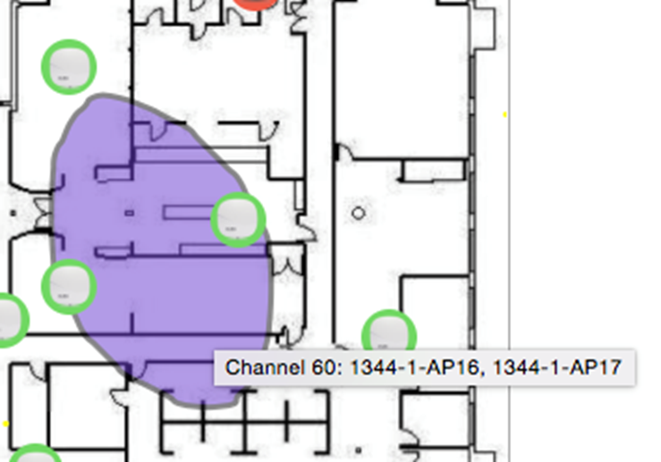
Channel Overlay
Identify Overlapping Regions
Notes:
Key Points:
VisualRF makes it easy to find overlapping regions for a given channel or all channels.

Slide 39
Configuration
Notes:
Sujatha: So Configuration. How many customers use AirWave for config—or is that a bad thing to ask? You’d like to? Awesome. That’s what I want to hear, I use it for config now (kidding); that makes it two.

Slide 40
IGC: Instant Graphical Configuration
Notes:
Key Points:
AirWave management of Aruba Instant includes templates and IGC (Instant Graphical Configration)
IGC provides a similar look and feel to configuring Instant as the Instant’s built-in UI.
Many Aruba Instant clusters can be managed and monitored using AirWave

Slide 41
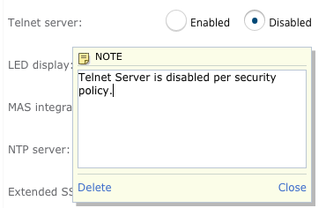
IGC: Notes and Multi-Edit
Notes:
Key Points:
Notes can be attached to individual configuration “knobs” so that context can be provided for that knob and why that setting might have been chosen or any other info that might be useful for someone who is reviewing the configuration.
Editing multiple IAP virtual controllers at the same time is possible with certain configuration options such as “Name” and “System Location”.

Slide 42
Switch Config

Slide 43
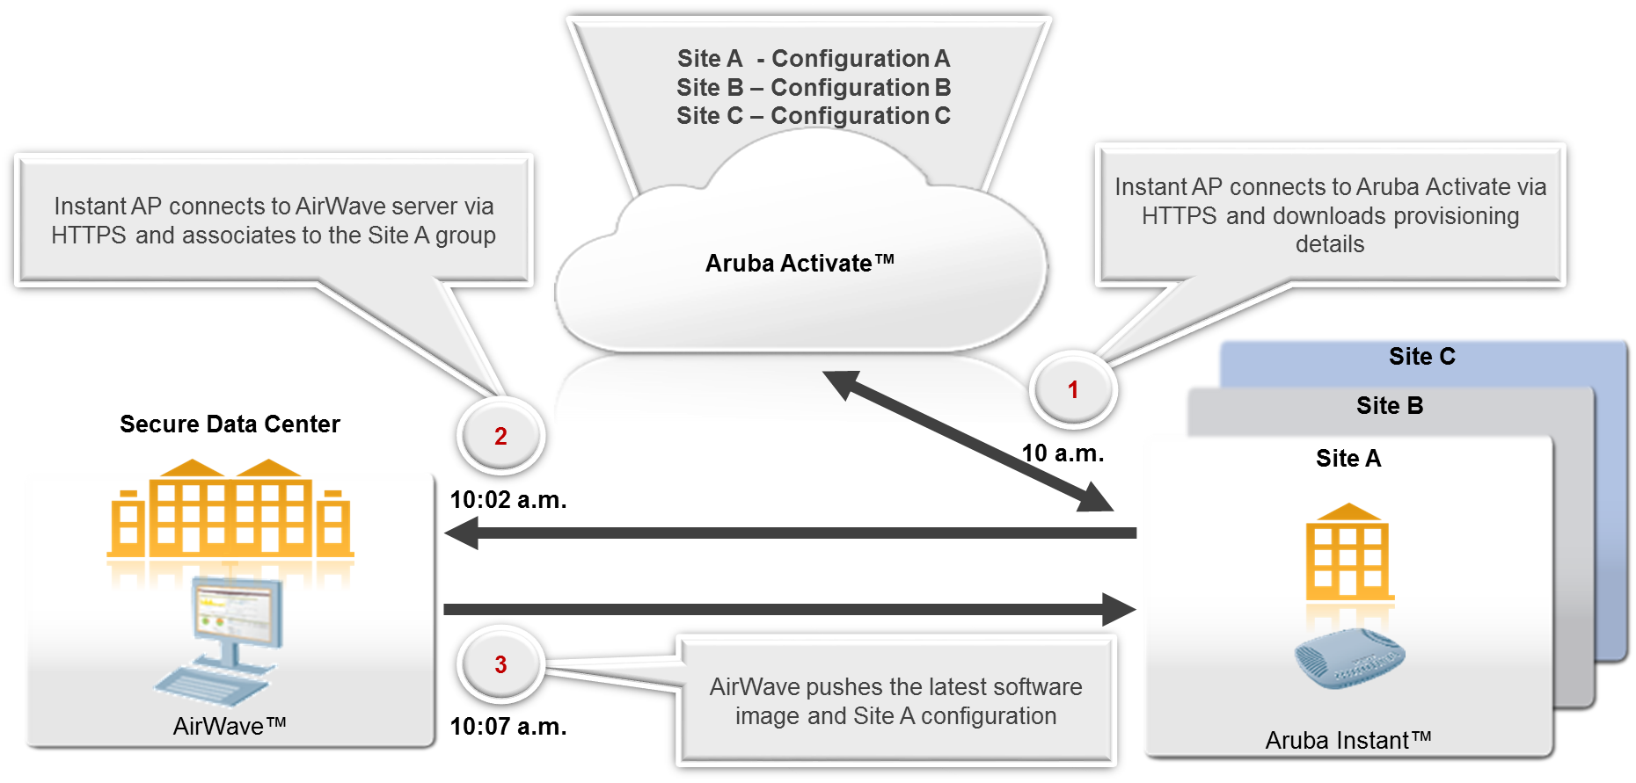
Provisioning Using Activate
Notes:
Key Points:
Integration with Aruba Activate means that Aruba Instant AP’s can be shipped directly to remote sites with internet access and those AP’s will come up and find the AirWave server without onsite intervention.
Configuration can be pushed down in this way to rapidly bring remote sites online.

Slide 44
Controller Config
Notes:
Key Points:
Configuration of Aruba Mobility Controllers is also possible from within AirWave.

Slide 45
Serviceability
Notes:
Serviceability—this is my last topic.

Slide 46
Run CLI Command(s) at Intervals
Notes:
Key Points:
With Aruba Mobility Controllers, Switches and Aruba Instant, CLI commands can be run from the device’s monitor page. Those commands are chosen from a drop-down and can be run every interval of time for a set amount of time to troubleshoot problems. This can be done without having to open an SSH window yourself.

Slide 47
Controller Backups/Config
Notes:
Key Points:
Controller backups gather everything, including licenses and local databases.
This is extremely helpful if a device needs to be replaced or if configuration applied to the device has had unexpected consequences. The backup of the configuration can be restored to a previous point in time.

Slide 48
THANK YOU

