Slide 1
What is happening in your mobile network
Fall 2012

Slide 2
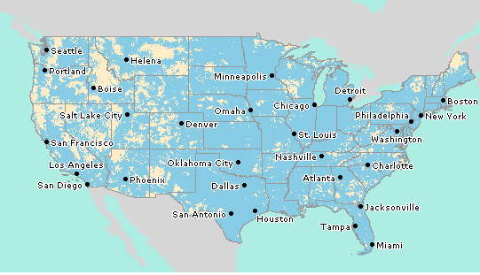
The Situation
Your team relies on a mobile data network controlled by your carrier.
But your carrier does not know how YOUR network is performing.
ATT Data Coverage map 2012
Notes:
Carriers drive test every 4-12 months to collect only two data points:
Call Quality Measure (CQM) – a voice quality measure indicating “can you hear me now”
Received Signal Strength Indication (RSSI) – an arbitrary antenna power level metric

Slide 3
Why is that a problem?
You pay for a service you cannot measure
You are not optimizing your mobile spend
You can’t identify the best carrier for your business
Impacts quality of service and total cost of ownership
Support costs are high
Inefficient allocation of human and capital resources
Unknown coverage gaps
Decreases employee productivity

Slide 4
Now there is a solution. Mobile Pulse.
You pay for a service you cannot measure
You are not optimizing your mobile spend
Improve service levels and negotiate pricing with your carriers using Mobile Pulse analytics and reports.
You can’t identify the best carrier for your business
Impacts quality of service and total cost of ownership
Make the best possible carrier selections by measuring expected and actual levels of service using our unique analytics engine.
Support costs are high
Inefficient allocation of human and capital resources
Quickly determine the source of connectivity issues with live, detailed maps that pinpoint deadspots and poor coverage areas.
Unknown coverage gaps
Decreases employee productivity
Have full visibility into your network by measuring coverage and availability data from your devices.

Slide 5
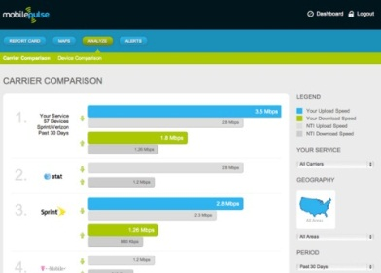
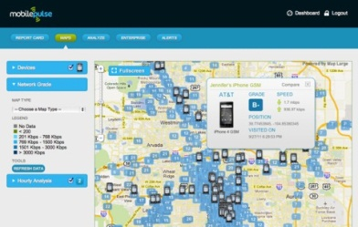
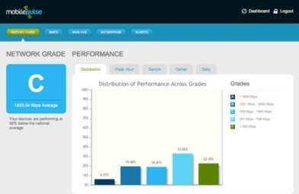
The Mobile Pulse Solution
Mobile Pulse provides simple, secure and scalable tools that leverage your organization's existing mobile devices to give you a full view of your mobile network.
Use real data to negotiate with carriers
Decrease time to troubleshoot device and network issues
Minimize lost productivity of deadspots
Save Money
Troubleshoot Coverage Issues
Pinpoint deadspots and poor coverage areas
See trends where coverage issues repeatedly occur
Separate problem devices from poor coverage
Improve Quality of Service
Compare performance of carriers and find the best carriers for your business
Know if your network meets your needs
See performance trends and track improvements

Slide 6
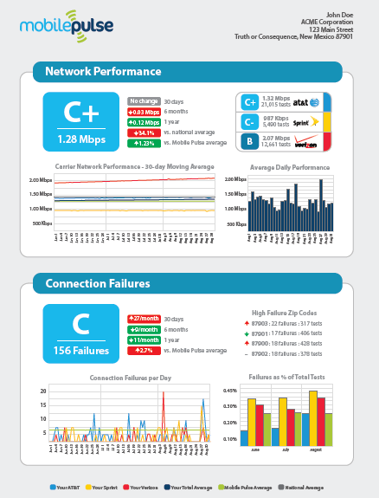
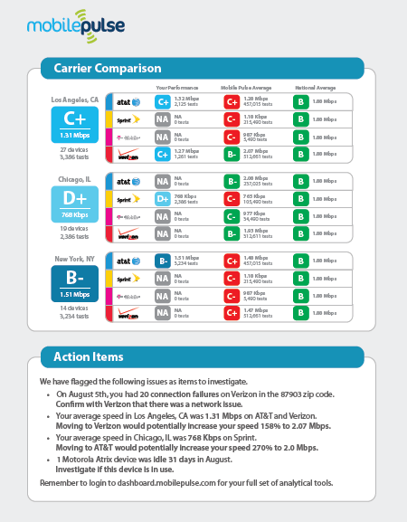
Results are quick- Monthly Reports

Slide 7
Next Steps
Please contact us to find out more. Set up a free trial.
We are absolutely confident you will benefit!
Christine Ekman
Founder
christine@mobilepulse.com
720-283-0417
www.mobilepulse.com

Slide 8
Thank you.

