Slide 1
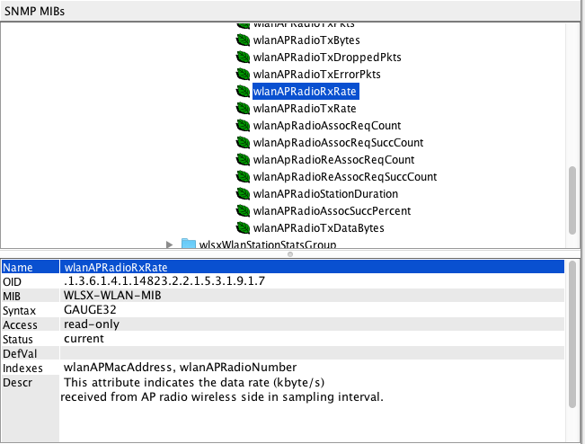
MIB file & Guide
Guide MIB has been defined as "wlanAPRadioRxRate" is "kByte / s".
However, as is different from the results we tested.

Slide 2
Test Topology
172.16.0.254
Aruba Controller
7010 v6.4.4.9
AP 205
11g
Client
iPerf Server
2.4GHz
iPerf Test
172.16.0.3
172.16.0.100

Slide 3
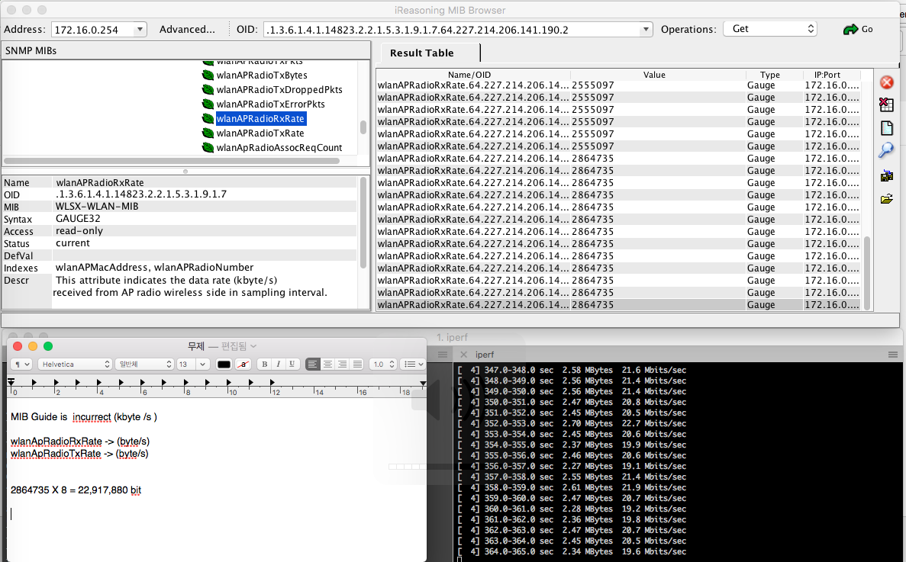
Test Results
MIB Guide is incurrect (kbyte /s )
wlanApRadioRxRate -> (byte/s)
wlanApRadioTxRate -> (byte/s)
2864735 X 8 = 22,917,880 bit
MIB Browser
iPerf Server
As a result we tested is not "kiloByte / s"
It seems to be "Byte / s".

