Slide 1
ArubaOS-Switch Tunneled Node
Justin Noonan – Global TME
Ruben Iglesias – Global TME
July 2016

Slide 2
Introduction

Slide 3
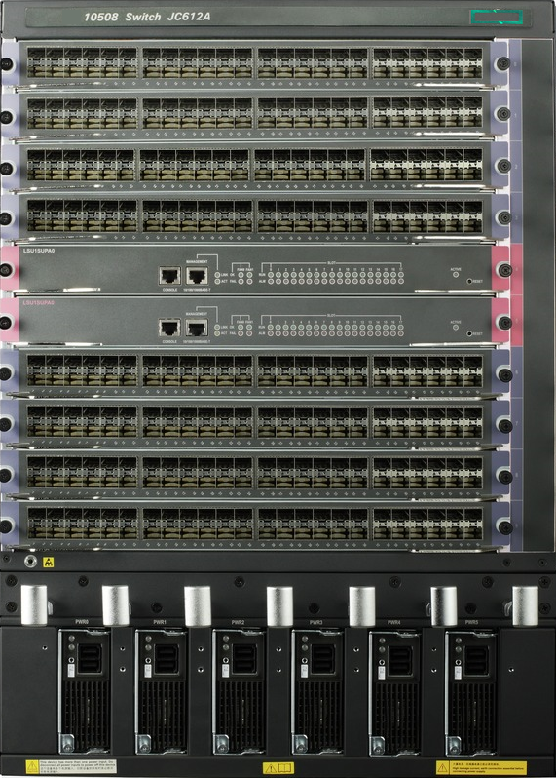
What is Tunneled Node?
Tunneled Node
Extends the AP-controller tunneling scheme to the access switches
Per-port tunnel
A single GRE tunnel transports all traffic to/from “tunneled” interfaces
Traffic from other interfaces is forwarded normally by the switch
Management and control traffic is NOT tunneled
Policy enforcement
GRE
Products
5400R switch series with v2 and v3 modules
3810 switch series
3800 switch series
2930F switch series
2920 switch series
Notes:
Tunneled-node can be applied up to 120 physical ports.

Slide 4
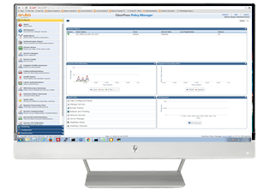
Use case: Unified Policy Enforcement
WWW
WAN / VPNs
ClearPass
Policy Manager
3rd Party Directory Svc
Local controller
Policy enforcement
(CPPM, Skype for Business, etc.)
Guest mgmt
Device profiling
Core
Switch
(VSF/IRF)
3rd party MDM
SDN/API
Skype for Business
(Lync Edge server)
WLAN
Tunnel
Wired LAN
Tunnel
LAN

Slide 5
Tunneled Node Testing

Slide 6
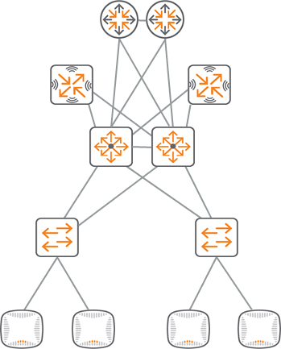
Generic layout
Mobility controllers:
Aruba 72xx / 70xx
Tunnel
Core switch:
5400R / 10500
Access switches:
3810, etc.

Slide 7
Tested layer 2 layout
Tunnel
Intranet /
Internet
7010 MC (DHCP Server for VLAN 200)
10500
R
V200
V200
Tunnel
10.2.200.1
10.2.200.7
V10
Def
V10
Def
0/0/2
1/4/0/2
10.2.10.11
10.2.10.11
2/4/0/2
LAG1
MAS 3500
0/0/0
3810
TRK1
V10
Def
V200
V10
Def
V200
10.2.10.3
10.2.10.25

Slide 8
Tested routed layout
Tunnel
Intranet /
Internet
7010 MC (DHCP Server for VLAN 200)
Core switch: 10500
R
V200
V200
Tunnel
10.2.200.1
10.2.200.7
V10
Def
V10
Def
0/0/2
1/4/0/2
10.2.11.1
V11
Def
10.2.10.11
10.2.10.1
2/4/0/2
LAG1
MAS 3500
0/0/0
3810
TRK1
V11
Def
V200
V11
Def
V200
10.2.11.3
10.2.11.25

Slide 9
Tested filtered layout
acl number 3001
rule 20 permit icmp
rule 50 permit gre
rule 51 permit tcp destination-port eq 8080
rule 52 permit tcp destination-port eq www
rule 53 permit tcp destination-port eq 4343
rule 54 permit udp destination-port eq tftp
rule 55 permit udp destination-port eq 21
rule 56 permit udp destination-port eq syslog
rule 57 permit udp destination-port eq 443
rule 58 permit udp destination-port eq 22
rule 59 permit udp destination-port eq 23
rule 60 permit udp destination-port eq 8211
rule 100 deny ip
Tunnel
interface GigabitEthernet1/4/0/2
port link-mode bridge
port link-type trunk
port trunk permit vlan 1 10 200
packet-filter 3001 outbound
Intranet /
Internet
7010 MC
10500
R
V200
V200
Tunnel
V10
Def
V10
Def
0/0/2
1/4/0/2
V11
Def
2/4/0/2
LAG1
MAS 3500
0/0/0
3810
TRK1
Tunneled-Node uses ports 50 (GRE) and 8211 (PAPI)
V11
Def
V200
V11
Def
V200
Notes:
Port 8211 is the PAPI (Aruba Proprietary) protocol – For more information go to https://arubapedia.arubanetworks.com/arubapedia/index.php/PAPI

Slide 10
Tunneled Node and NAT: Not Supported
NAT
DC Router
Tunneled note
Public IPs
Mobility
controllers
Private IPs

Slide 11
Remote Tunneled Node
Remote controller: not recommended
NAT
NAT
Router
Router
Mobility
controllers
Tunneled note
Private IPs
Private IPs
Use local controller
for tunneled node
NAT
NAT
Router
Router
Local controller
Mobility
controllers
Tunneled node
Private IPs
Private IPs

Slide 12
Tunneled Node Configuration

Slide 13
Tunneled Node Configuration – Switch Configuration Steps
Step 1: Setup Tunneled-Node-Server IP address (Aruba Mobility Controller)
Aruba-Stack-3810M(config)# tunneled-node-server controller-ip 10.2.10.11
Optional: Setup Backup Controller IP
Aruba-Stack-3810M(config)# tunneled-node-server backup-controller-ip 10.2.10.12
Optional: Set Tunneled-Node Keepalive timer – Set time interval between keepalive messages (Default = 8)
Aruba-Stack-3810M(config)# tunneled-node-server keepalive interval
<1-8> Configure the time interval between two successive
keepalive messages sent to the controller.
Step 2: Enable Tunneled-Node on interface
Aruba-Stack-3810M(config)# interface 1/23
Aruba-Stack-3810M(eth-1/23)# tunneled-node-server
Step 3: Check to see if Tunneled-Node is complete
Aruba-Stack-3810M(config)# show tunneled-node-server state
Tunneled Node Port State
Active Controller IP Address : 10.2.10.11
Port State
------ -------------------------
2/23 Complete

Slide 14
Tunneled Node Configuration – Statistic View
Aruba-Stack-3810M(config)# show tunneled-node-server statistics
Tunneled Node Statistics
Port : 2/23
Control Plane Statistics
Bootstrap packets sent : 1
Bootstrap packets received : 1
Bootstrap packets invalid : 0
Tunnel Statistics
Rx Packets : 302
Tx Packets : 0
Rx 5 Minute Weighted Average Rate (Pkts/sec) : 0
Tx 5 Minute Weighted Average Rate (Pkts/sec) : 0
Aggregate Statistics
Heartbeat packets sent : 56607
Heartbeat packets received : 56607
Heartbeat packets invalid : 0
Fragmented Packets Dropped (Rx) : 0
Packets to Non-Existent Tunnel : 0
MTU Violation Drop : 0

Slide 15
Tunneled Node Configuration – 3810M switch
ip route 0.0.0.0 0.0.0.0 10.2.11.1
tunneled node-server
controller-ip 10.2.10.11
exit
interface 1/21
tunneled node-server
exit
interface 1/23
tunneled node-server
exit
interface 1/24
tunneled node-server
exit
vlan 11
name "VLAN11"
untagged Trk1
ip address 10.2.11.3 255.255.255.0
exit
vlan 200
name "VLAN200"
untagged 1/21,1/23-1/24
tagged 1/1,Trk1
no ip address
ip helper-address 10.1.0.195
jumbo
exit
Note:
The Mobility Access Switch will establish a single GRE tunnel between it and a Mobility Controller for Tunneled Node operation.
However from the perspective of the Mobility Controller, each Tunneled Node port from a single switch/stack will appear as an individual tunnel and consume tunnel resources as such.

Slide 16
Tunneled Node Configuration - MAS 3500 switch
!
interface vlan "11"
ip address 10.2.11.25 255.255.255.0
!
ip-profile
default-gateway 10.2.11.1 0
!
interface-profile switching-profile "10500 link"
access-vlan 11
native-vlan 10
trunk allowed vlan 10
!
interface-profile switching-profile "TunneledPorts"
access-vlan 200
native-vlan 200
trunk allowed vlan 200
!
interface-profile tunneled node-profile "default"
controller-ip 10.2.10.11
!
interface gigabitethernet "0/0/0"
switching-profile "10500 link"
!
interface gigabitethernet "0/0/23"
tunneled node-profile "default"
switching-profile "TunneledPorts"
!
interface gigabitethernet "0/0/24"
tunneled node-profile "default"
switching-profile "TunneledPorts"
!
interface gigabitethernet "0/0/25"
tunneled node-profile "default"
switching-profile "TunneledPorts“

Slide 17
Tunneled Node Status – Aruba Mobility Controller
Note:
Tunnel is automatically created when Tunneled-Node is enabled on switch interface

Slide 18
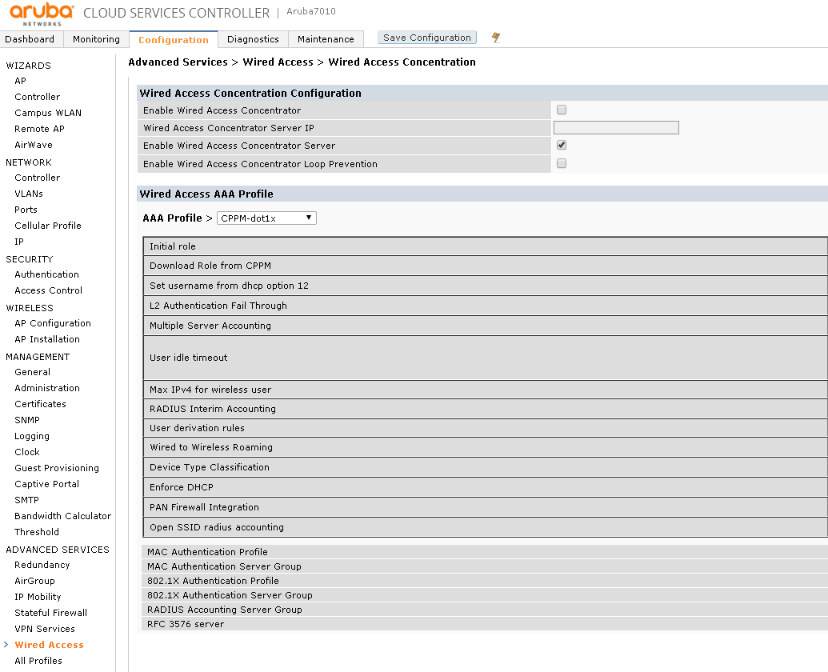
Tunneled Node Configuration – Mobility Controller
1
2
3

Slide 19
ClearPass Authentication – Controller Wired Access Profile
Ensure that the Wired Access profile in the Aruba Mobility Controller is configured correctly and enabled.
This allows the controller to handle authentication when a client is plugged into a tunneled-node port on the switch
CLI example:
aaa authentication wired
profile "CPPM-dot1x"
Notes:
Example Controller AAA config :
aaa rfc-3576-server "10.1.0.197"
!
aaa authentication mac "default"
!
aaa authentication dot1x "default"
!
aaa authentication dot1x "NewDot1x"
!
aaa authentication-server radius "10.1.0.197"
host "10.1.0.197"
key 6b63f476e437838c6a4ac563e07cd8a5e14166fd391049c5
nas-identifier "10.1.0.197"
nas-ip 10.1.0.197
!
aaa server-group "CPPM"
auth-server 10.1.0.197
!
aaa server-group "default"
auth-server Internal
set role condition role value-of
!
aaa profile "CPPM-dot1x"
authentication-dot1x "NewDot1x"
dot1x-server-group "CPPM"
rfc-3576-server "10.1.0.197"
!
aaa profile "default"
!
aaa authentication captive-portal "default"
!
aaa authentication wispr "default"
!
aaa authentication vpn "default"
!
aaa authentication vpn "default-rap"
!
aaa authentication mgmt
!
aaa authentication stateful-ntlm "default"
!
aaa authentication stateful-kerberos "default"
!
aaa authentication stateful-dot1x
!
aaa authentication wired
profile "CPPM-dot1x"

Slide 20
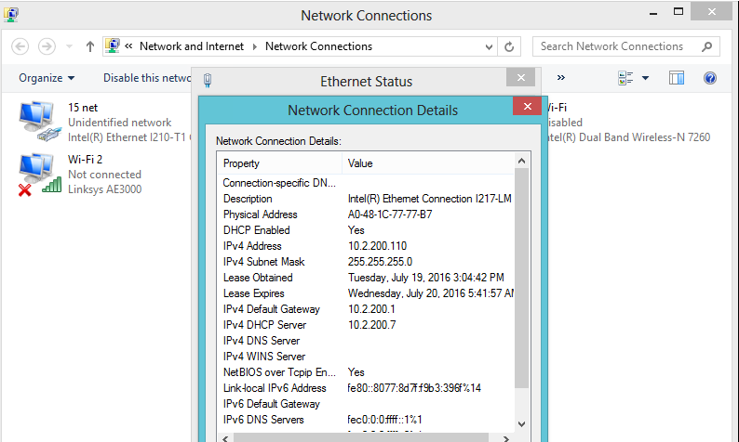
ClearPass Authentication – Client View
Windows Client is plugged into tunneled-node port
Enter proper user credentials into 802.1x authentication settings
Client will authenticate and receive IP address

Slide 21
ClearPass Authentication – Access Tracker
Client user access can be monitored from the Access Tracker in ClearPass.
Shows what source the user is authenticating with (i.e. RADIUS), which ClearPass service profile is being used, and whether the login was accepted or rejected.

Slide 22
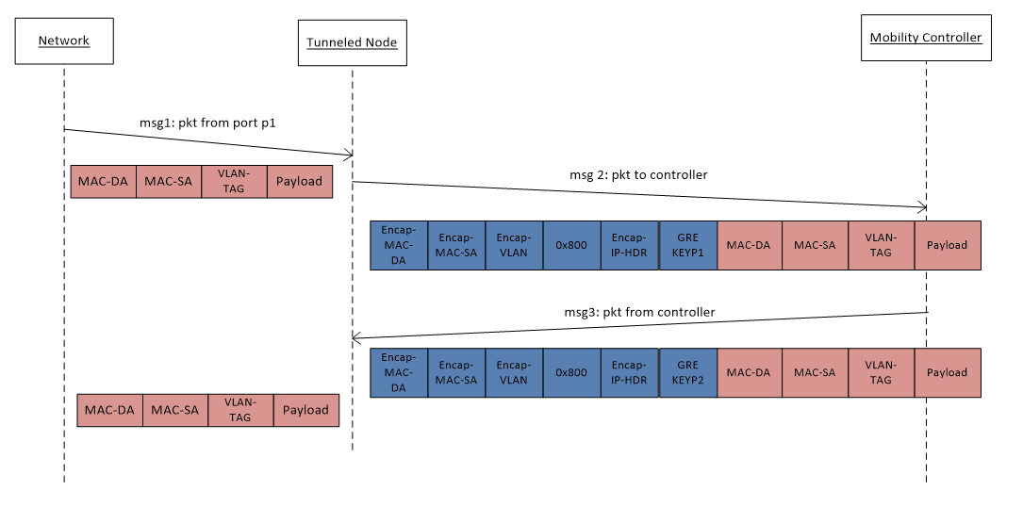
Tunneled Node Frame Details
When a port is configured for tunneled-node, ingress packets are encapsulated in an IP GRE frame which is then forwarded to the controller
A unique GRE Key is needed – 1 to 1 Mapping:
For the controller to uniquely identify GRE packet source port
For the switch to send de-capsulated packet to particular port

Slide 23
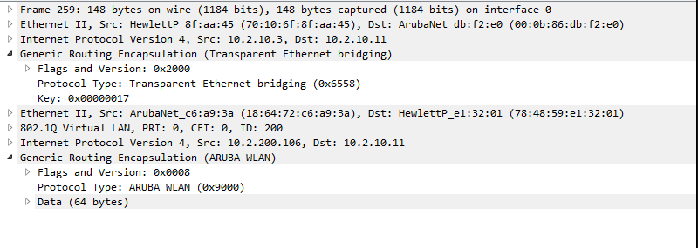
What happens if? AP is plugged into Tunneled-Node port
3810
MAS S3500
Behavior: Tunnel in a tunnel
Can cause a network performance issue
Not an ideal scenario

Slide 24
Tunneled Node – Does not work with…
Globally
IP Multicast Routing
Openflow
QinQ
Distributed Trunking
Switch Meshing
VXLAN
Per VLAN
IP addressing – manual & DHCP
DHCP Snooping (IPv4/6)
ARP Protect
Per Port
802.1x/MAC Auth/Web Auth/LMA/Port Sec
RA Guard
MACSec
DIPLD (IPv4/6)
Port Trunking

Slide 25
Tunneled Node – Best Practices
Recommendations:
Avoid plugging access points into wired tunneled-node ports.
This creates a “tunnel within a tunnel”, which can impact performance.
Instead, set aside physical ports to use solely for access points and wired tunneled node ports (i.e. one block of ports for AP’s, one for wired tunneled node ports).
Ensure that the wireless controller can handle the necessary bandwidth and number of tunnels (Max physical ports that can be used as tunnels is 120).
Ensure that the Tunneled-Node VLAN is present and enabled on both the controller and switch.
Ensure that enough licenses are on the controller to handle the tunneled-node ports within the network (1 switch with Tunneled-Node ports enabled = 1 license on controller)
AP Ports
Tunneled-Node Ports

Slide 26
Thank you

