Slide 1
CX Port-Access Radius Overridden or Mixed Role
AOS-CX 10.8 Transfer of Information
August 2021
Presenters
Yash, TME

Slide 2
Agenda
1 | Overview
2 | Use Cases
3 | Details and Caveats
4 | Configuration
5 | Best Practices
6 | Troubleshooting
7 | Demo
8 | Additional Resources

Slide 3
Overview

Slide 4
CX Port-Access User Roles
Local User Role (local) – Supported from 10.4
Name : dot1xclient
Type : local
Downloadable User Role (clearpass) - Supported from 10.4
Name : DURnny-3006-4
Type : clearpass
Radius IETF standard Role (RADIUS) - Supported from 10.4
Name : RADIUS_2991820597
Type : radius
10.8 Radius Overridden / Mixed Role (RADIUS_Overridden) *
Name : RADIUS_Overridden_3237254956
Type : radius
User Role + VSA
User Role + Standard Radius Attributes
C1
C3
C2
Notes:
LUR + VSA
LUR + Radius attributes
DUR + Radius attributes

Slide 5
Use Cases

Slide 6
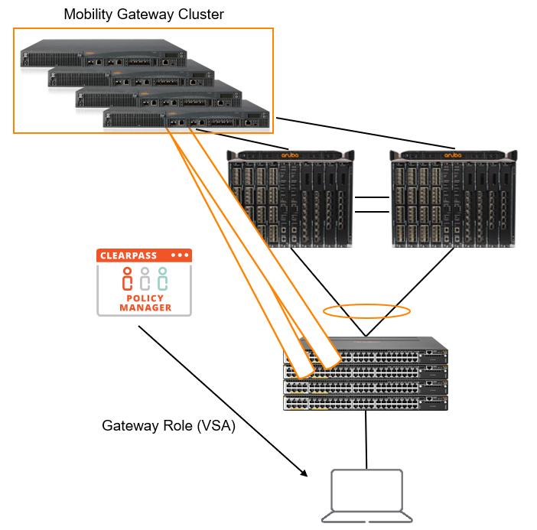
Automatic GW Role Download from CPPM

Slide 7
IETF Egress VLAN / Captive-Portal Redirect / Voice role Assignment
C1
C3
C2

Slide 8
Details & Caveats

Slide 9
CX 10.8: Radius Overridden / Mixed Role
Mixed role enable admin to create a new Radius overridden role by overriding client-role (LUR or DUR) attributes.
Port-access Auto-Vlan
Any changes made to LUR after the creation of a mixed role will not affect the mixed roles. Also, the mixed roles will not be affected even on LUR deletion.
If LUR/DUR contains VLAN ID and RADIUS attribute contains VLAN name or VLAN group, then the final role will contain both VLAN ID and VLAN name or VLAN group and VLAN ID takes precedence. If both VLAN ID and VLAN name or group are present, VLAN ID takes precedence.
description of the LUR will not be copied to the mixed role during an override.
A new CLI is added in the interface level to Enable/disable this feature.
Same is supported in interface range context as well.

Slide 10
CX 10.8 Radius Overridden / Mixed Role
Combination of roles in Access-Accept | CX 10.7 or Action with radius-override disabled | Action with radius-override enabled
Local User Role and RADIUS attributes | Local User Role is applied | New RADIUS Overridden role with Local User Role and RADIUS attributes is created and applied
Downloadable User Role and RADIUS attributes | Downloadable User Role is applied | New RADIUS Overridden role with Downloadable User Role and RADIUS attribute is created and applied
Local User Role and Downloadable User Role | Local User Role is applied | Local User Role is applied
Local User Role, Downloadable User Role, and RADIUS attributes | Local User Role is applied | New RADIUS Overridden role with Local User Role and RADIUS attributes is created and applied
Platform | 4100i | 6100 | 6200 | 6300 | 6400 | 8320 | 8325 | 8360 | 8400 | Simulator
Radius Overridden / Mixed Role | Yes | Yes | Yes | Yes | Yes | No | No | No | No | Yes

Slide 11
6300-1-VSF# sh port-access clients interface 2/1/5 detail
Port Access Client Status Details:
Client fc:15:b4:9f:db:f9, fc15b49fdbf9
============================
Session Details
---------------
Port : 2/1/5
Session Time : 8868s
IPv4 Address :
IPv6 Address :
Device Type :
VLAN Details
------------
VLAN Group Name :
VLANs Assigned : 106
Access :
Native Untagged :
Allowed Trunk : 106
Authentication Details
----------------------
Status : mac-auth Authenticated
Auth Precedence : dot1x - Not attempted, mac-auth - Authenticated
Auth History : mac-auth - Authenticated, 2s ago
mac-auth - Authenticated, 7s ago
mac-auth - Authenticated, 12s ago
mac-auth - Authenticated, 17s ago
mac-auth - Authenticated, 22s ago
Authorization Details
----------------------
Role : DURnny-3006-4
Status : Applied
Role Information:
Name : DURnny-3006-4
Type : clearpass
Status: Completed
----------------------------------------------
Reauthentication Period : 5 secs
Cached Reauthentication Period : 200 secs
Authentication Mode : client-mode
Session Timeout :
Client Inactivity Timeout :
Description :
Gateway Zone :
UBT Gateway Role :
UBT Gateway Clearpass Role :
Access VLAN :
Native VLAN :
Allowed Trunk VLANs : 106
Access VLAN Name :
Native VLAN Name :
Allowed Trunk VLAN Names :
VLAN Group Name :
MTU :
QOS Trust Mode :
STP Administrative Edge Port :
PoE Priority :
PVLAN Port Type :
Captive Portal Profile :
Policy :
GBP :
Device Type :
6300-1-VSF#
6300M-7-VSF# show port-access clients interface 1/1/1 detail
Port Access Client Status Details:
Client 00:50:56:8e:4e:88, hpn
============================
Session Details
---------------
Port : 1/1/1
Session Time : 249s
IPv4 Address :
IPv6 Address :
Device Type :
VLAN Details
------------
VLAN Group Name :
VLANs Assigned : 110
Access : 110
Native Untagged :
Allowed Trunk :
Authentication Details
----------------------
Status : dot1x Authenticated
Auth Precedence : dot1x - Authenticated, mac-auth - Not attempted
Auth History : dot1x - Authenticated, 3s ago
dot1x - Authenticated, 48s ago
dot1x - Authenticated, 148s ago
dot1x - Authenticated, 249s ago
Authorization Details
----------------------
Role : dot1xclient
Status : Applied
Role Information:
Name : dot1xclient
Type : local
----------------------------------------------
Reauthentication Period : 100 secs
Cached Reauthentication Period :
Authentication Mode :
Session Timeout : 20 secs
Client Inactivity Timeout :
Description :
Gateway Zone :
UBT Gateway Role :
UBT Gateway Clearpass Role :
Access VLAN : 110
Native VLAN :
Allowed Trunk VLANs :
Access VLAN Name :
Native VLAN Name :
Allowed Trunk VLAN Names :
VLAN Group Name :
MTU :
QOS Trust Mode :
STP Administrative Edge Port :
PoE Priority :
PVLAN Port Type :
Captive Portal Profile :
Policy :
GBP :
Device Type :
6300M-7-VSF#
6300M-7-VSF# sh port-access clients interface 1/1/5 detail
Port Access Client Status Details:
Client 00:0a:41:42:69:97, 000a41426997
============================
Session Details
---------------
Port : 1/1/5
Session Time : 1907005s
IPv4 Address :
IPv6 Address :
Device Type :
VLAN Details
------------
VLAN Group Name : vlangroup
VLANs Assigned : 31
Access : 31
Native Untagged :
Allowed Trunk :
Authentication Details
----------------------
Status : mac-auth Authenticated
Auth Precedence : dot1x - Not attempted, mac-auth - Authenticated
Auth History : mac-auth - Authenticated, 1906712s ago
mac-auth - Unauthenticated, Server-Timeout, 1906995s ago
Authorization Details
----------------------
Role : RADIUS_2991820597
Status : Applied
Role Information:
Name : RADIUS_2991820597
Type : radius
----------------------------------------------
Reauthentication Period :
Cached Reauthentication Period :
Authentication Mode :
Session Timeout :
Client Inactivity Timeout :
Description :
Gateway Zone :
UBT Gateway Role :
UBT Gateway Clearpass Role :
Access VLAN :
Native VLAN :
Allowed Trunk VLANs :
Access VLAN Name :
Native VLAN Name :
Allowed Trunk VLAN Names :
VLAN Group Name : vlangroup
MTU :
QOS Trust Mode :
STP Administrative Edge Port :
PoE Priority :
PVLAN Port Type :
Captive Portal Profile :
Policy :
GBP :
Device Type :
6300M-7-VSF#
6300M-7-VSF# sh port-access clients interface 1/1/1 detail
Port Access Client Status Details:
Client 00:50:56:8e:4e:88, hpn
============================
Session Details
---------------
Port : 1/1/1
Session Time : 26s
IPv4 Address :
IPv6 Address :
Device Type :
VLAN Details
------------
VLAN Group Name :
VLANs Assigned : 110
Access : 110
Native Untagged :
Allowed Trunk :
Authentication Details
----------------------
Status : dot1x Authenticated
Auth Precedence : dot1x - Authenticated, mac-auth - Not attempted
Auth History : dot1x - Authenticated, 10s ago
dot1x - Authenticated, 26s ago
Authorization Details
----------------------
Role : RADIUS_Overridden_3237254956
Status : Applied
Role Information:
Attributes overridden by RADIUS are prefixed by '*'.
Name : RADIUS_Overridden_3237254956
Type : radius
Base Role : dot1xclient, local, Wed Jul 28 11:52:30 UTC 2021
-----------------------------------------------------------------------------
Reauthentication Period : 100 secs
Cached Reauthentication Period :
Authentication Mode :
*Session Timeout : 1000 secs
Client Inactivity Timeout :
Description :
Gateway Zone :
UBT Gateway Role :
UBT Gateway Clearpass Role :
Access VLAN : 110
Native VLAN :
Allowed Trunk VLANs :
Access VLAN Name :
Native VLAN Name :
Allowed Trunk VLAN Names :
VLAN Group Name :
MTU :
QOS Trust Mode :
STP Administrative Edge Port :
PoE Priority :
PVLAN Port Type :
Captive Portal Profile :
Policy :
GBP :
Device Type :
6300M-7-VSF#

Slide 12
Configuration

Slide 13
CX 10.8: Radius Overridden / Mixed Role
(config-if)# aaa authentication port-access radius-override enable

Slide 14
CX 10.8: Radius Overridden / Mixed Role
Validated Radius Overridden attributes | Local User Role | Downloadable User Role
Framed-MTU | Y | N
Session-Timeout | Y | N
Egress-VLAN-ID | Y | Y
Egress-VLAN-Name | Y | Y
Tunnel-Private-Group-ID | Y | N
Aruba-Captive-Portal-URL | Y | Y
Aruba-UBT-Gateway-Role | Y | Y
Aruba-Gateway-Zone | Y | Y
Aruba-UBT-Gateway-CPPM-Role | Y | Y

Slide 15
Trubleshooting

Slide 16
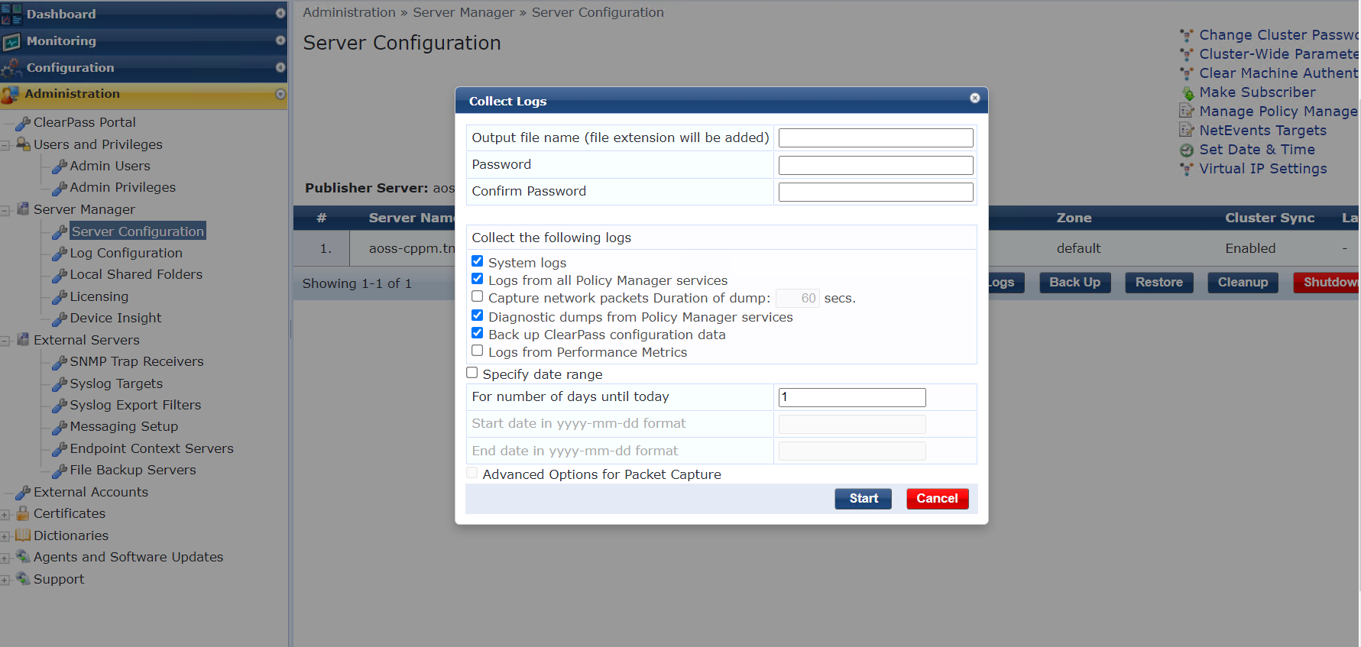
Troubleshooting - Mirror
Mirror session 1
Source interface 1/1/1 both
Destination CPU
enable
diag utilities tshark file
copy tshark-pcap tftp://10.80.2.187/djky.pcap vrf mgmt
Note: Once done disable or delete mirror session

Slide 17
Feature/Solution Troubleshooting Basic level
6300-1-VSF#
show mac-address-table detail
show lldp neighbor-info
show cdp neighbor-info
show radius-server detail
show port-access clients detail
show aaa authentication port-access dot1x authenticator interface all client-status
show aaa authentication port-access mac-auth interface all client-status
show aaa authentication port-access interface all client-status
6300-1-VSF#
show events -r -d port-accessd
Daigdump
6300-1-VSF# diagnostics
diag-dump port-access basic
diag-dump dot1x-authenticator basic
diag-dump mac-auth basic
Debugs
6300-1-VSF#
debug radius all
debug port access all
debug destination buffer
6300-1-VSF#
show debug buffer

Slide 18
Troubleshooting
CX Switch
show ubt
show ubt state
show ubt users all
show ubt statistics
show ubt information
show ubt zone
show ubt brief
debug ubt all
debug ubt cp vrf
debug ubt hw
debug ubt packet
show debug buffer module ubt | include <zone name>
Switch – Port Access
show port-access clients
show port-access clients interface <int ID> detail
show port-access role <role name>
show radius-server
show radius-server detail
debug portaccess (all)
debug radius (all)
Gateway
show tunneled-node-mgr tunneled-nodes
show tunneled-node-mgr tunneled-users
show datapath tunnel table
show tunneled-node-mgr trace-buf
show datapath bridge
show license-usage

Slide 19
Demo

Slide 20
Demo: Radius Overridden / Mixed Role Topology
Mac-auth Client
- DUR + Radius_overridden Role
- Let’s change device type as Voice Aruba-Device-Traffic-Class (thanks to MDA)
6300-7-VSF
6300-1-VSF
C1
C2
dot1x Client
- LUR + Radius_overridden Role
- Let’s Change egress vlan to 23 from 110
port-access role dot1xclient
session-timeout 20
reauth-period 100
vlan access 110

Slide 21
Demo: Radius Overridden / Mixed Role Topology
port-access role user-tunnel
reauth-period 1800
gateway-zone zone toi gateway-role emp-role
ubt-client-vlan 1000
ubt zone toi vrf default
primary-controller ip 10.5.8.6
enable
interface 1/1/1
no shutdown
description User Kamal-VM connected!
no routing
vlan access 1
no sflow
aaa authentication port-access allow-cdp-bpdu
aaa authentication port-access allow-lldp-bpdu
aaa authentication port-access radius-override enable
aaa authentication port-access dot1x authenticator
enable

Slide 22
How to calculate Egress-VLANID
VLAN 23 untagged
https://www.rapidtables.com/convert/number/decimal-to-hex.html?x=23
23= 0x017
Prepend 0x32000 for untagged
Now convert 0x32000017 back to decimal = 838860823
VLAN 123 tagged
Convert to hex is ( use https://www.rapidtables.com/convert/number/decimal-to-hex.html?x=123 )
123 = 0x07b
Prepend 0x31000 for tagged
Now convert 0x3100007b back to decimal = 822083707

Slide 23
Thank you
yashavanth.n.n@hpe.com

